Slide 1
«ÄµÀ£ï CAvÉÆåÃzÀAiÀÄ

Slide 2
¥ÀjZÀAiÀÄ
«ÄµÀ£ï CAvÉÆåÃzÀAiÀÄ MAzÀÄ MUÀÆÎr¸ÀÄ«PÉAiÀÄ PÁAiÀÄðZËPÀmÁÖVzÀÄÝ, fÃªÀ£ÀªÀÄlÖ ªÀÄvÀÄÛ fÃªÀ£ÉÆÃ¥ÁAiÀÄUÀ¼À ªÉÄÃ°£À §zÀ¯ÁªÀuÉ ªÀÄvÀÄÛ ¥sÀ°vÁA±ÀªÀ£ÀÄß ¥ÀjuÁªÀÄPÁjAiÀiÁV C¼ÉAiÀÄÄªÀ ªÀÄvÀÄÛ GvÀÛgÀzÁ¬ÄvÀéªÀ£ÀÄß vÀgÀªÀÅ ¸ÁzsÀ£ÀªÁUÀ°zÉ.
MUÀÆÎqÀÄ«PÉ¬ÄAzÀ £ÉÊdªÁzÀ §zÀ¯ÁªÀuÉAiÀÄ£ÀÄß PÁt§ºÀÄzÁVzÉ
§qÀvÀ£ÀzÀ ««zsÀ DAiÀiÁªÀÄUÀ¼À£ÀÄß eÉÆvÉ-eÉÆvÉAiÀÄ°è ¥ÀjºÀj¸À§ºÀÄzÁVzÉ

Slide 3
GzÉÝÃ±À
«ÄµÀ£ï CAvÉÆåÃzÀAiÀÄ eÁj ªÀiÁqÀÄwÛgÀÄªÀ ¥ÀæªÀÄÄR GzÉÝÃ±ÀªÉAzÀgÉ:-
  UÁæªÀÄ ¥ÀAZÁAiÀÄwUÀ¼À£ÀÄß §qÀvÀ£À ªÀÄÄPÀÛªÀ£ÁßV¸ÀÄªÀÅzÀÄ
  UÁæªÀÄ ¥ÀAZÁAiÀÄwAiÀÄ C©üªÀÈ¢ÞAiÀÄ°è£À CAvÀgÀzÀ ªÀgÀ¢ ¹zÀÝªÁUÀÄªÀÅzÀÄ
  UÁæªÀÄ ¥ÀAZÁAiÀÄwUÀ¼À£ÀÄß ±ÉæÃtÂPÀj¸ÀÄªÀÅzÀÄ

Slide 4
«ÄµÀ£ï CAvÉÆåÃzÀAiÀÄzÀ°ègÀÄªÀ ºÉÆ¸ÀvÀ£À
PÀÄlÄA§ / UÁæ.¥ÀA AiÀÄ£Àß WÀlPÀªÁV ¥ÀjUÀtÂ¹ MUÀÆÎr¸ÀÄ«PÉAiÀÄ PÁAiÀÄðPÀæªÀÄUÀ¼ÀÄ
¸ÀA¥ÀÆtðUÉÆ½¸ÀÄªÀ PÁAiÀÄð«zsÁ£À
§qÀvÀ£ÀªÀ£ÀÄß ¤ªÀÄÆð®£ÉUÉÆ½¸À®Ä ««zsÀ ¥ÀæAiÀÄvÀßUÀ¼ÀÄ
MmÁÖV ºÀ®ªÀÅ E¯ÁSÉUÀ¼ÀÄ PÁAiÀÄð ¤ªÀð»¸ÀÄªÀÅzÀÄ
¸ÀÄ¹ÜgÀ DyðPÀ ZÀlÄªÀnPÉUÀ¼À PÀqÉ UÀªÀÄ£ÀºÀj¸ÀÄªÀÅzÀÄ
QgÀÄ G¢ÝªÉÄUÀ¼À£ÀÄß ªÀiÁgÀÄPÀmÉÖUÉ ¸ÉÃ¥Àðr¸ÀÄªÀÅzÀÄ
¨ÉÃ¸ï¯ÉÊ£ï ªÀiÁ»wAiÉÆA¢UÉ ¥sÀ°vÁA±ÀªÀ£ÀÄß C¼ÉAiÀÄÄªÀÅzÀÄ

Slide 5
«ÄµÀ£ï CAvÉÆåÃzÀAiÀÄ ºÀAvÀUÀ¼ÀÄ
ºÀAvÀ – 1 : 2017 – 50,000 UÁæªÀÄ ¥ÀAZÁAiÀÄwUÀ¼ÀÄ ªÀÄvÀÄÛ 44 ¸ÀÆZÀåAPÀUÀ¼ÀÄ
ºÀAvÀ – 2 : 2018 – 2,00,000 UÁæªÀÄ ¥ÀAZÁAiÀÄwUÀ¼ÀÄ ªÀÄvÀÄÛ 44 ¸ÀÆZÀåAPÀUÀ¼ÀÄ
ºÀAvÀ – 3 : 2019 - zÉÃ±ÀzÀ J¯Áè UÁæªÀÄ ¥ÀAZÁAiÀÄwUÀ¼ÀÄ ¸ÀÆZÀåAPÀUÀ¼À°è §zÀ¯ÁªÀuÉ
        ¨sÁUÀ – 1 : 29 ªÀ®AiÀÄUÀ¼ÀÄ – 107 ¸ÀÆZÀåAPÀUÀ¼ÀÄ
        ¨sÁUÀ – 2 : 5 «µÀAiÀÄUÀ¼ÀÄ – 31 ¸ÀÆZÀåAPÀUÀ¼ÀÄ

Slide 6
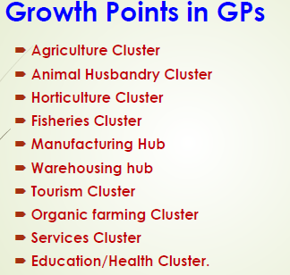

Slide 7
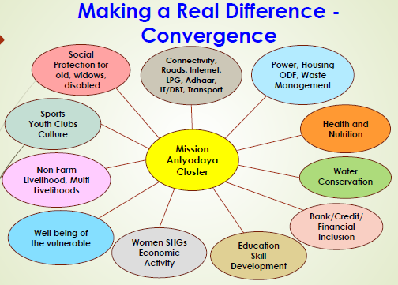

Slide 8
Areas covered in Part A & B GP Survey
PART-A
Basic parameters
Agriculture
Land Improvement
Animal Husbandry
Fisheries
Rural Housing
Drinking Water
Roads
Rural Electrification
Non-conventional energy
Poverty alleviation programme
Education
Vocational Education
Markets and Fairs
Health and Sanitation
Women and Child Development
Social welfare
Public Distribution System
Maintenance of community Assets
Family Welfare
Welfare of the Weaker Sections
Minor Irrigation
Social Forestry
Minor Forest Produce
Small Scale Industries
Khadi, Village and Cottage Industries
Fuel and Fodder
Adult and Non-Formal Education
Libraries
Cultural Activities
Infrastructure
PART-B
Health and Nutrition
Social Security
Agriculture & Livelihoods
Women Empowerment
Water Management and Efficiency

Slide 9
Tools To Be Used
Smart phone or Tablet
Mobile App ‘Mission Antyodaya’
Mission Antyodaya Portal - http://missionantyodaya.nic.in
Census 2011 Village Level Data will be Used as Reference/Guidance to the Data Collection Officials. ( To the extent Feasible).

Slide 10
Types Of Users
Gram Panchayat Officer (CRP etc.)
  Main functionary involved in the field survey
Block/District/State Level Officer
  Ensure that all the GP offered by the state have been enabled for survey.
  Ensure That All the Villages under the GP are available and correctly mapped to GP/Block.
  Authorization of Field Officers for enabling their Login.
  Monitoring Of Work Progress.
  MIS

Slide 11
Log in Process
Download the Mobile App and Install
Self Registration
Authorization by Controlling Authority
  State Nodal Officer authorizes the District Level Officer
  District Level Officer will authorize the block level officer and GP Level Officer
First Time Login using OTP
Ready for Data Collection and Uploading

Slide 12
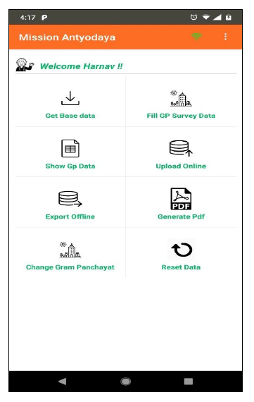
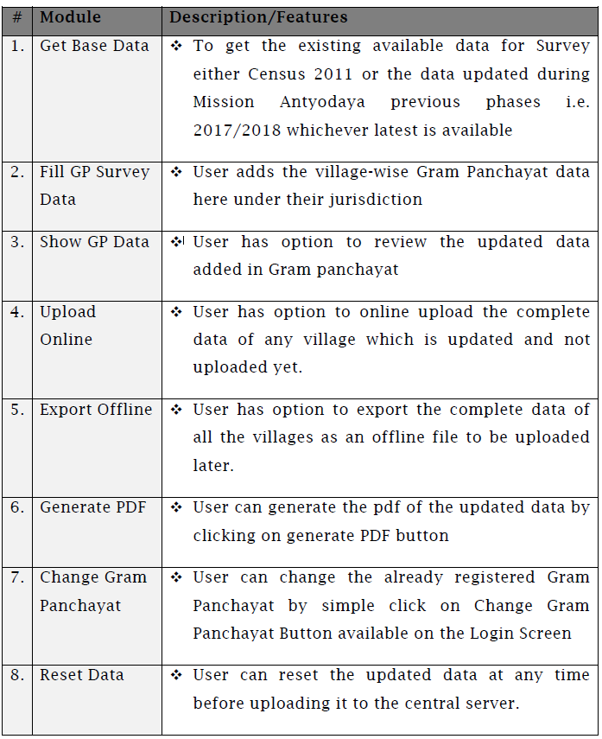
Log in

Slide 13
«ÄµÀ£ï CAvÉÆåÃzÀAiÀÄ ¥Àæ±ÁßªÀ½UÀ¼ÀÄ
¨sÁUÀ - J

Slide 14
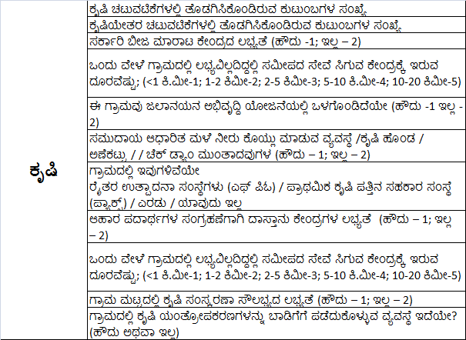

Slide 15
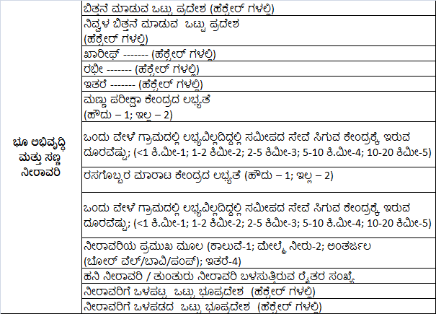

Slide 16
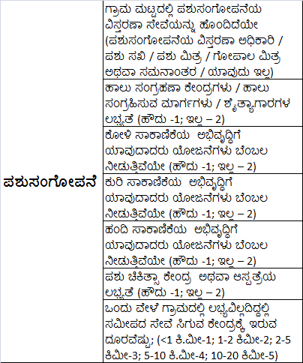

Slide 17
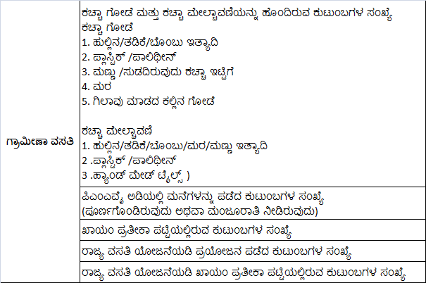

Slide 18
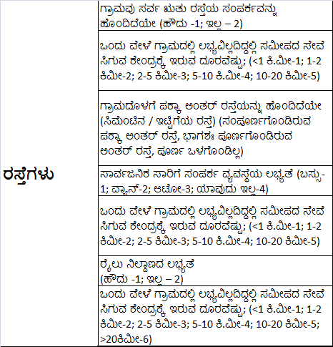

Slide 19
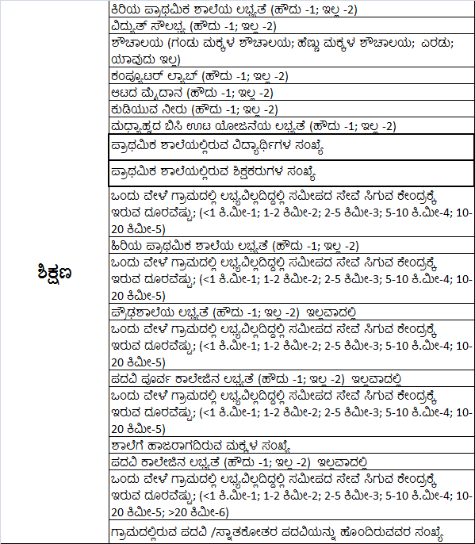

Slide 20
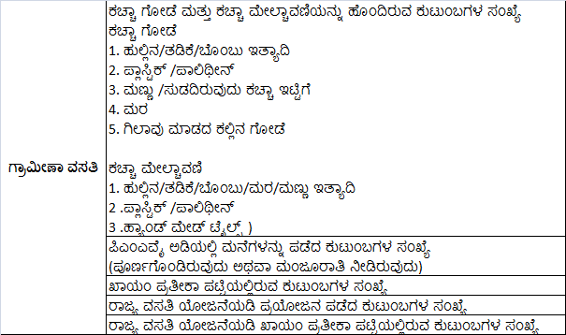

Slide 21
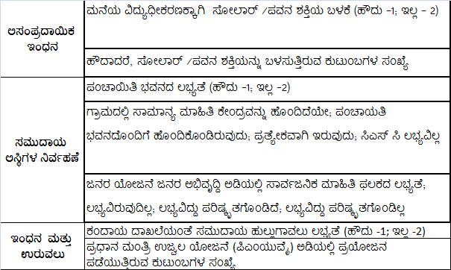

Slide 22
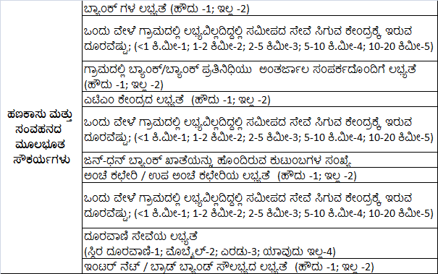

Slide 23
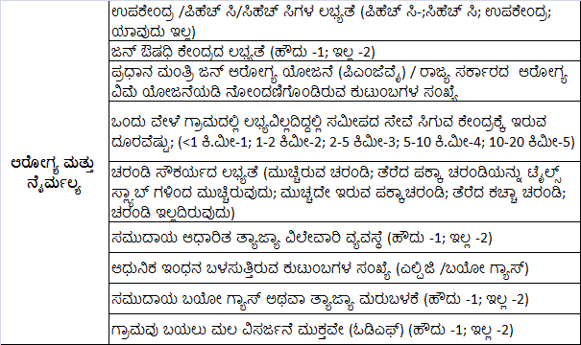

Slide 24
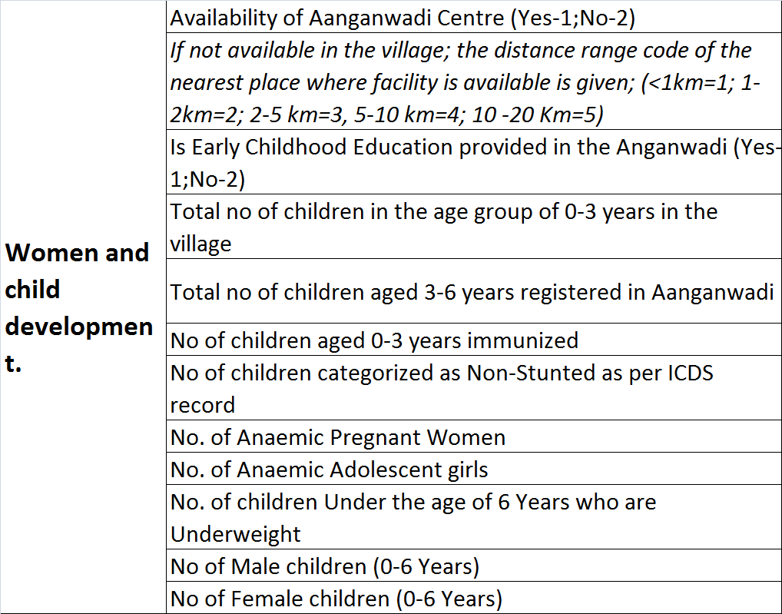

Slide 25
«ÄµÀ£ï CAvÉÆåÃzÀAiÀÄ ¥Àæ±ÁßªÀ½UÀ¼ÀÄ
¨sÁUÀ - ©

Slide 26
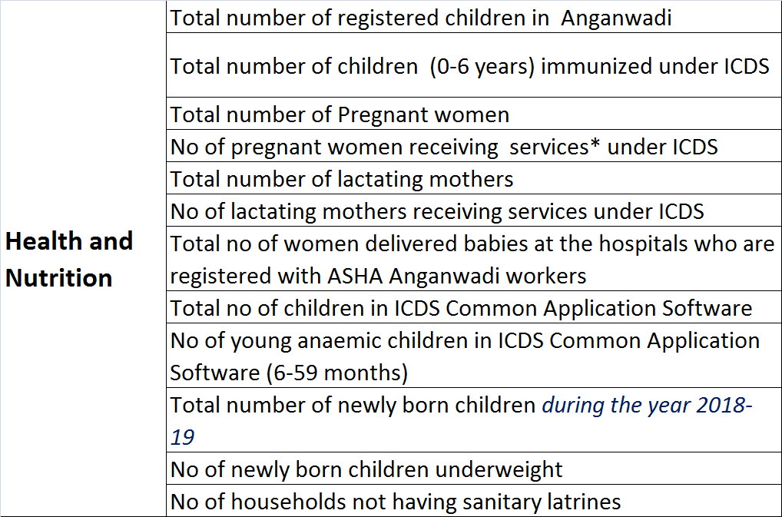

Slide 27
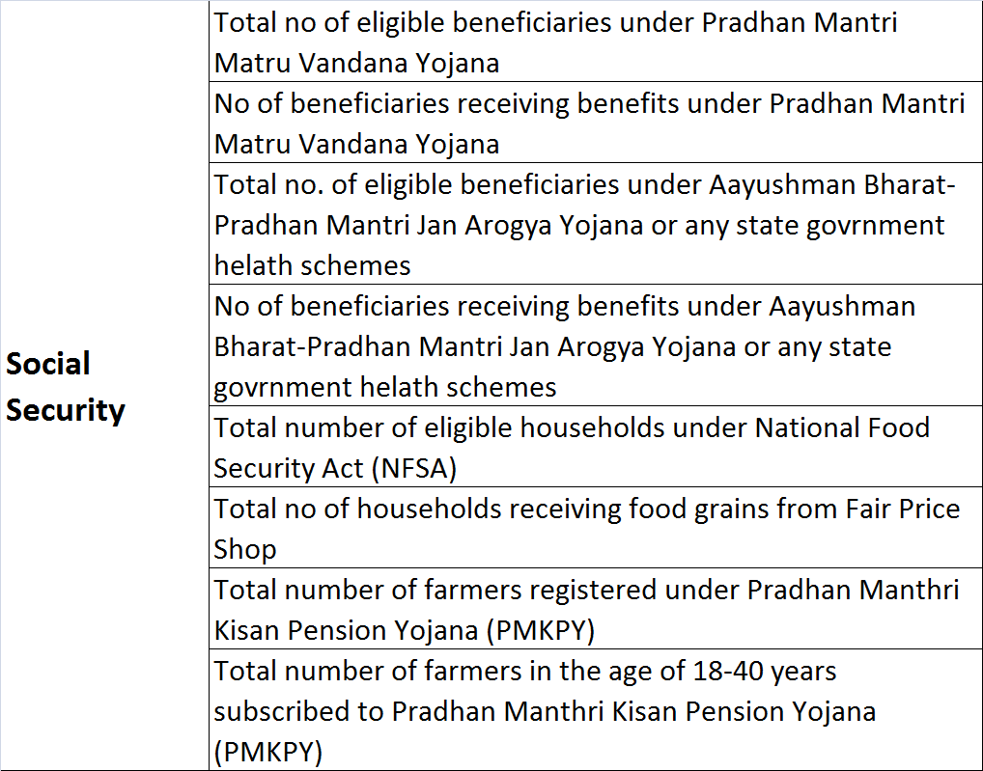

Slide 28
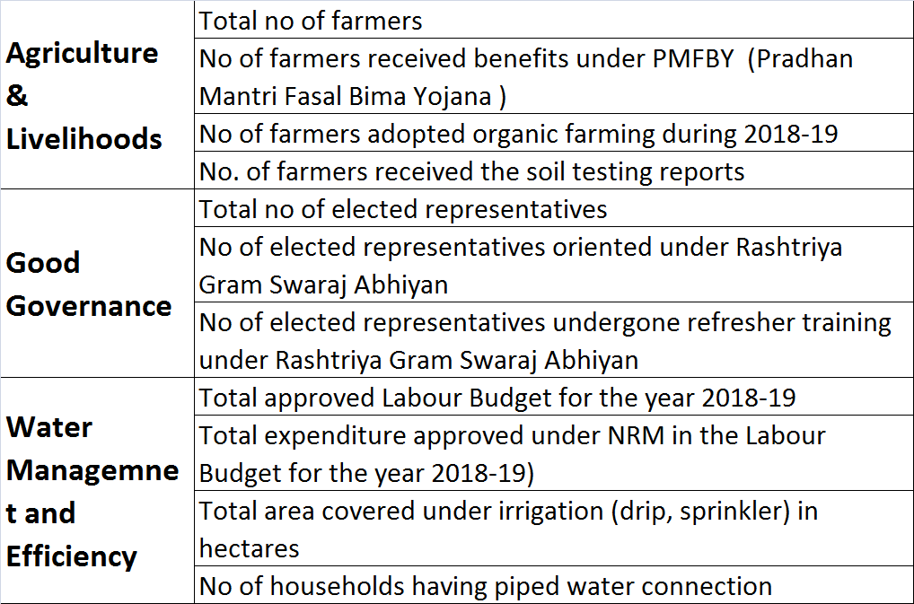

Slide 29
«ÄµÀ£ï CAvÉÆåÃzÀAiÀÄ
UÁæªÀÄ ¥ÀAZÁAiÀÄwAiÀÄ CAvÀgÀzÀ ªÀgÀ¢

Slide 30


