Slide 1


GPDP 2019-20
For CEC Meeting Date 12.10.2018

Slide 2
Activity Perform till date :-
Name of Activity | Date | Status
Mission Antoyaday (MA) mobile App training in SIRD Nimora | 11/09/2018 | Completed
All 27 District Zila Panchyat CEO give the information regarding GPDP via Video conferencing chaired by Additional chief secretary of Panchyat and Rural Department | 19/09/2018 | Completed
District level Master trainer training conduct in SIRD | 24/09/2018 to 27/09/2018 | Completed
State level line Department Nodal officer training was conducted in SIRD Nimora. | 25/09/2018 to 26/09/2018 | Completed
Chief Secretary take a meeting of all line Department Secretary Regarding GPDP | 29/09/2018 | Completed

Slide 3
Activity Perform till date :-
District level Facilitator and SHG training in DPRC and BPRC. | 29/09/2018 to 30/09/2018 | Completed
All district NRLM officer presents there poverty elevation program with the help of active SHG In Gram Panchyat in SIRD Nimora | 29/09/2018 | Completed
Mission Antoyaday Survey Completed | 30/09/2018 | Completed
Special Gram Sabah Organized in Gram Panchyat level | 02/10/2018 to 31/12/2018 | In progress
Public Information Board paste in gram Panchyat Bhawan | 30/09/2018 | Completed
Public Information board images and Gram Sabah images uploaded in GPDP portal | 02/10/2018 to 31/12/2018 | In progress

Slide 4
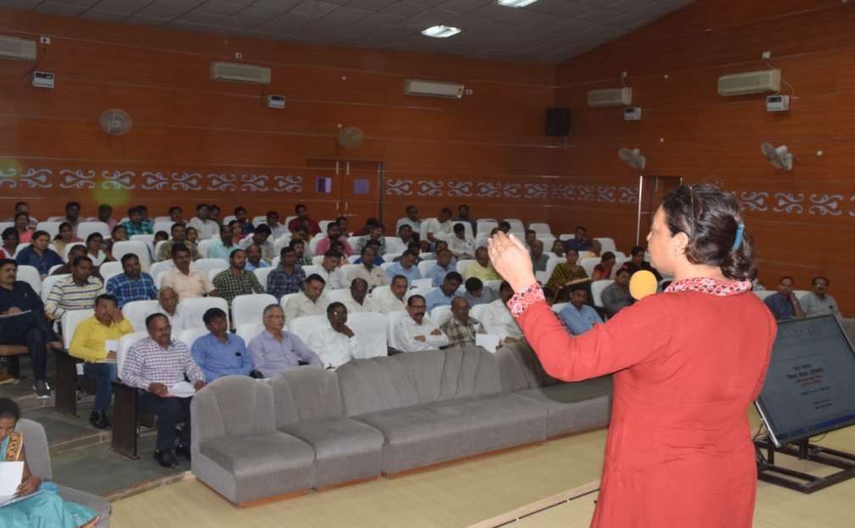
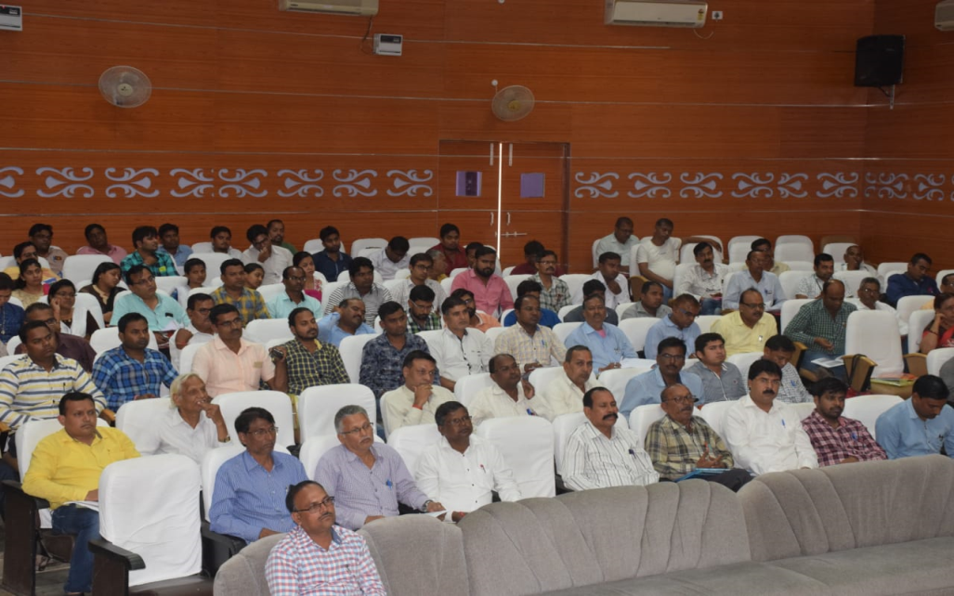
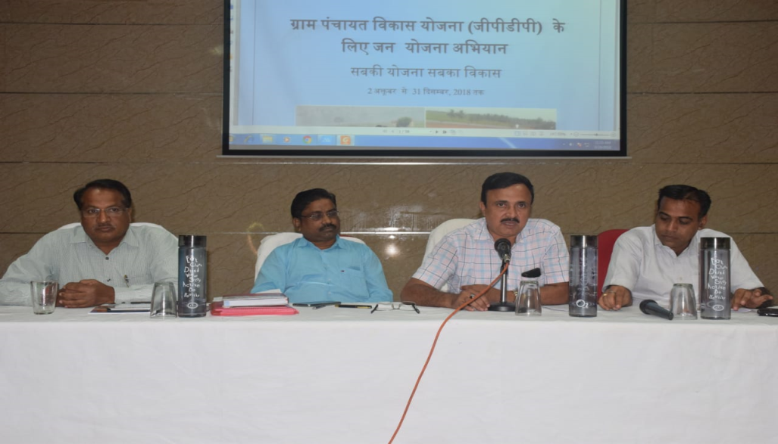
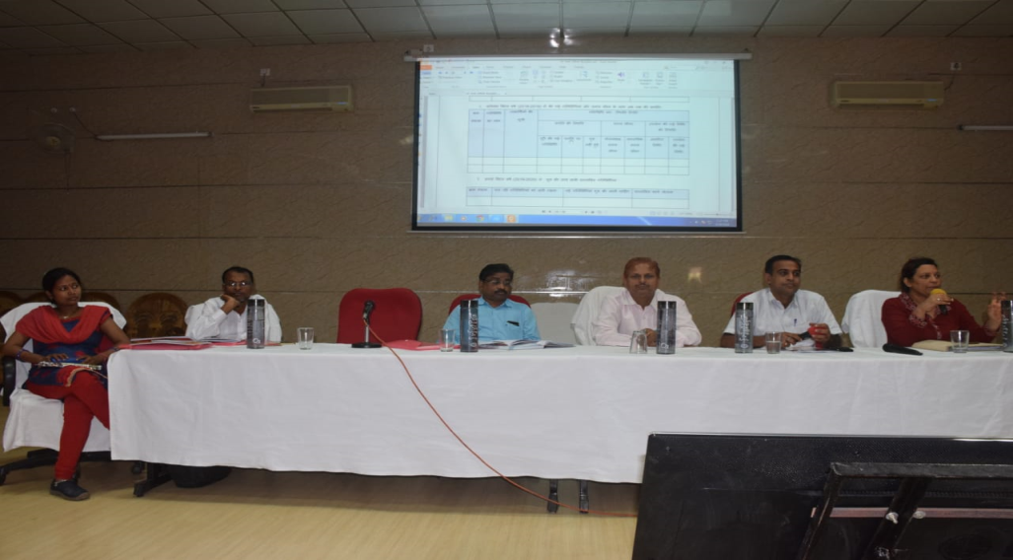
District Level Master trainer Training Program in SIRD Nimora

Slide 5
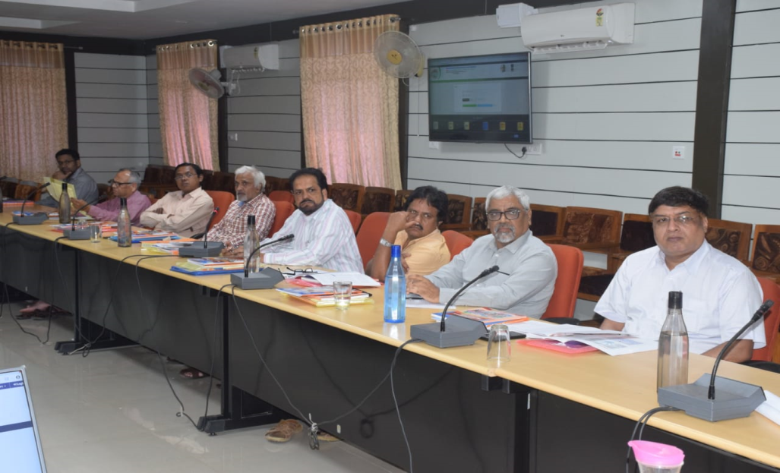
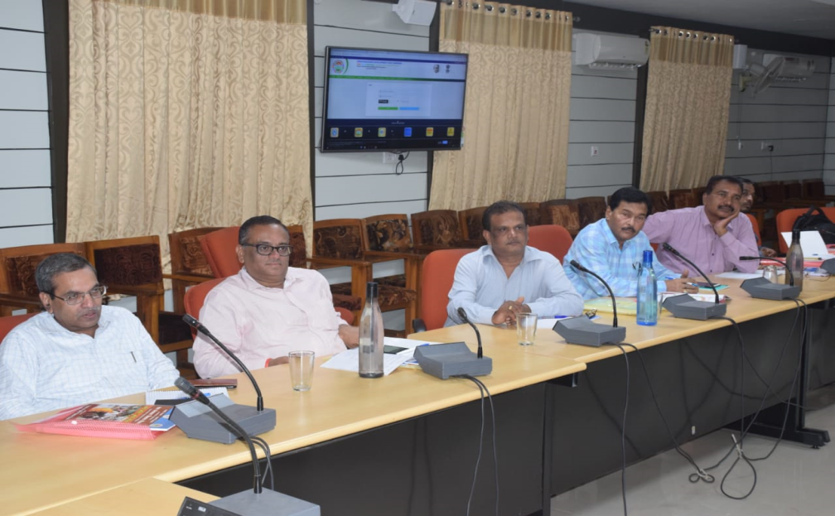
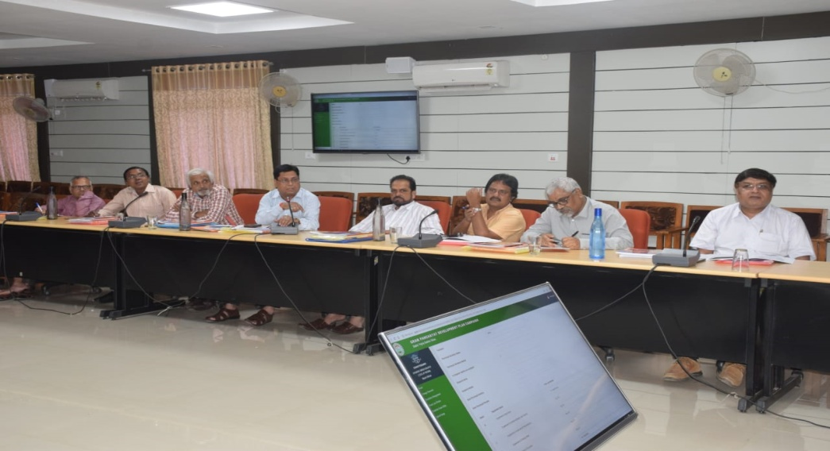
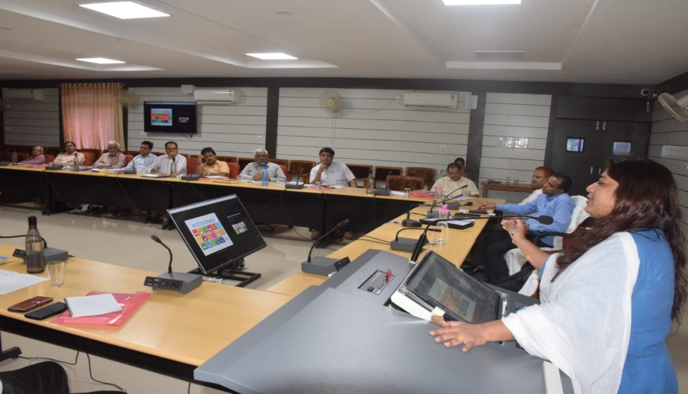
State Level Line Department Nodal officer Training Program in SIRD Nimora date 25/09/18 to 26/09/18

Slide 6
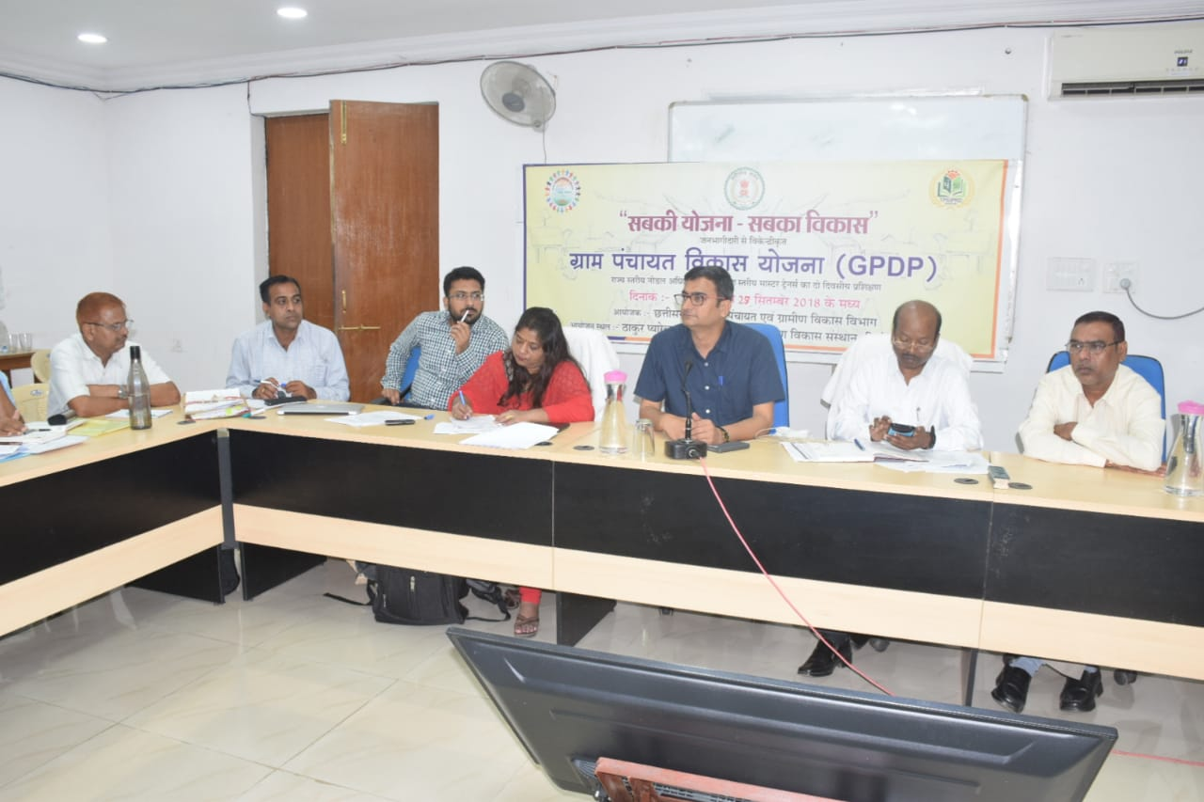
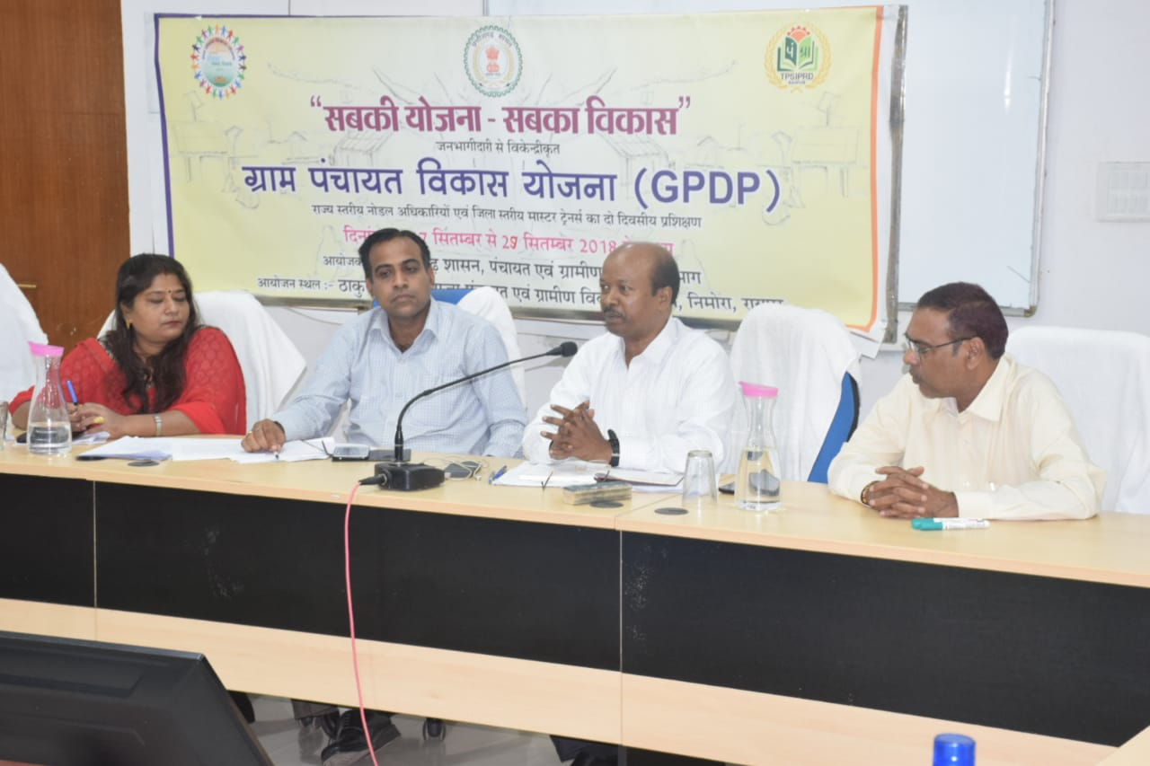
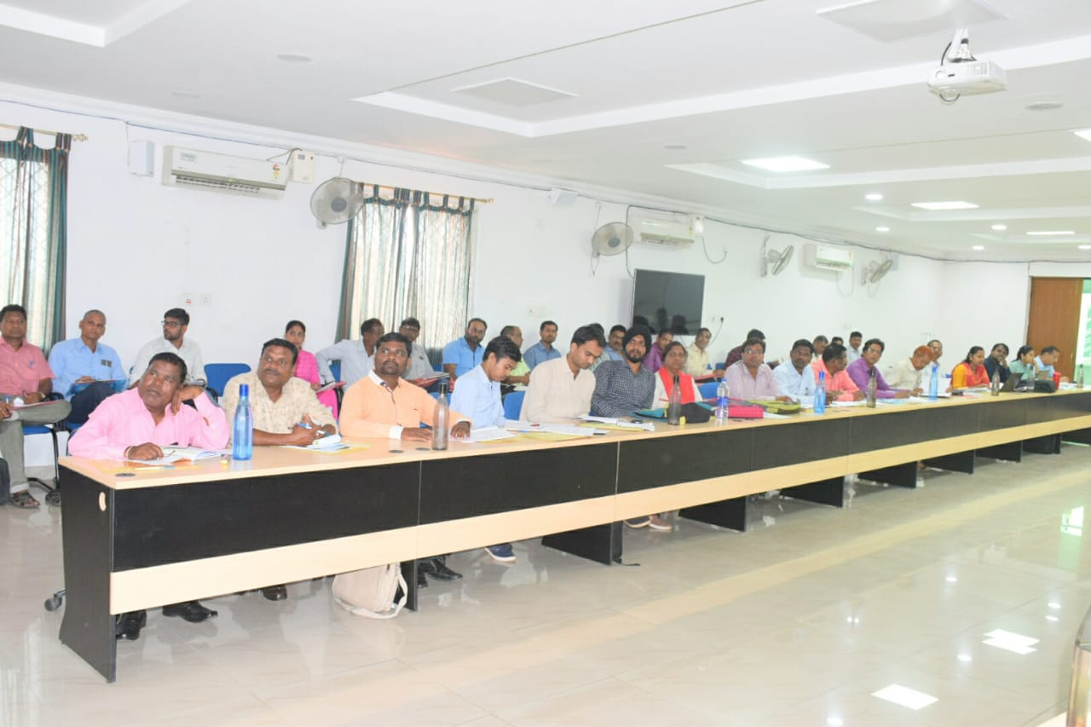
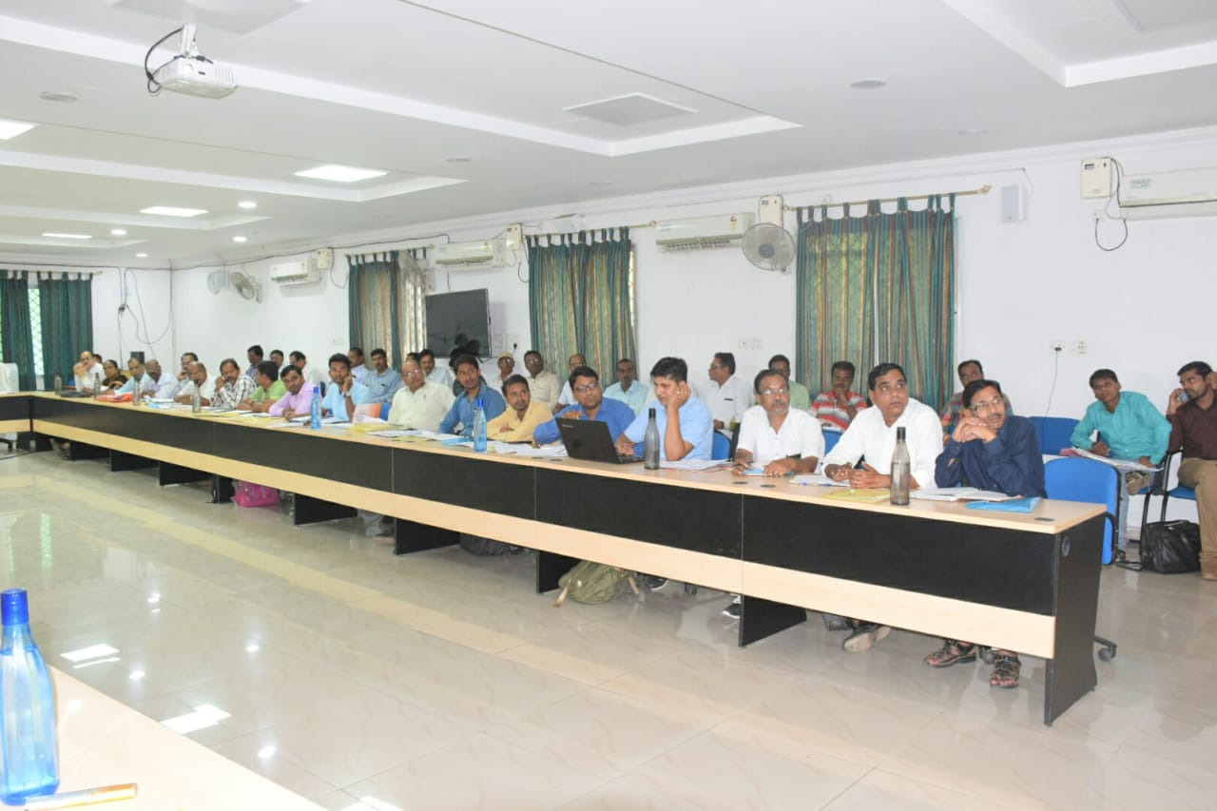
PRI-SHG Poverty Elevation Program Presentation in SIRD Nimora on Date 29/09/2018

Slide 7
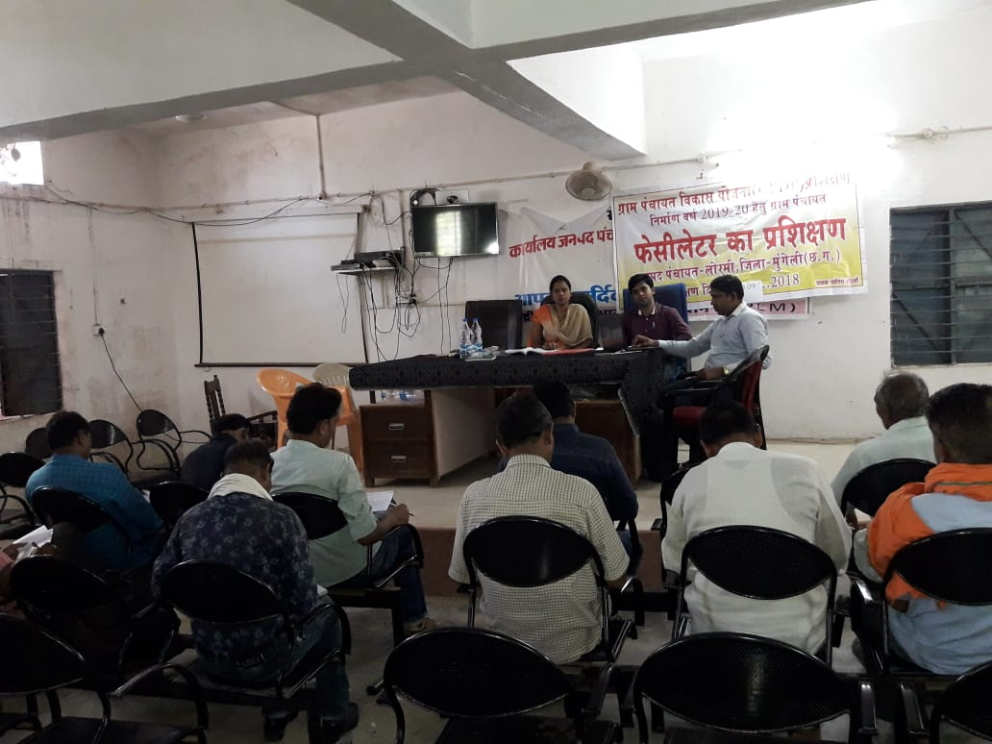
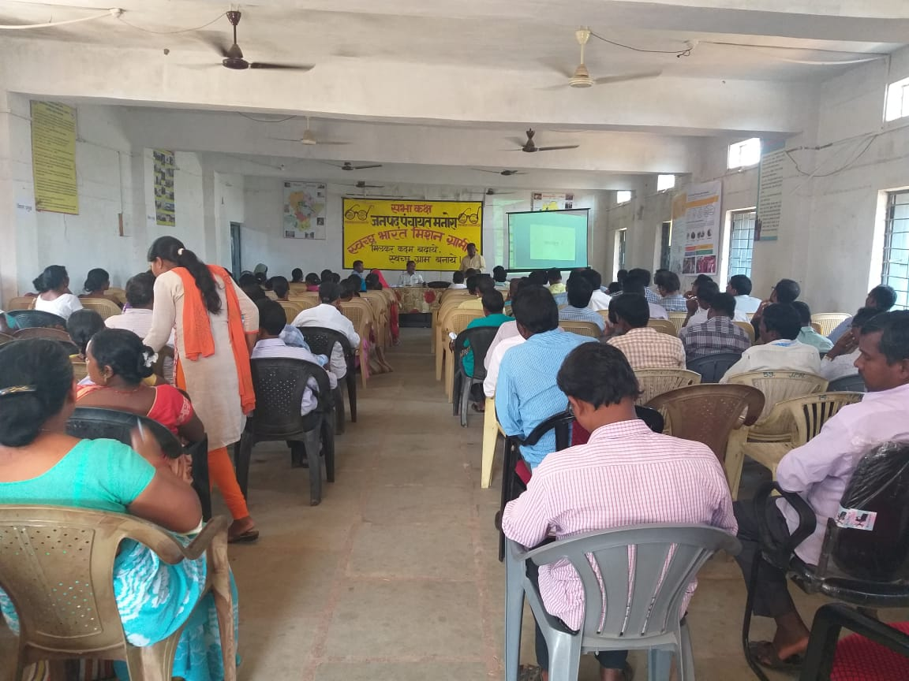
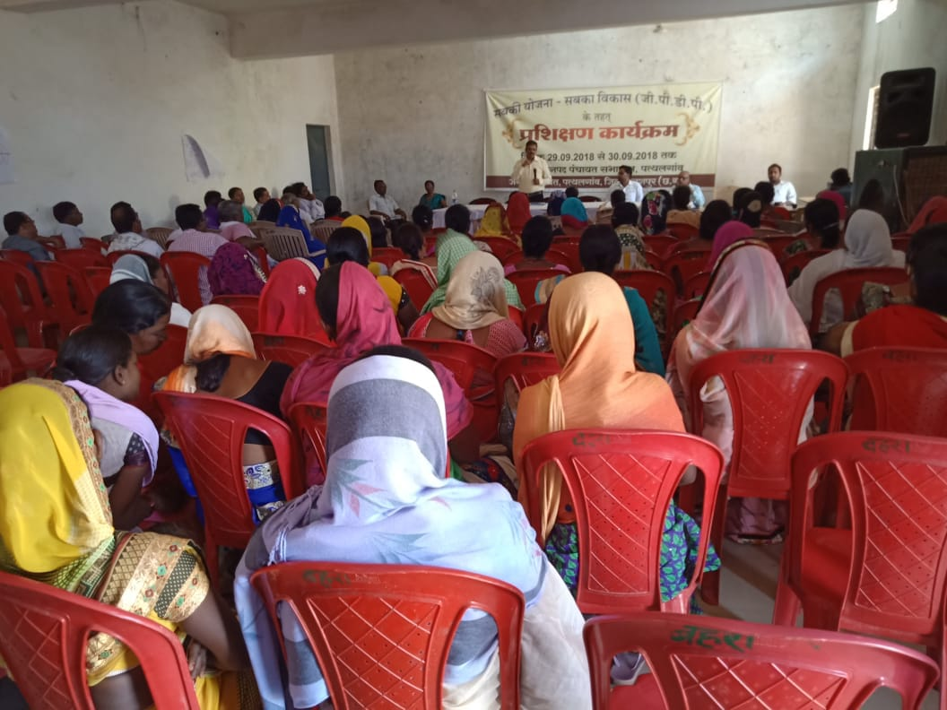
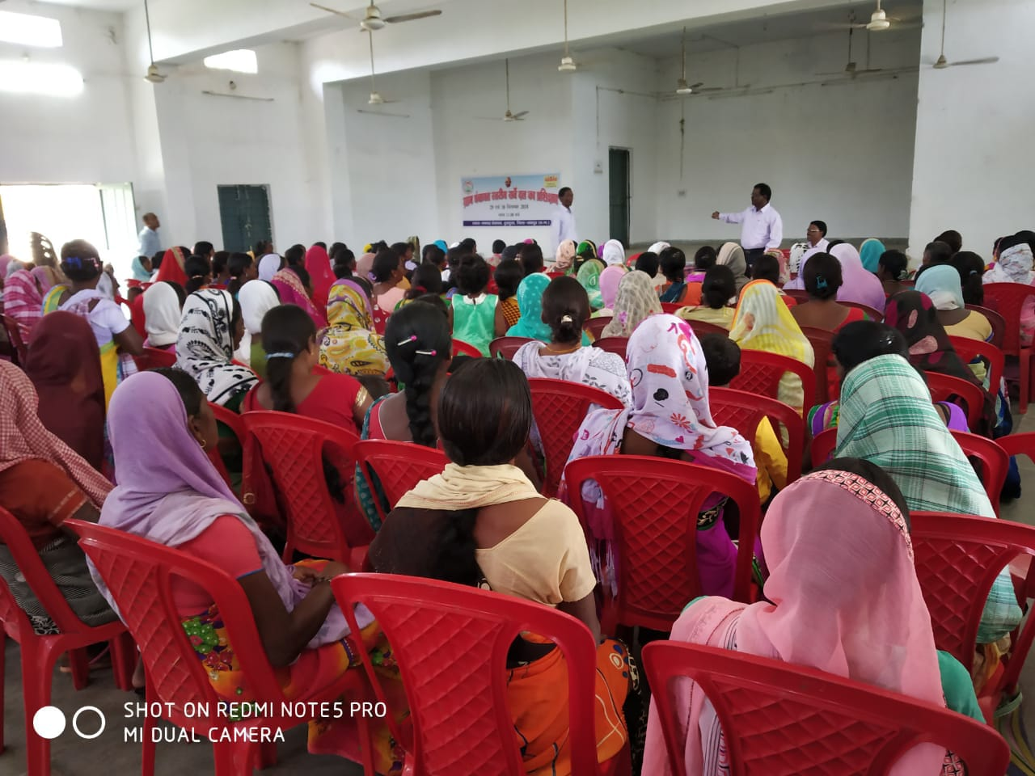
Facilitator and SHG Training In district level

Slide 8
GPDP Progress Report on date 24/10/2018
Total No District Level Master Trainer Training = 463
Total No of Mission Antoyaday Mobile app survey Completed till date =100 %
Total No of state level Resource person tarined = 48
Total no of SHG trained = 12000
Total no of Facilitator Trained = 10978
Total no of Nodal officer appointment till date = 27 dist +19 line dept nodal
Total no facilitator appointed = 18431 ( Include 9864 GP facilitator)
Total no gram Sabah schedule fixed till date = 10251
Total No of Gram sabha completed till date = 4615( upto 06/10/2018)
Total no Facilitator feedback Report submit = 708 (remaining feedback report submitting process is running )

Slide 9
Thanks

