Slide 1
GRAM PANCHAYAT DEVELOPMENT PLAN (GPDP)
Sabki Yojana Sabka Vikas
People’s Plan Campaign
2nd October 2018 – 31st December 2018
MINISTRY OF PANCHAYATI RAJ
DEPARTMENT OF RURAL DEVELOPMENT

Slide 2
Objectives of the People’s Planning Campaign…(1)
Strengthening Role of 31 lakh elected Panchayat Leaders and 5.25 crore SHG Women under DAY-NRLM in effective Gram Sabha.
Evidence Based Assessment of Progress made in 2018-19 and proposals for 2019-20 in all 29 subjects of XI Schedule.
Public Information Campaign – Full public disclosure on a Village Display Board on Schemes, Finances, etc. of all Programmes in Gram Panchayat Office and on Gram Samvaad App.

Slide 3
Objectives of the People’s Planning Campaign…(2)
Structured Gram Sabha meetings spread over 2nd October – 31st December, 2018, with physical presence and presentation by frontline workers/Supervisors of all 29 Sectors in XI Schedule.
PlanPlus strengthened to provide for a pragmatic and holistic Gram Panchayat Development Plan.

Slide 4
29 Sectors in XI Schedule
1. Agriculture.
2. Land Improvement.
3. Minor Irrigation.
4. Animal Husbandry.
5. Fisheries.
6. Social Forestry.
7. Minor Forest Produce.
8. Small scale industries.
9. Khadi, village and cottage industries.
10. Rural Housing.
11. Drinking Water
12. Fuel and fodder.
13. Roads.
14. Rural Electrification.
15. Non-conventional energy.
16. Poverty alleviation programme.
17. Education.
18. Vocational education.
19. Adult and non-formal education.
20. Libraries.
21. Cultural activities.
22. Markets and fairs.
23. Health and sanitation.
24. Family welfare.
25. Women and child development.
26. Social welfare.
27. Welfare of the weaker sections.
28. Public distribution system.
29. Maintenance of community assets.

Slide 5





Gram Swaraj Abhiyan in Aspirational Districts
Partnership for Results
Pradhan Mantri Ujjawala Yojana
Saubhagya (Pradhan Mantri Sahaj Bijli Har Ghar Yojna)
Pradhan Mantri Jan Dhan Yojana
Pradhan Mantri Jeevan Jyoti Bima Yojana
Ujala Yojana
Pradhan Mantri Suraksha Bima Yojana
Mission Indradhanush
Improving Village School
COMMUNITY MOBILISATION
Better Health Service
Panchayat Leaders
SHG Women
Capacity Development
Enrolment of Beneficiaries.
Community Action for Poshan Abhiyan
FRONTLINE WORKERS
Asha, AWW, ANM
Panchayat Secretary
Gram Rozgar Sewak
School Teachers
Pilots in Agriculture
Thrust on Skills for Youth

Slide 6
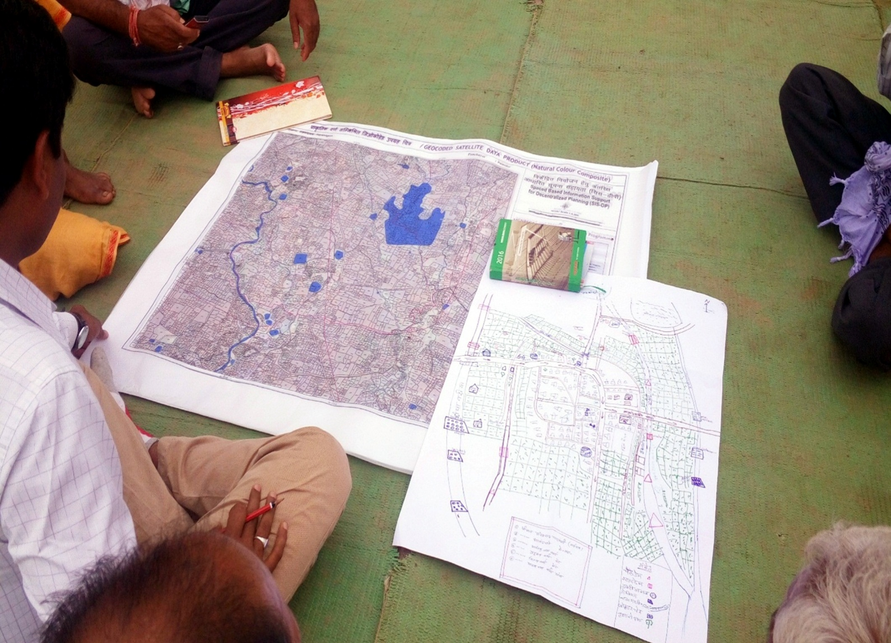
GIS based planning

Slide 7
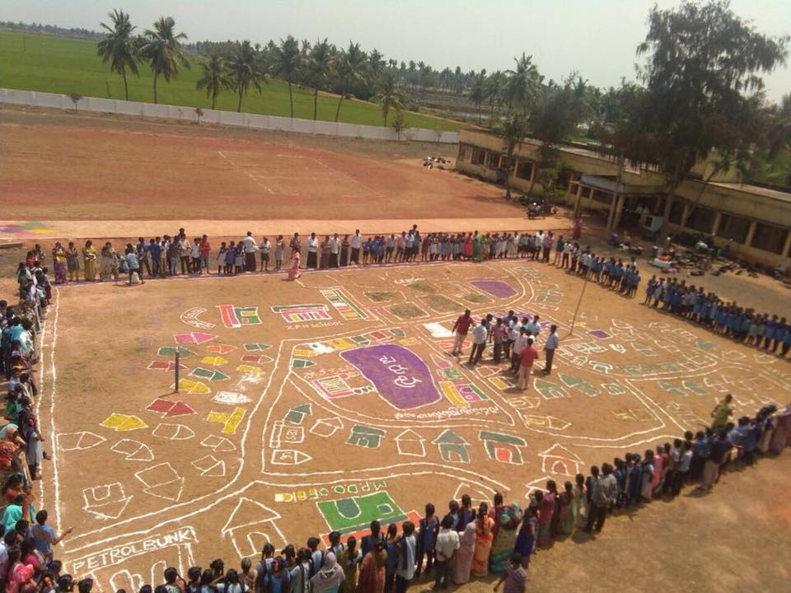
Gram Sabha , Andhra Pradesh

Slide 8
Cluster/GP Development Plan
Cluster/GP Development Plan
HUMAN DEVELOPMENT
- Health facilities/Nutrition.
- Medicine Availability.
- Village School.
- Girls’ Education.
- Adolescent Health.
MONITORING
- DISHA Dashboard.
- PRIASoft.
- Gram Samvad.
- SHG Women as Social Auditors.
IMPLEMENTATION
- Geo tagging – Before, During, After.
- Public Information.
- IT/DBT Transfers for Wages & Materials.
- Social/Internal Audit.
INFRASTRUCTURE DEVELOPMENT
- Village Roads & Drains.
- Street lights.
- Solid & Liquid Resource Management.
- Electricity/LPG Gas.
- Housing/SBM.
PLANNING & HR
- PlanPlus – Data from All.
- HR through Convergence.
- Community Cadre – Performance based.
- Gram Sabha
RESOURCE MOBILISAITON
- Sources of Revenue.
- Identifying Priorities.
- Bank linkage.
- Convergence.
- United funds.
- Community/Household Contribution.
ECONOMIC ACTIVITY
- Farm livelihood.
- Non-farm livelihoods.
- Skills for Wage Employment
- Women’s Skills/livelihoods.
- Bank loans.

Slide 9
Accountability Framework
Accountability Framework
CITIZEN CENTRIC APPS
- Meri Sadak App.
- Awaas App.
- GeoMGNREGA App.
COMMUNITY MOBILIZATION
- 31 lakh PRI Elected Members.
- 5.25 cr SHG women.
- Joint Capacity Devp under RGSA Scheme.
RESEARCH, EVALUATION & MONITORING
- National Evaluation of all major programmes.
- National level Monitoring Institutions in Districts.
- Annual Common Review Mission.
- Advisory Group of Experts on HR, IT, Markets & Value Chains, Financial Incl, Internal Audit.
SOCIAL AUDIT
- Independent Social Audit Units in all States.
- Auditing Standards notified Certificate Courses for District & Block Resource Persons by NIRD&PR/TISS.
- Women SHG Members as Village level Social Auditors – 60,000 trained already.
INTERNAL AUDIT
- 4 weeks certificate programme for Internal Audit launched by NIRD&PR and Inst. of Internal Auditors.
- At least 5000 Internal Auditors.
- Suggestions of Advisory Group on Internal Audit as guidance framework.
PUBLIC INFORMATION CAMPAIGN
- Gram Swaraj Abhiyan.
- Display of details of programs in GP office.
- Gram Samvad App.
- Short video clips on Social Media.
IT/DBT/GEOTAGGING
- All programs on EFMS/PFMS, IT/DBT Platform
- Universal Geo-tagging of assets under MGNREGS
- Stage-wise Geo-tagging under PMAY-G homes
- 14th FC funded assets geo-tagging, PRIASoft and PFMS link.

Slide 10

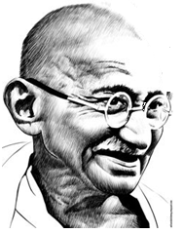
150th BIRTH ANNIVERSARY OF MAHATMA GANDHI

Slide 11
Poverty Free Rural Cluster
Connectivity,
Roads, Internet, LPG, IT/DBT
Social Protection for old, widows,
disabled
Power, Housing ODF, Waste Management
Sports
Youth Clubs Culture
Health and Nutrition
Mission Antyodaya Cluster
Non Farm Livelihood,
Multiple Livelihoods
Water Conservation
Well-being of the vulnerable
Bank Credit Financial Inclusion
Women SHGs Economic Activity
Education,
Skill Development

Slide 12
Making a Difference
Lack of Education and Skills
Under-Nutrition and ill-health
Lack of Employment opportunities
Assetlessness
Lack of Safe Housing
Poverty of Households
Limited Access to Public Services
Clutches of middlemen/corruption/ moneylender
Absence of Social Capital-collectives of women/youth/poor households
Low Price for produce - distress
Violence/crime
Poverty of Geographies
Unirrigated agri/vagaries of monsoon
Lack of basic infra-Roads, Electricity,
internet
Lack of access to markets and jobs
Lack of non-farm opportunities

Slide 13
SECC 2011- Focused efforts on most deprived sections
Particular | Deprived Households | Interventions Required PMAY Gramin DAY-NRLM MGNREGS DDUGKY/RSETI NSAP Livelihoods Education/Skills Animal Resources Non-Farm option Markets/Value Social Capital Bank Linkage Enterprise Professionals Horticulture Organic Health Nutrition SBM
Only zero room or one room with kucha walls and kucha roof (D1) | 2,37,31,674
No adult member between 16 to 59 (D2) | 65,15,205
Female headed households with no adult male member between age 16 to 59 (D3) | 68,96,014
Disabled member and no able bodied adult member (D4) | 7,16,045
SC/ST households (D5) | 3,85,82,225
No literate adult above 25 years (D6) | 4,21,47,568
Landless households as manual casual labour (D7) | 5,37,01,383
TRANSFORMING LIVES AND LIVELIHOODS MEASURING OUTCOMES

Slide 14
Measuring GP Performance (Census 2011) Household’s Well – Being (SECC 2011)
INFRASTRUCTURE AND ACCESS TO SERVICES | SOCIAL DEVELOPMENT AND PROTECTION | ECONOMIC DEVELOPMENT AND DIVERSIFICATION OF LIVELIHOODS
All Weather Road (Y/N) | % of children fully immunized | % of HHs with Bank loans for diversified livelihood
Internet Connectivity (Y/N) with Bank/Banking Correspondent | % of 0-3 children under weight, stunted, wasted | % of HHs earning through dairy & animal resources.
% of Households with safe housing | % Deprived HHs with maternity benefits/Health Protection, access to basic medicines & primary care. | % of HHs with placement/settlement in wage/self-employment.
% of HHs getting power for 12 hours daily | % of HHs with food security and clean water | % of HHs with over Rs. 10,000 in Savings account.
% of HHs cooking on LPG | % girls completing Secondary Education/Skill Certificate Course | % of HHs in non farm employment with skills, markets and Bank linkage.
% of Agricultural Land giving 2 crops/protective irrigation. | % of needy old, widows, disabled under social protection | % of HHs in Farmers’ Producer Organizations/ PACS
% of HHs with solid and liquid waste management/ODF | % of 18-24 year covered under Skills/Higher Education | % of women in paid/self-employment

Slide 15
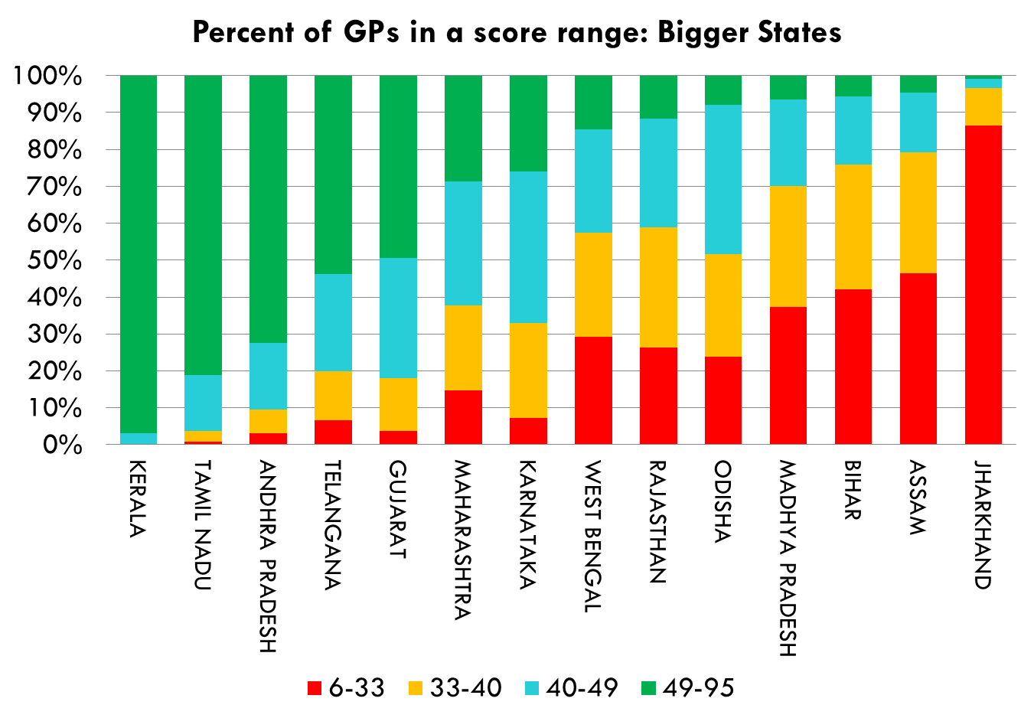
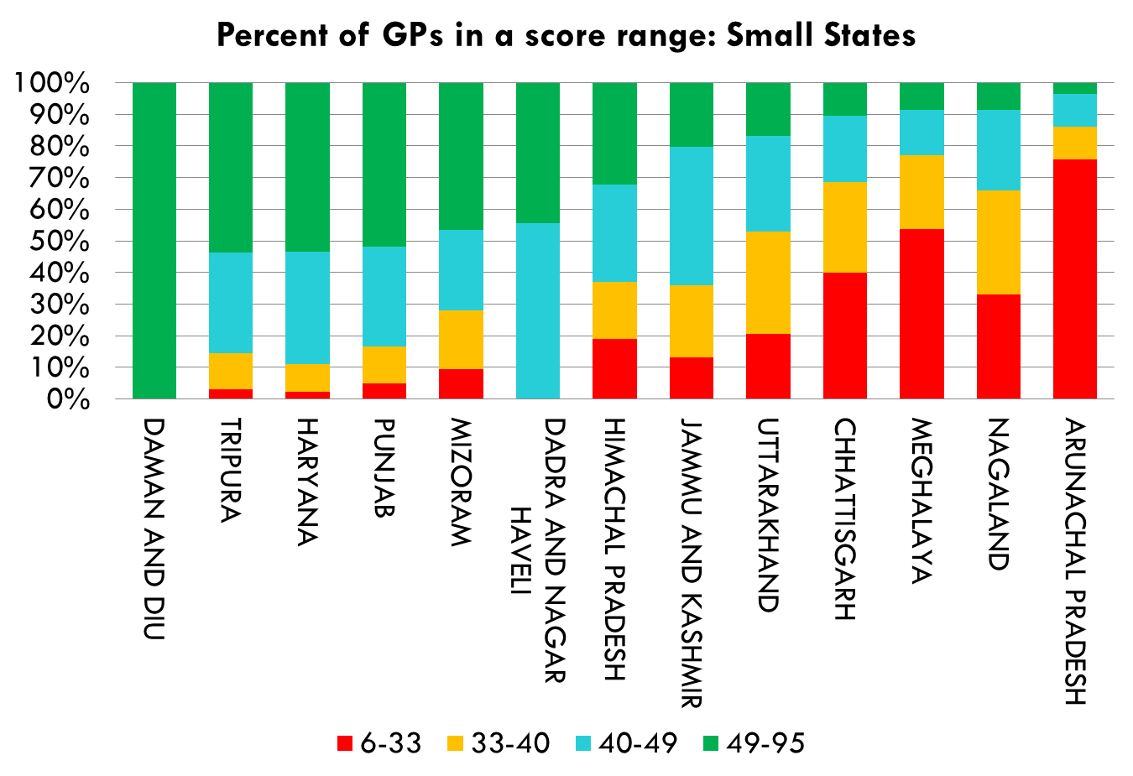
Observations from baseline survey

Slide 16
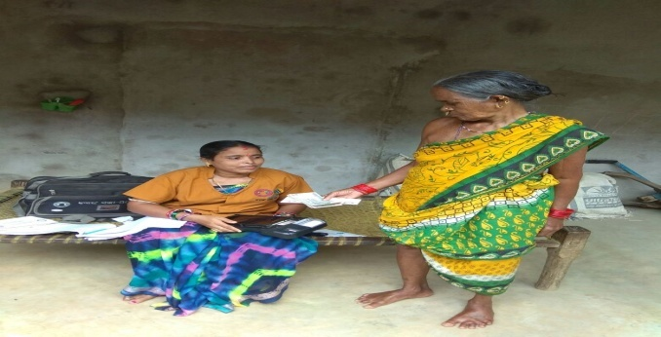
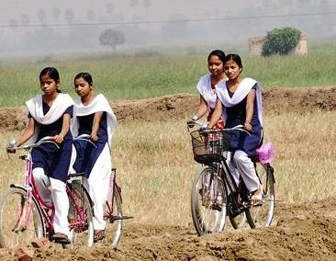
Adolescent Girls – The ‘Schooling Revolution
Sl. No | Change Parameters | 1986-87 | 2015
1. | Girls in Schools in Rural Areas | 69.23% 6+ females never enrolled (NSSO - 42nd Round) | Attendance Ratio upto Class-VIII same for boys & girls (NSSO – 71st Round)
2. | Participation of Girls in Secondary/Higher Secondary Schools | Very low | Almost equal at Secondary
3. | IMR | 95 | 38
4. | TFR | 4.1 | 2.2
5. | Age at Marriage | Low | Rising
6. | Effective ASHAs, SHG women and women in PRIs | Low/No | High/Many
Transforming Rural India

Slide 17


Panchayat Statistics
Avg. population per GP
National Average population per GP: 3,420
No. of PRIs in the country | : | 2,55,537
No. of Gram Panchayats | : | 2,48,624
No. of Block Panchayats | : | 6,307
No. of District Panchayats | : | 606
No. of Elected members of PRIs | : | 31.00 lakh
No. of Elected Women Representatives | : | 13.76 lakh (44%)
Areas not covered by PRIs (Non Part IX):
Meghalaya, Mizoram, Nagaland & parts of Hill areas of Manipur, district Darjeeling, West Bengal, parts of Assam and Tripura
Jammu & Kashmir
(2170)
3 Highest States: WB, Kerala, Assam
3 Lowest States: Punjab, Uttarakhand, Arunachal Pr
Himachal Pradesh
(1914)
Arunachal Pradesh
(599)
Punjab
(1331)
Haryana
(2661)
Uttarakhand
(884)
Sikkim
(2597)
Assam
(12185)
Rajasthan
(5205)
Uttar
Pradesh
(2629)
Bihar
(11005)
Gujarat
(2474)
Madhya Pradesh
(2304)
Jharkhand
5697
West
Bengal
(18607)
Manipur
(10784)
Chhattisgarh
(1787)
Tripura
(4590)
Odisha
(5142)
Maharashtra
(2198)
Telangana
(2486)
Goa
(2889)
Andhra Pradesh
(4362)
> 10000 Avg. population per GP
5001-10000 Avg. population per GP
Karnataka
(6220)
3501 – 5000 Avg. population per GP
2000 – 3500 Avg. population per GP
500-2000 Avg. population per GP
Tamil Nadu
(2973)
Kerala
(18567)
Andaman and Nicobar Islands

Slide 18
Preparatory Work…(1)
Letter to Chief Secretaries outlining approach.
Coordination with 18 Ministries/Departments.
Training Module for Panchayat Leaders & SHG Women – 28th August 2018 – NIRD-SIRD Workshop.
Developing Calendar of Gram Sabhas by Districts/States.
Ensuring Structured Presentation by frontline workers at Gram Sabha.

Slide 19
Preparatory Work…(2)
Illustrative Schedule for Gram Sabha meeting.
Pre populating PlanPlus with full background information/data.
NIRD&PR led module on facilitation of GPDP meeting for Community Resource Persons (CRPs) & Cluster Coordinators of DAY-NRLM.
Next Issue of Panchayat Quarterly Magazine to focus on GPDP.
Update PRIASoft uploading, EFMS/PFMS/Geo-tagging/14th Finance Commission.

Slide 20
Public Information Campaign
Display of physical & financial progress on boards in GP Office.
Uploading on Gram Samvaad.
Mission Antyodaya like ranking of all Gram Panchayats/Villages on same format by all GPs.
Display Boards, Bill Boards on People’s Plan Campaign.
Inter Personal Communication materials with frontline workers.

Slide 21
Monitoring of People’s Plan Campaign
Portal uploading GP meeting visuals.
Report of Facilitators in standard format.
PlanPlus uploading of GPDP for all 29 sectors.
Visit to Gram Sabhas for every District/State/Central level official of concerned Departments.
NLM visits to random Gram Sabhas.

Slide 22
Participating Ministries/Departments
M/o Panchayati Raj &
D/o Rural Development
M/o Micro Small and Medium Enterprises
M/o Drinking Water & Sanitation
D/o School Education & Literacy
M/o Health & Family Welfare
D/o Financial Services
D/o Animal Husbandry, Dairying & Fisheries
D/o Agriculture Cooperation & Famers Welfare
M/o Environment, Forest & Climate Change
M/o Women & Child Development
D/o Food & Public Distribution
M/o Tribal Affairs
&
M/o Social Justice & Empowerment
M/o Power
M/o Petroleum and Natural Gas

Slide 23
Timeline for Preparations
Sl | Timelines | Date
1. | Letter to Chief Secretaries, Secretaries (PR & RD) of all States/UTs | 13th August 2018
2. | Pre populating PlanPlus. | 30th August 2018
3. | EFMS/PFMS/PRIASoft/Geo-tagging | 30th September 2018
4. | Panchayat Quarterly Magazine despatched | 25th August 2018
5. | Training Module for PRIs/SHGs ready | 30th August 2018
6. | Roll out of Facilitators Training Module | 30th August 2018
7. | Appointment of Facilitators for every Gram Panchayat | 10th September 2018
8. | Gram Sabha wise Calendar of Events uploaded | 10th September 2018
9. | Illustrative Gram Sabha meeting schedule finalized | 30th August 2018
10 | Public Information Boards in every GP on all Programs | 15th September 2018
11 | Deployment order for Gram Sabha meeting issued | 15th September 2018

Slide 24
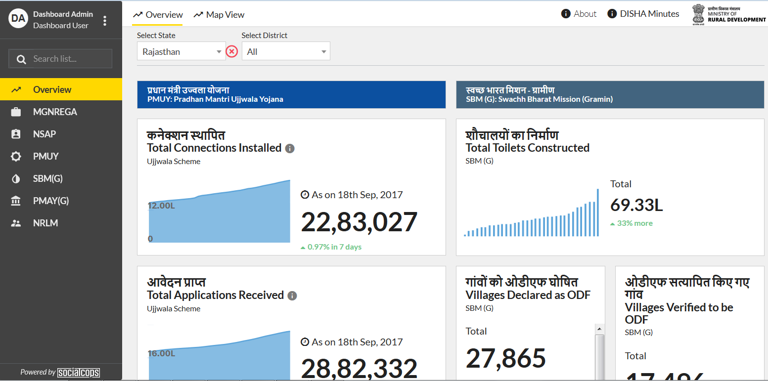
DISHA
District Development Coordination and Monitoring Committee
View Options
Dynamic Filters
Schemes List
Dynamic Data on Mouse hover
Information about schemes like:
MGNREGA
PMAY-G
Users will see information on pre-set indicators as a set of widgets or on a map, compared over time and regions
NSAP
SBM-G
NRLM
PMUY

Slide 25
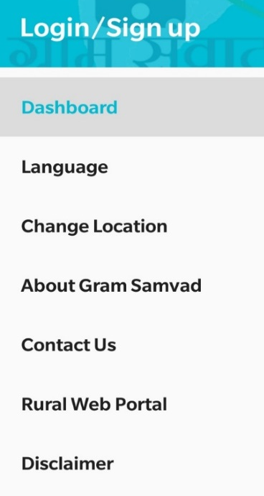
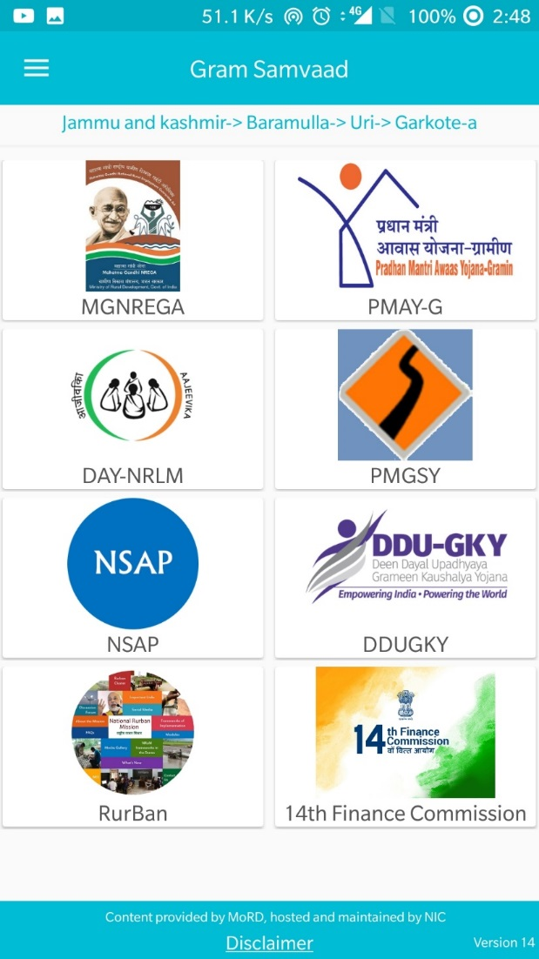
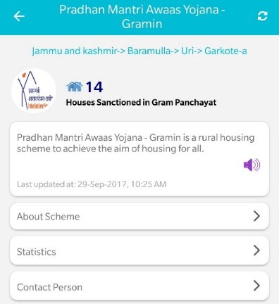
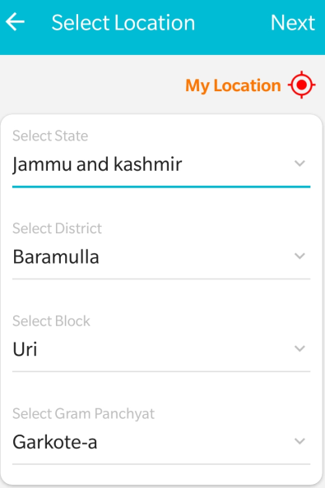
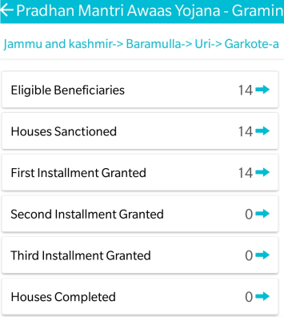
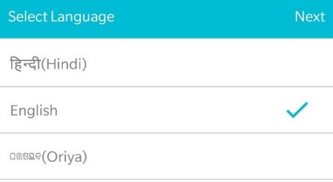
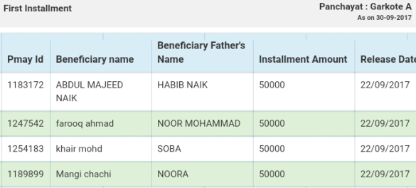

सूचना से सशक्तिकरण
To choose current location using GPS
Reads out the content for user
ग्राम संवाद-
List of beneficiaries in GP Garkote-A given 1st installment
Currently Bilingual, next release would be Multilingual

