Slide 1
Gram Panchayat Development Plan
(2nd October- 31st December)
Sabki Yojana Sabka Vikas

Slide 2
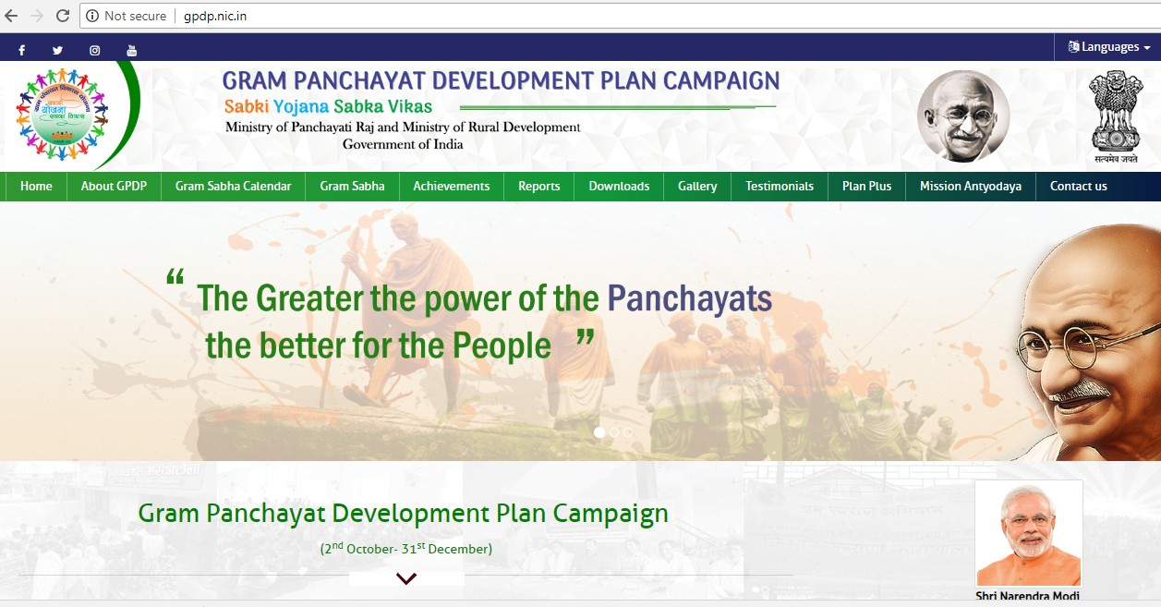
Home Page- http://gpdp.nic.in

Slide 3
Key Principles of Data Entry in GPDP Portal
LGD to be used as standard Location Code Directory: State -> District/District Panchayat -> Block/Block Panchayat -> GP. Mapping with LGD a pre-condition in case there arise a need to integrate with any other portal
Names, designations, Mobile no., email IDs of Nodal Officer/Facilitators/Frontline Workers to be captured, but only names to be put in public domain.
Mobile No to be used as Login ID for all on the Portal
Only the Nodal Officer and Facilitators will enter data on the portal.
Nodal Officers for Central Line Ministries, who in turn create State/District/Block level users for their field functionaries.
GP-wise entries to be made preferably from Block level. <States may also assign task to District if required>
Calendar of ‘Gram Sabhas’ to be entered by District/Block (as decided by State). Validation to avoid overlapping dates of Gram Sabhas within a block/district.

Slide 4
Key Principles of Data Entry in GPDP Portal
Provision to upload geo-tagged pictures for each GP (i.e. Gram Sabha Meeting, Public Information Board etc.)
Photographs uploaded through cloud sourcing will be moderated
In Non Part-IX States, entries will be made for equivalent elected RLBs (by officials assigned by the State)
Assumption: While field functionaries of all 18 line departments will need to mandatorily provide GP-wise data to the GP & Facilitator, they will not be required to make any entry in the portal.

Slide 5
Features of GPDP Portal
Provision to schedule special Gram Sabha
Assigning facilitator/frontline workers to a Gram Sabha
Facilitator Feedback Report
Provides Key Performance Indicators(KPI) Reports to Citizen
Provision to upload images
Content Management System
SMS/email based notifications
Mobile(Android) Application for GPDP

Slide 6
Stakeholders in GPDP Portal
Nodal Officers
  Central
  State
  District/District Panchayat
  Block/Block Panchayat
Line Departments
Facilitators
Citizen (For viewing publically available reports)

Slide 7
Nodal officers- Center
User Management – Can Create the State Nodal Officers
Send Notification – Can Send the email/SMS based notifications to any level of users of any state.
Upload Image – Can Upload the images related to GPDP Campaign
Moderate Image – Can moderate the images uploaded by users
Manage Help Desk Users – Create/Manage helpdesk users
Content Management System – Can upload any document related to Campaign material, Circular/Letters, Government Orders

Slide 8
Nodal officers-State
User Management – Can Create Nodal Officer at Districts/District Panchayat/Block/ Block Panchayat level
Facilitator Management– Can Create the facilitators at Districts/District Panchayat/Block/ Block Panchayat level
Line Department Users– Can create the line department nodal officer of a state
Content Management System – Can upload any document related to Campaign material, Circular/Letters, Government Orders etc
Upload Image – Can upload the image on behalf of State
Moderate Image – Can moderate the images uploaded by users

Slide 9
Nodal officers-Line Department
User Management – Can Create the line department users at District/Block level
Frontline Worker– Can Create the frontline worker of his/her respective department
Upload Image – Can upload the image on behalf of department

Slide 10
Nodal officers-District/District Panchayat Official
User Management – Can Create user at Block/ Block Panchayat level
Facilitator Management– Can Create the facilitators at District and at Block level
Frontline Worker– Can Create the Frontline worker of line departments(By only District Official user)
Schedule Gram Sabha – Can schedule and freeze the Special Gram Sabha of Gram Panchayat
Upload Image – Can upload the image on behalf of District/District Panchayat

Slide 11
Nodal officers-Block/Block Panchayat Official
Facilitator Management– Can Create the facilitators at Block/ Gram Panchayat level
Frontline Worker– Can Create the Frontline worker of line departments at Block Level
Schedule Gram Sabha – Can schedule and freeze the Special Gram Sabha for a Gram Panchayat
Upload Image – Can upload the image on behalf of Block/Block Panchayat

Slide 12
Facilitators
Facilitates the Special Gram Sabha for GPDP on a designated day
Ensure community/mobilization during the Gram Sabha
Coordination with Frontline workers staffs of participating line departments
Submit a report regarding the conduct of the Special Gram Sabha on the GPDP Portal
Can upload the images of the Special Gram Sabha

Slide 13
Citizens – For viewing the KPI reports
Various KPI reports are available for citizens including:
  Number of Nodal Officers appointed
  Number of Facilitators appointed
  Number of Nodal officers for line department
  Number of Frontline workers nominated
  Special Gram Sabha Scheduled
  Special Gram Sabha held
  Gram Sabha Images/Public Information Board Images
  Final GPDP Uploaded in PlanPlus
  Gram Panchayat for which Mission Antyodaya data captured
  Facilitator Report
  Calendar view of Special Gram Sabha

Slide 14
Citizens – For viewing the KPI reports Contd..
  Number of Nodal Officers appointed – Detailed report of Nodal officers appointed by the state to conduct GPDP campaign at respective Districts and Blocks Level with Print and export to excel functionality.
  Number of Facilitators appointed –Detailed report of Facilitators appointed by the state for conducting GPDP campaign in Gram Panchayat with drill down.
  Nodal officers for line department – Detailed report with name and designation of Nodal officers of line department at Center/State/District and Block level

Slide 15
Citizens – For viewing the KPI’s Contd..
  Number of Frontline workers nominated– Detailed KPI related for Frontline workers with name and designation associated with GPDP campaign at State level
  Special Gram Sabha Scheduled–State wise report of special Gram Sabha schedule with a drill down at Gram Panchayat level along with the Gram Panchayat Profile with including total population and SC/ST population
  Special Gram Sabha held– KPI report which gives the details about the successfully held special Gram Sabha.

Slide 16
Citizens – For viewing the KPI’s Contd..
  Number of Frontline workers nominated– Detailed KPI related for Frontline workers with name and designation associated with GPDP campaign at State level
  Special Gram Sabha Scheduled–State wise report of special Gram Sabha schedule with a drill down at Gram Panchayat level along with the Gram Panchayat Profile with including total population and SC/ST population
  Special Gram Sabha held– KPI report which gives the details about the successfully held special Gram Sabha.

Slide 17
Citizens – For viewing the KPI’s Contd..
  Gram Sabha Images/Public Information Board Images– State wise count of total uploaded photographs and total approved geo tagged photos uploaded by officers and citizens from mobile app.
  Final GPDP Uploaded in PlanPlus– Panchayat hierarchy wise detailed report of approved plans of the Gram Panchayat for the period of 2019-2020
  Gram Panchayat for which Mission Antyodaya data captured– Report containing Gram Panchayat score card recorded by Mission Antyodaya baseline survey 2018

Slide 18
Citizens – For viewing the KPI’s Contd..
  Facilitator Report– Detailed report submitted by the facilitator after successful completion of special Gram Sabha at Gram Panchayat level.
  Calendar view of Special Gram Sabha- Calendar view is available for Citizen to view the date wise schedule of special Gram Sabha meetings. Count wise detailed drill down at State/District Panchayat/Block Panchayat level along with details.
  Gram Panchayat Details- Citizen can also view the profile of any Gram Panchayat carrying the details like Sarpanch details, total population of gram panchayat along with SC/ST population and participating line departments in special Gram Sabha

Slide 19
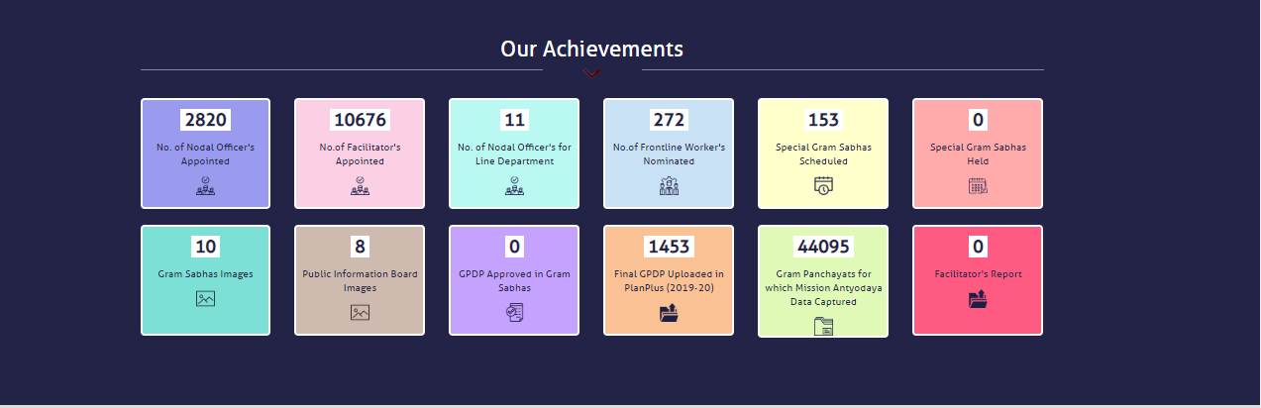
Our Achievement - Screen

Slide 20
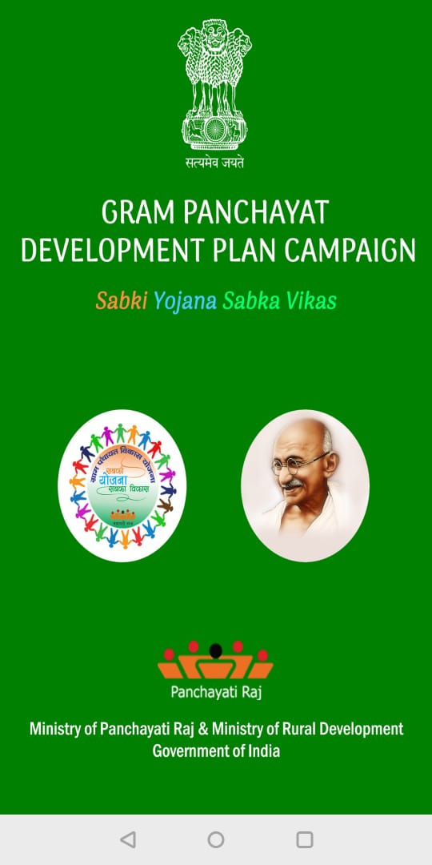
Mobile App - ‘GPDP Facilitator Report’
Android Mobile App:
GPDP Facilitator Report (download from Google PlayStore)
Facilitates
Capture geo-tagged photographs of Gram Sabhas and Public Information Board by Cloud Sourcing and/or Official Login (as in gpdp.nic.in)
Pictures captured by Cloud Sourcing will be published after moderation
Capture Facilitators Feedback Report
Available in English & Hindi
Google PlayStore

Slide 21
Control Room / Technical Support
Email Support
gpdp.mopr@nic.in (for entire GPDP campaign)
nictech-ma@nic.in (for Mission Antyodaya & PlanPlus related queries)
Helpline numbers (9am to 8pm; All working days)
011-23074309
011-23386556
011-23383816
011-23386140

Slide 22


