Slide 1
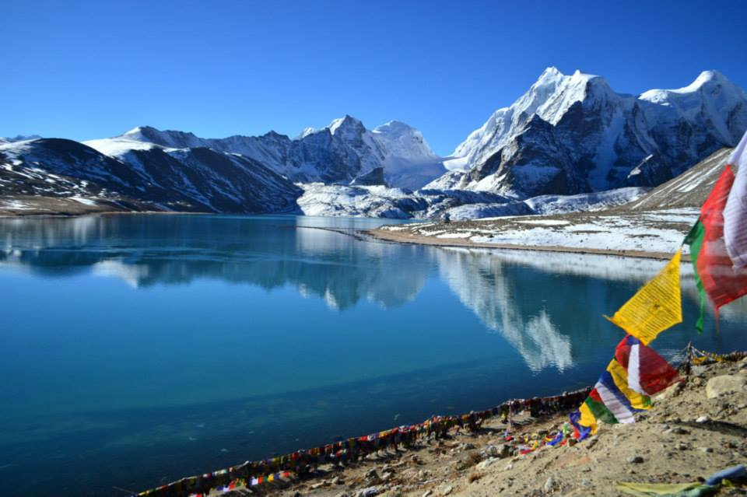
Directorate of Panchayat Raj, RM&DD
Government of Sikkim
SABKI YOJANA SABKA VIKAS
People’s Plan Campaign: Preparedness for Activities & Action items

Slide 2
SABKI YOJANA SABKA VIKAS
Preparedness, action Taken/initiated
DATE | ACTIVITY | STAKEHOLDERS | ASSIGNED TO
10.09.2018 | Correspondence/ intimation about the campaign, Coordination Meeting, ToT of Master Trainers and Training of FFs. Circular for appointment of Facilitators | Line Departments and other Cells of RM&DD, ADCs (Dev.), DPOs, BDOs, ZPs, GPUs Banks, BSNL, SHGs, CBOs and NGOs. | DoPR
13.09.2018 | Preliminary meeting of SIRD&PR Team to finalize the draft activity calendar | SIRD&PR & DoPR | SIRD&PR

Slide 3
SABKI YOJANA SABKA VIKAS
Preparedness, action Taken/initiated
DATE | ACTIVITY | STAKEHOLDERS | ASSIGNED TO
14.09.2018 | Meeting with Field Facilitators (SIRD&PR) | SIRD&PR | SIRD&PR
15.09.2018 | Finalization of Gram Panchayat wise activity calendar and ToT | GPU | DoPR
18.09.2018 | Coordination meeting with Line Department for appointment of Nodal Officer and Frontline Officials | Line Departments and other Cells of RM&DD, ADCs (Dev.), DPOs, BDOs, ZPs, GPUs Banks, BSNL, SHGs, CBOs and NGOs. | SIRD&PR

Slide 4
SABKI YOJANA SABKA VIKAS
Preparedness, action Taken/initiated
DATE | ACTIVITY | STAKEHOLDERS | ASSIGNED TO
20.09.2018 – 21.09.2018 | Training of Master Trainers at SIRD&PR, Karfectar. | FF, PMU and respective Nodal Officers of Line Department | SIRD&PR
24.09.2018 | Training of Field Facilitators (District wise) | VAA, PDA, ITA, PAA, SHGs, CBOs, NRLM, NERLEP, Frontline Officials | SIRD&PR
25.09.2018 – 30.09.2018 | Display of Public Information Board Invitation/intimation to Line Departments for PRA exercise for GPDP 2019-20 | GPU ZP, GPU, Line Departments, RM&DD, SHGs, CBOs, NGOs and citizens | DoPR GPU

Slide 5
SABKI YOJANA SABKA VIKAS
Preparedness, action Taken/initiated
DATE | ACTIVITY | STAKEHOLDERS | ASSIGNED TO
02.10.2018 | Gandhi Jayanti Inauguration of People’s Campaign SPARSH Leprosy awareness campaign Discussion on GPDP campaign preparedness | ZP, GPU, Line Departments, RM&DD, SHGs, CBOs, NGOs and citizens 4 Gram Sabhas supported by SIRD&PR | GPU, Health Care, Human Services & Family Welfare Department, RM&DD and SIRD&PR
04.10.2018 –10.10.2018 | Block Level Training for FFTs | FF, SHG, frontline officials | SIRD&PR
11.10.2018 –13.11.2018 | PRA exercise/Ward Sabhas/ GPF Meeting | ZP, GPU, Line Departments, RM&DD, SHGs, CBOs, NGOs and citizens, Line Department | GPU, Line Departments, DoPR and SIRD&PR

Slide 6
SABKI YOJANA SABKA VIKAS
Preparedness, action Taken/initiated
DATE | ACTIVITY | STAKEHOLDERS | ASSIGNED TO
14.11.2018 – 24.11.2018 | Special Gram Sabha for finalization of GPDP 2019-20 | ZP, GPU, Line Departments, RM&DD, SHGs, CBOs, NGOs and citizens | GPU, Line Departments, DoPR and SIRD&PR
26.11.2018 - 30.11.2018 | Uploading photographs/reports of Special Gram Sabha | GPU, DoPR | GPU, DoPR
26.11.2018 - 05.12.2018 | Publishing of approved GPDP 2019 – 20 on Plan Plus | GPU, DoPR | GPU, DoPR

Slide 7


Thank You

Slide 8

Sikkim- Key Statistics
Geographical area -7096 Sq km.
Capital- Gangtok.
District- 4.
82% under forest cover.
Total Population - 6,10,577 (Source - Census 2011).
Rural Population- 4,56,992 (Source - Census 2011).
Population Density persons/km² – 86.
Literacy Rate - 81.4 %
Home to ethnically diverse communities– Bhutia, Lepcha and Nepali, Business Community.

Slide 9
Panchayati Raj in Sikkim
Panchayati Raj in Sikkim functioning since 1965.
Sikkim Panchayat Act, 1993 adopted in the light of 73rd Amendment of the Constitution.
Two Tier Panchayati Raj system i.e
  Zilla Panchayat.
  Gram Panchayat.
Devolution of 3Fs- 2003.
50% reservation for women in the Year 2012.
Making Panchayats institutions for the Poor.
Panchayat people partnership.

Slide 10
Decentralization
Well defined legal entitlements of PRIs through Legislation
Transfer of Institutions & staff
Transfer of Financial Resources
Capacity Building initiatives taken up by SIRD&PR
State of the art infrastructure

Slide 11
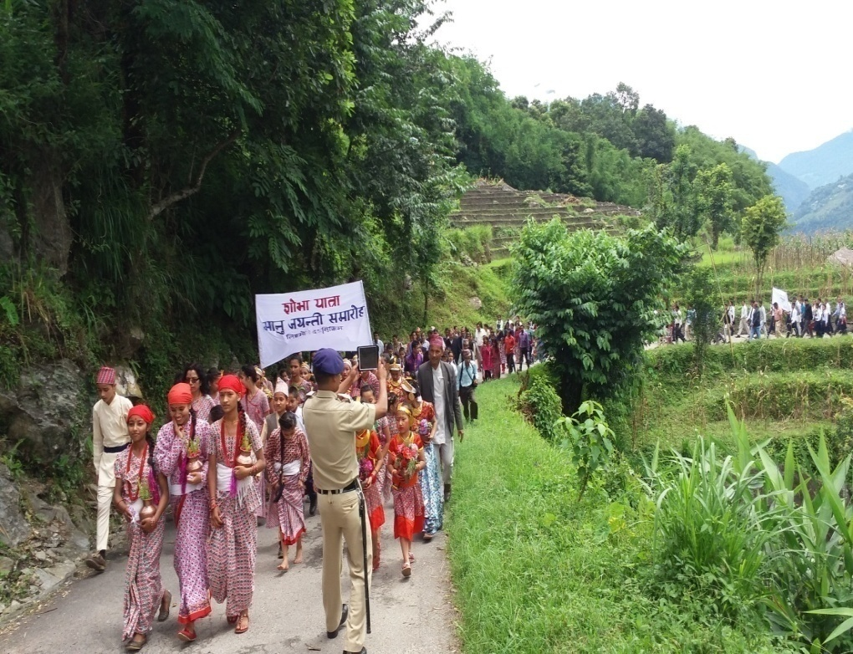
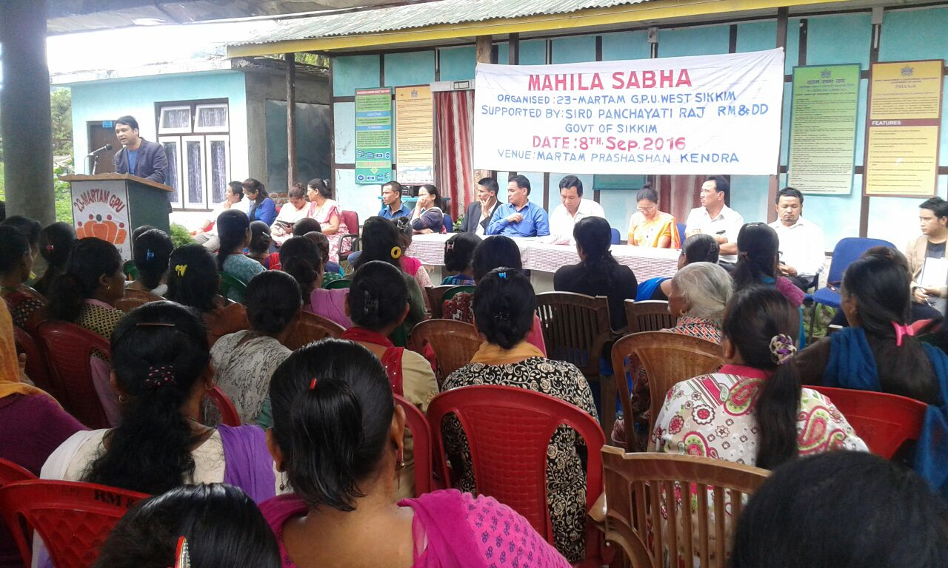
People centric development.
Deepening of democracy.
Primacy to Gram Sabha.
Independent social audits for accountability & transparency.
Leading by example:-
  Eligibility Criteria for Election/ Benefits- Eg:Sanitation Certificate
  Zero Waste Protocol.
Notes:
Also effective social audits have played an important role in ensuring public accountability

Slide 12
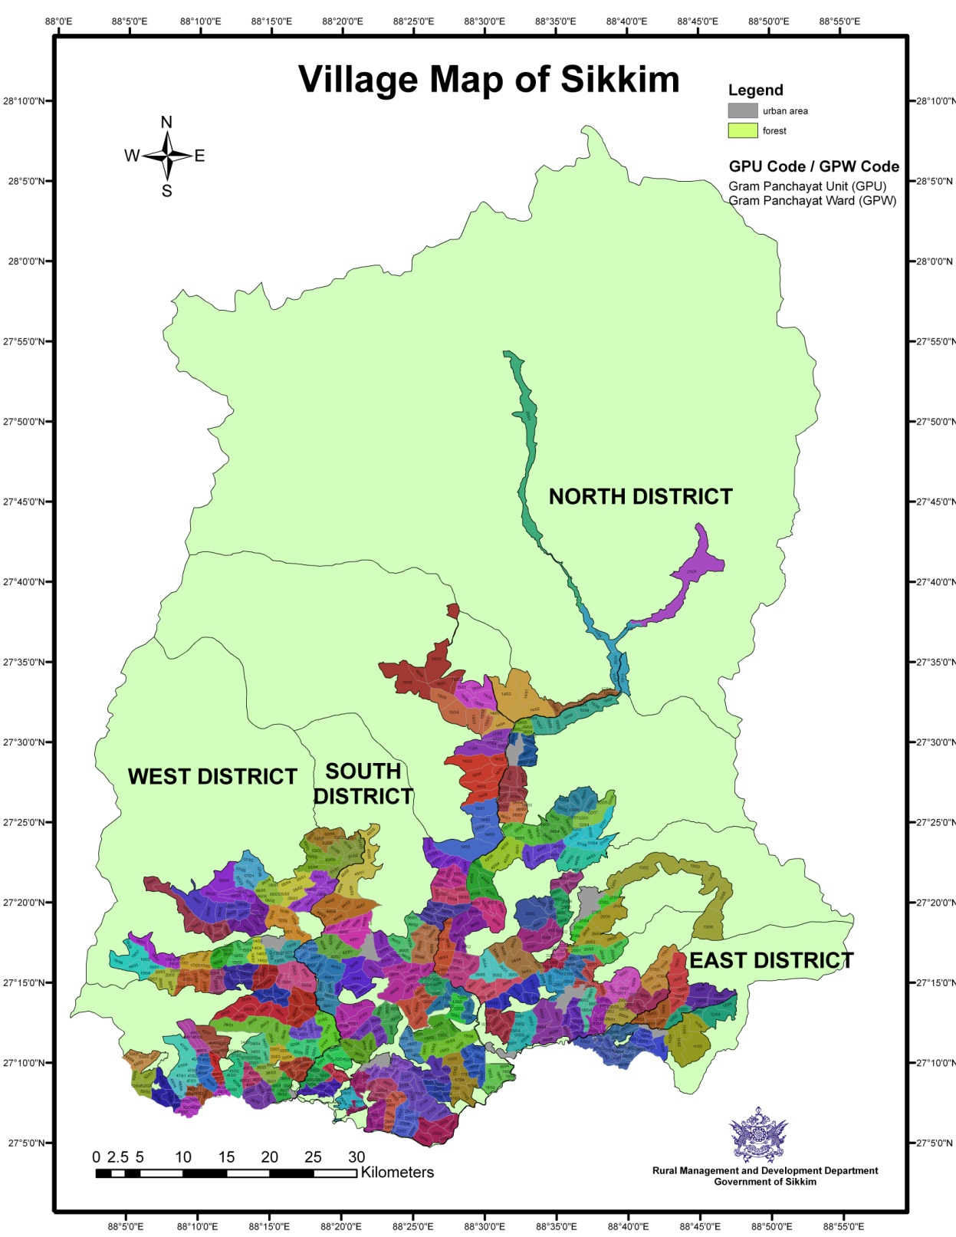
ZP | No | ZP Members (2017)/ TC
NORTH | 1 | 30
EAST | 1 | 24
SOUTH | 1 | 28
WEST | 1 | 31
TOTAL | 4 | 113
 | 2017
District | GPU | GPW
NORTH | 25 | 126
EAST | 51 | 283
SOUTH | 48 | 283
WEST | 61 | 348
TOTAL | 185 | 1040

Slide 13
Responsibilities transferred to PRIs
Activities identified under the following:-
Agriculture & Food Security
Horticulture & Cash Crops
Animal Husbandry, Livestock, Veterinary Services
Education
Health & Family Welfare
Forests, Environment and Wildlife
Disaster Management
Irrigation
Cultural Activities
Rural Water Supply
Rural Bridges
Rural Sanitation
Commerce & Industries
Cooperatives
Miscellaneous
All Centrally Sponsored Schemes

Slide 14
Dzumsa
Dzumsa, a traditional democratic institution of local governance is in existence for decades in the two villages of Lachen and Lachung in the North District of the State. The headman is called ‘Pipon’.

Slide 15
Gram Panchayat Administration
At the Gram Panchayat level ‘Gram Prasashan Kendras’ have been constructed for Village Level Administration.
These have offices for all Panchayat Members and village level functionaries along with a conference hall and a rural library.
These offices are typically located in the central Ward of the GPU.

Slide 16
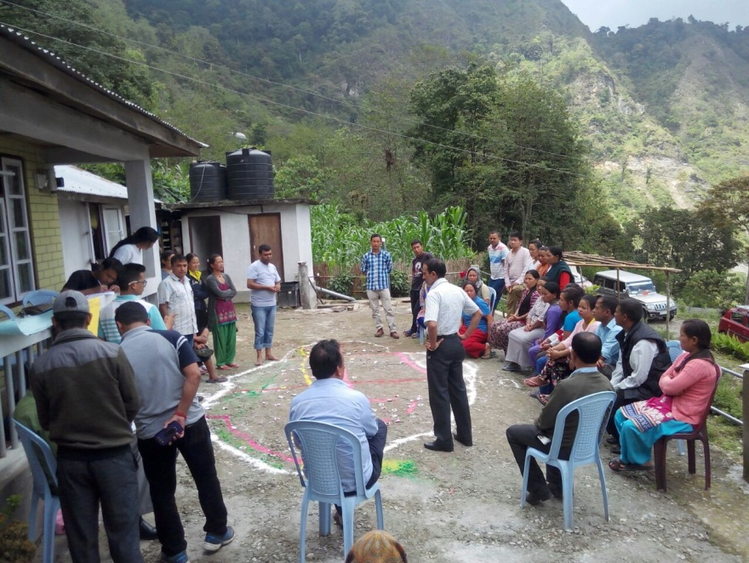
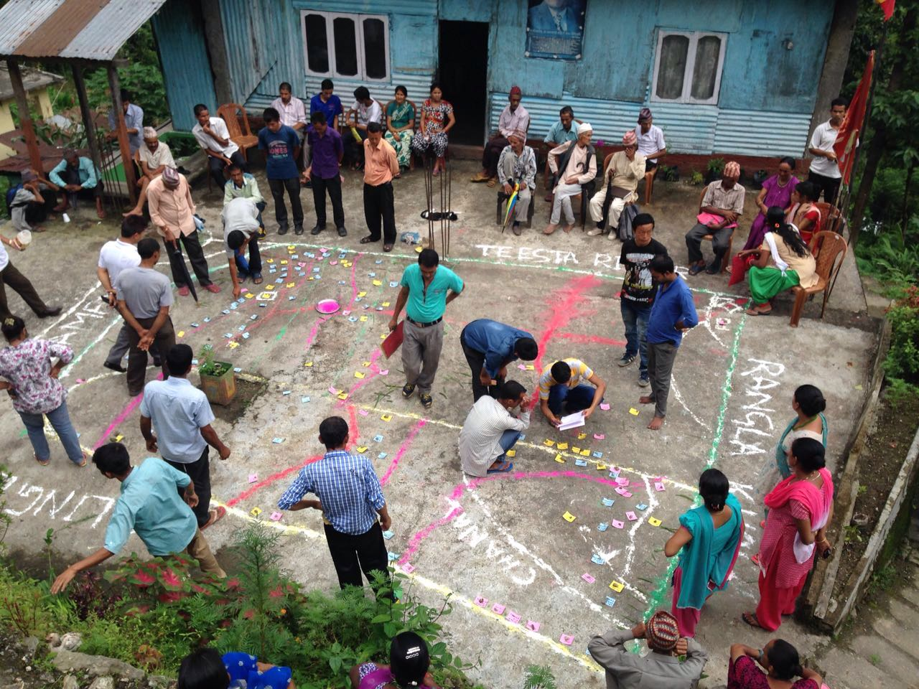
Gram Panchayat Development Plan (GPDP)
Focus on
    Basic Services
  Non Infrastructural Component-
      Human Development targets- to improve quality of life
    Socio-Economic development
  Zero Cost Initiatives- Costless development
  Integration of Sustainable Development Goals
PRA Exercise
People Participation

Slide 17
Resource Envelope for GPDP
  FFC Grant
  4th SFC Grant
  Pooling of Resources from:
    MGNREGA/SBM
    Own Resources
    Fund devolved from Line Departments
  Voluntary contributions and services
  Donations
  Corporate Social Responsibility (CSR) initiatives

Slide 18
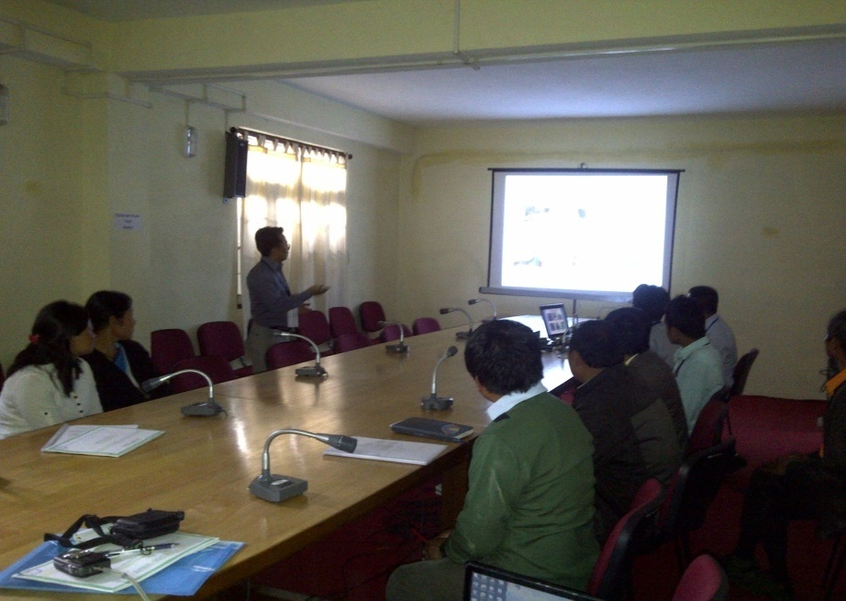
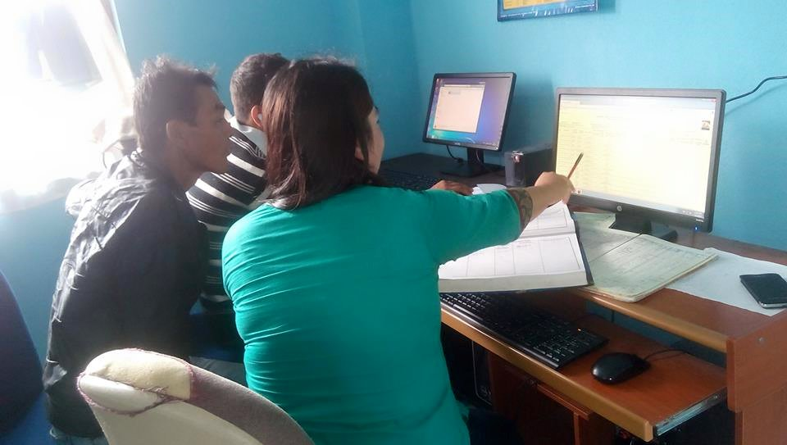
RGPSA/ RGSA- Social Sector Intervention
Manpower support
  176 Panchayat Development Assistant (PDA)
  31 Information Technology Assistants (ITA)
Infrastructural development at GP level
  Construction of Village administrative Centre: 8
  Repair of VAC: 13
  SPRC – 1 (Under Progress)
  DPRC – 1 (Under Progress)
Peer Learning through Exposure visit (Within/Outside State)
IEC Activities
State Panchayat Resource Group under eEnablement/PMU

Slide 19
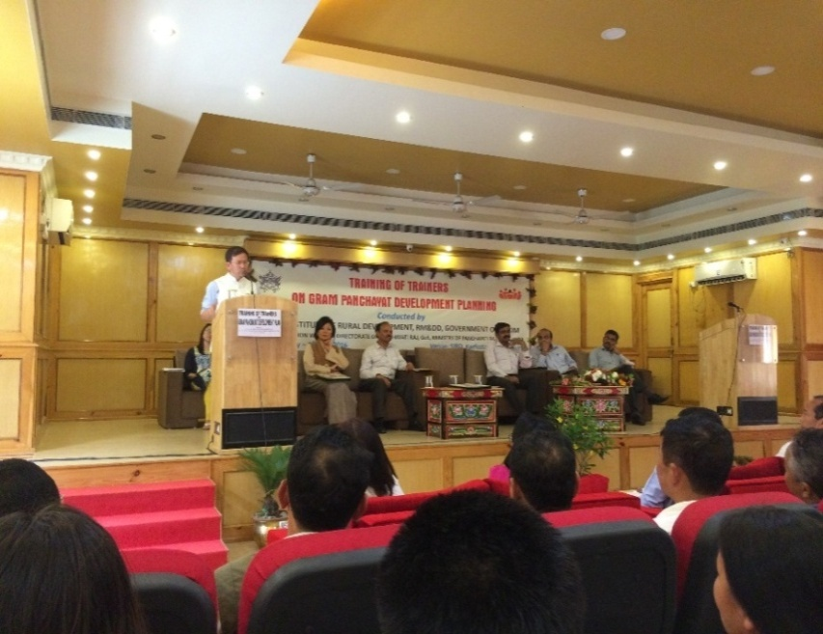
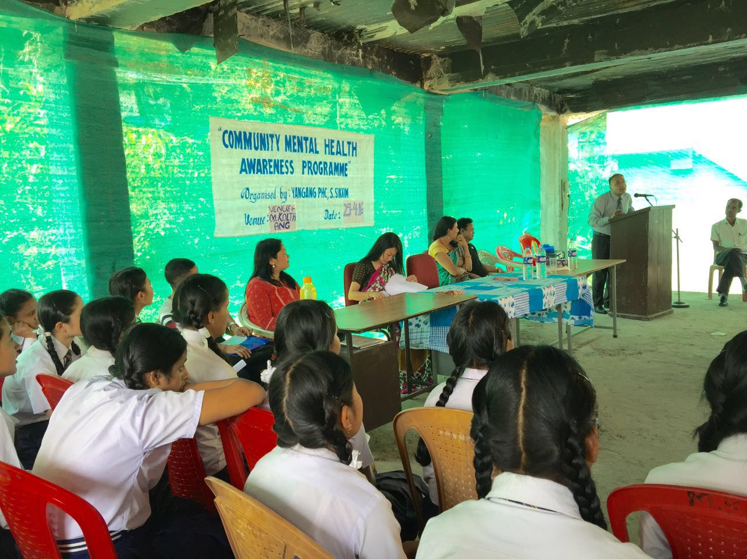
Capacity building under RGPSA/RGSA
Capacity building
  Focus
    GPDP
    Sustainable Development Goals
    Gram Panchayat Functioning & Gram Sabha
    Leadership Development
  Other Trainings
    Recordkeeping & Budgeting
    Leadership Development vis-à-vis Beacon Panchayats
    TOTs for Resource Person/Master Trainer
    e-Panchayat
  Area of SDG proposed for training
    Mental Health
    Agriculture/Horticulture convergence
    Climate Change
    Sanitation

Slide 20
E-PANCHAYAT MISSION MODE PROJECT (MMP)
Sl No | Name of the Application | Implementation | Remarks
1 | Local Government Directory (LGD) | Yes (100%) | All ZP and GP data are entered as per 2012 Delimitation
2 | Plan Plus | Yes (100%) | GPDP Plans entered
3 | PRIASoft | Yes | Day to day entry is being made by PDAs with constant assistance from the State PMU Team.
4 | National Asset Directory (NAD) | Yes | Details are entered as per new assets created under BRGF. Other asset details are also being entered.
5 | Action Soft | Yes | Details are entered as per Plan Plus and progress of BRGF Plan.
6 | Area Profiler | Yes | Elected member details are entered. Other village profile details are being entered after training of PDAs
7 | National Panchayat Portal | Yes (Nascent Stage) | Technical Assistants are being trained for implementation.
8 | Meeting Management and Training Management | Yes | State PMU team and SIRD will be entering details in this application
9 | Social Audit | Yes | Details are to be entered but due to technical glitches progress has been halted
10 | ServicePlus | Nascent Stage | Service frameworks are prepared by State NIC team and will be operational very soon.
11 | mAsset | Yes (100%) | A part of NAD, mAsset is mobile asset mapping and has been done thoroughlythroughout the State.

Slide 21
Challenges
Topographical Challenges.
Sparse population leading to very low
  Financial Entitlement.
  Avenues for revenue generation.
Salary of Contractual Employees.
Internet Connectivity in interior GPs.
Disparity in entitlements as per Finance Commission Recommendation

Slide 22
Thank You

