Slide 1
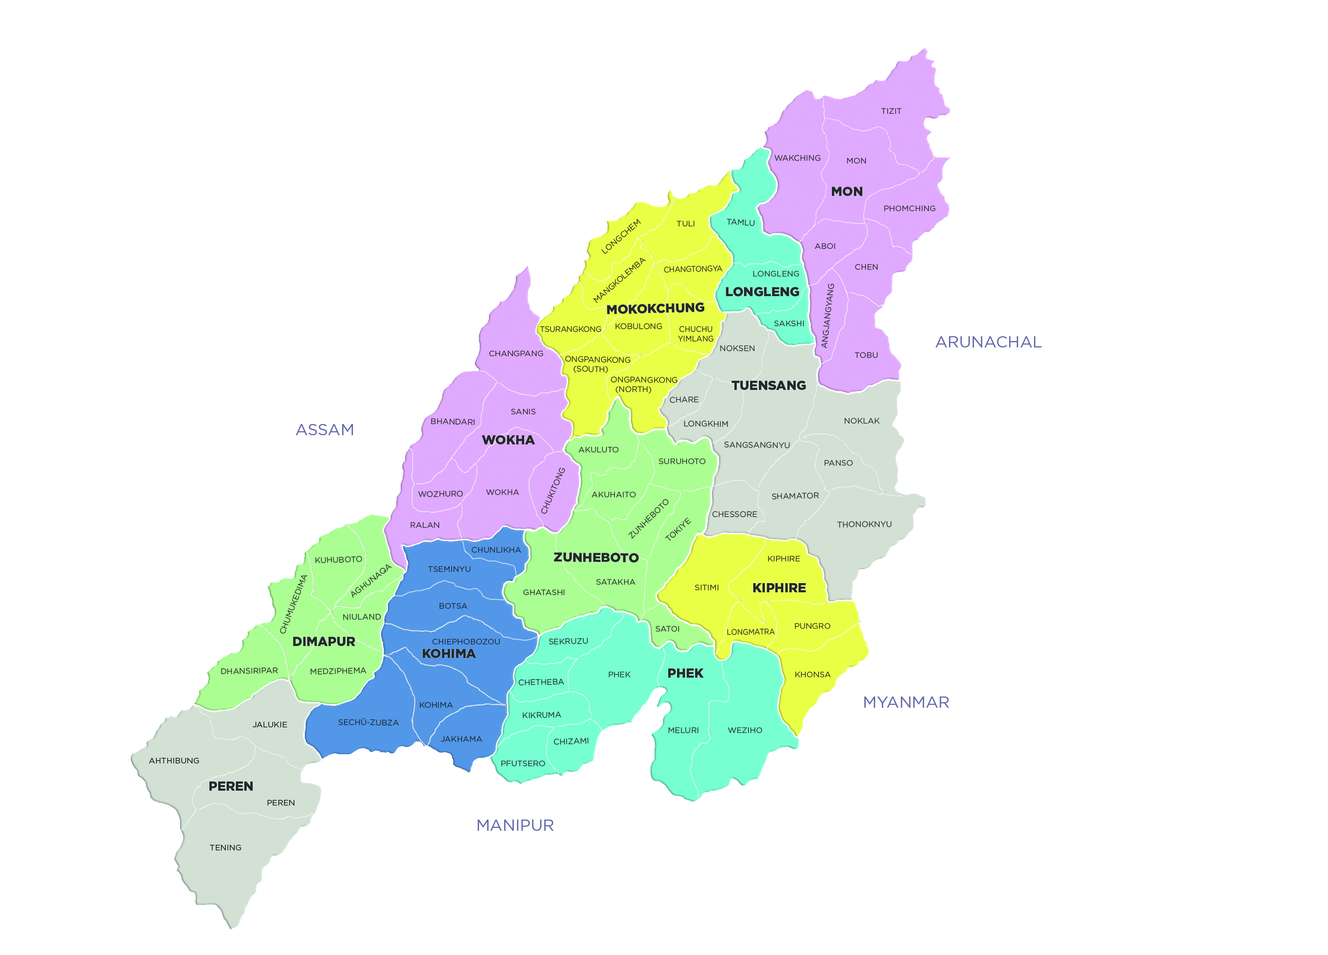
Government of Nagaland
Department of Rural Development

Slide 2
STATE BASIC INFORMATION
Total Area : 16,579 Sq. Kms.
Total Population : 19,78,502
Population Growth : -0.58%
Rural Population : 14,07,536 (71.14%)
Urban Population : 5,70,966 (28.86%)
Sex Ratio : 931 F : 1000 M
Literacy Rate : 79.55%
a. Male : 82.75% (7,23,957 persons)
b. Female : 70.01% (6,18,477 persons)
BPL during 2011-12 : 18.88% (3,76,000 persons)
Official Language : English
No. of District : 11 Districts
No. of Block : 74 Blocks
No. of Village : 1,238 VDBs
State Boundaries : East - Myanmar & Arunachal Pradesh
West - Assam
North - Assam & Arunachal Pradesh
South - Manipur

Slide 3
Rural Community Empowerment
The concept of Village Development Board (VDB) began to take shape during the 7th Plan Period.
The idea of grass-root level planning and development became a reality in 1980-81.
The Constitution of the VDBs from 1980 onwards.
Presently all VDBs in the State are legislated empowered bodies through the Model Rules 1980 and Nagaland Village Council Act 1978.

Slide 4
Salient Features of VDBs:
The State of Nagaland have been exempted from purview of the 73rd Amendment of the Constitution due to the existence of traditional local self-government bodies like the Village Councils and the VDBs.
Incepted and started functioning as the primary grass root level developmental organization in the State of Nagaland from 1980 onwards.
Primary objective is to achieve de-centralized planning through involvement of the VDBs at the grass-root level.

Slide 5
VDBs function under the control of Deputy Commissioners, who operate as ex-officio Chairman VDBs and as also the Village Councils concerned.
VDBs are responsible for preparation of Annual Plan, its implementation and proper utilization of funds.
All bonafide citizens of village constitute the General Body of the VDB with rights to decisions and demand to Social Audit of accounts and activities.
Management Committee of VDBs have a secretary with 25% compulsory representation of woman as its members

Slide 6
Mandatory VDB General Body meetings of the Village are to be conducted twice a year; and
Monthly meeting of the Management Committee is pre-requisite for the functioning of the VDBs.
All Schemes are identifies and selected on local priority based needs in these meetings.
Agendas and prioritized schemes are submitted to approval to the General Body Meeting.
Activities of the VDBs are prominently displayed for general information.

Slide 7
All Schemes of the Department of Rural Development are being implemented by the VDBs through the DRDAs and Blocks.
All Schematic funds are directly released and deposited into their respective accounts which is operated jointly by the CEO, DRDA, Project Director DRDA and the VDB Secretary.
All funds of the VDBs are released only through a resolution passed by the general Body.
Auditing is mandatory every year by a Committee selected by the Chairman VDB.

Slide 8
Tentative People’s Plan Campaign for preparation of GPDP
(Sabki Yojana Sabka Vikas)
Date | Activities | Venue | Remarks
21st Sept. 2018 | Line Departments consultative meeting | Chief Secretary’s Conference Hall | Action – Secretary RD
21st – 30th Sept 2018 | Baseline Survey of GPs under Mission Antyodaya | Remaining 991 VDBs | Action - NSRLM
22nd Sept 2018 | RD, SIRD & NSRLM officers meeting and appointment of State, District, Block Facilitators, VDB Secretaries and Frontline workers from the Line Departments. | RD Conference Hall, Kohima | Under the chairmanship of Secretary, RD.
22nd Sept 2018 | Awareness through bulk SMS, flexi-banners, Radio, Local TV Channel, Whatsapp and Local Newspapers. | 1238 VDBs, 74 Blocks, 11 Districts, 4210 SHGs and 244000 households | Action - RD & NSRLM
24th – 25th Sept 2018 | Training of ToT (District level) officers from all allied/line Departments. | SIRD Kohima | 50 Trainees to be trained. Action - SIRD
25th-30th Sept 2018 | Installation of Public Information Boards and wall writing. | 1238 Villages | Action - VDBs/VCs & BDOs

Slide 9
Date | Activities | Venue | Remarks
26th – 29th Sept 2018 | Training of Block Level Officials and facilitators. | 74 Blocks | State/District level ToT
2nd Oct 2018 | Commencement of preparation of draft VDB Plan & Celebration of 150th Birth Anniversary of Mahatma Gandhi and validation of survey data. | 1238 VDBs | To be overseen by Line Departments, BDO, Village Council and VDB Secretary
3rd Oct – 9th December 2018 | Conduct of VDB Meeting: 1st, 2nd & Final Phase. | 1238 VDBs | In co-ordination with all concerned Line Departments. (Subject to the approval of the State Government)
10th Dec – 20th Dec2018 | Uploading of GPDP to MoPR for 2019-20 | State | Rural Development Department

Slide 10
THANK YOU

