Slide 1
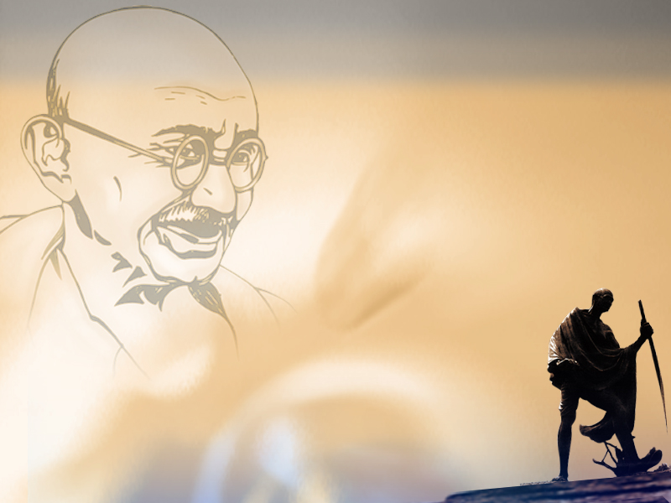
People’s Plan Campaign – Karnataka Initiatives
SABKI YOJANA SABKA VIKAS
Government of Karnataka
RURAL DEVELOPMENT AND PANCHAYAT RAJ DEPARTMENT, KARNATAKA

Slide 2
The team from Karnataka participated in the workshop held at NIRD&PR, Hyderabad.
Secretary, Panchayat Raj, RDPR, Chaired a meeting of the Stakeholders to initiate People’s Plan Campaign in the State – 06/09/2018

Slide 3
State Government has appointed Director, Panchayat Raj – 2 as Nodal Officer at the State Level.
  Chief Executive Officer, ZP, will monitor all the operations related to People’s Plan Campaign in the District.
  Chief Planning Officer, Zilla Panchayat, to be the Nodal officer at the District Level.
  Executive Officer, Taluka Panchayat, to be the Nodal officer at the Taluka Level.
  CEO/EO will nominate a Nodal Officer for each of the GPs

Slide 4
Master Trainers were trained at NIRD&PR, on 06th & 07th September 2018.
DPMUs will be District Level Master Trainers
DPMUs will train PDOs of all the GPs on the Mobile application for capturing the data in Mission Anthyodaya formats.
Training for DPMUs and PDOs to be
organized during 3rd and 4th
week of September 2018.

Slide 5
State Nodal Officer has issued detailed Guidelines on operationalizing People’s Plan Campaign in the State
Dates for capturing Mission Anthyodaya data on mobile app will be finalized by the State Nodal Officer.

Slide 6
PDO, Gram panchayat, will be the facilitator at the GP level and will be assisted by the GP Staff and other GP level functionaries
ANSSIRD & PR will train all the facilitators on People’s Plan Campaign.

Slide 7
People’s Plan Campaign
Namma Grama Namma Yojane (NGNY)
Focus on All Inclusive Development

Slide 8
Strengthening of NGNY
NGNY to focus on attaining SDG targets at GP level.
Focus of NGNY on Aspirational Districts and Mission Anthyodaya GPs
Ensure PRI – SHG Convergence at GP level
Focus on Vulnerable Groups especially SCs, STs, Gender and child issues.
Identification Cost Effective or No cost development activities
Sectoral convergence of GP activities with RDPR, Health, Education and WCD
Convergence of GP activities with intermediate and District Panchayats

Slide 9
Institutionalisation of Decentralised Planning System in Karnataka
State Plan
Karnataka State Decentralised Planning & Development Committee (KSDPDC)
Sec. 310
District Planning Committee (DPC)
Sec. 310
District YSS
Respective ULBs
Taluk Planning & Development Committee (TPDC)
Sec. 309 D
Taluk YSS
Respective ULBs
Grama Panchayat
Sec. 309 B
GP YSS
Grama Sabha
Sec. 3
Ward Sabha
Janavasati Sabha

Slide 10
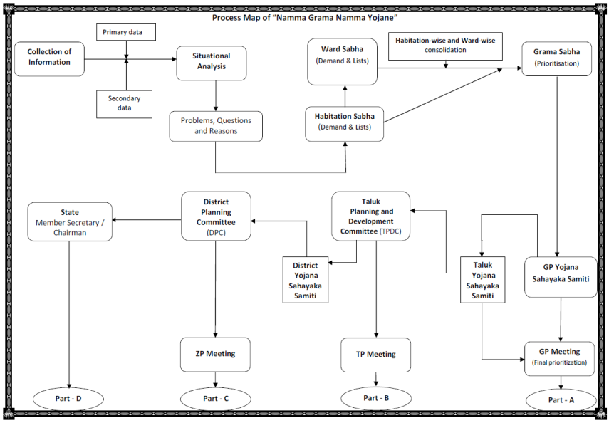
Planning Process – Flow Chart

Slide 11
NGNY Initiatives during People’s Plan Campaign
Identification of Anganawadi Worker, ASHA Worker and one School Teacher in each of the 6024 Gram Panchayats
To provide hand holding support to PDOs in the preparation of plan document.
Mobilization of SHGs members for
People’s Plan Campaign and preparation of NGNY for the year 2019-20

Slide 12
PDO along with other grassroot functionaries to orient SHG members on the activities of Women and Child Development, Health, Education and RDPR activities
Orient SHG members on PRIs-SHGs convergence, Human Development and Sustainable Development parameters
Including the above parameters in the situation analysis report of NGNY

Slide 13
Time line for NGNY Activities
Issue of State Guidelines on People’s Plan Campaign and NGNY
SHG members to be trained by the facilitators at the door step of GPs – 1st week of October 2018
Gram sabha dates to be scheduled between October 15th to November 15th

Slide 14
Mission Anthyodaya data to be placed before the gram sabha for validation - scheduled between October 15th to November 15th
Identification of activities to be carried out by the Gram Sabha based on the situation analysis report.
Gram Panchayat Yojana Sahayak Samithi to finalize the activities of PRIs - between November 15th to November 30th

Slide 15
Gram Panchayat meeting to finalize the GP plans – December 1st to December 10th 2018
Entry of GP plans on Plan Plus Software – December 10th to December 15th 2018

Slide 16
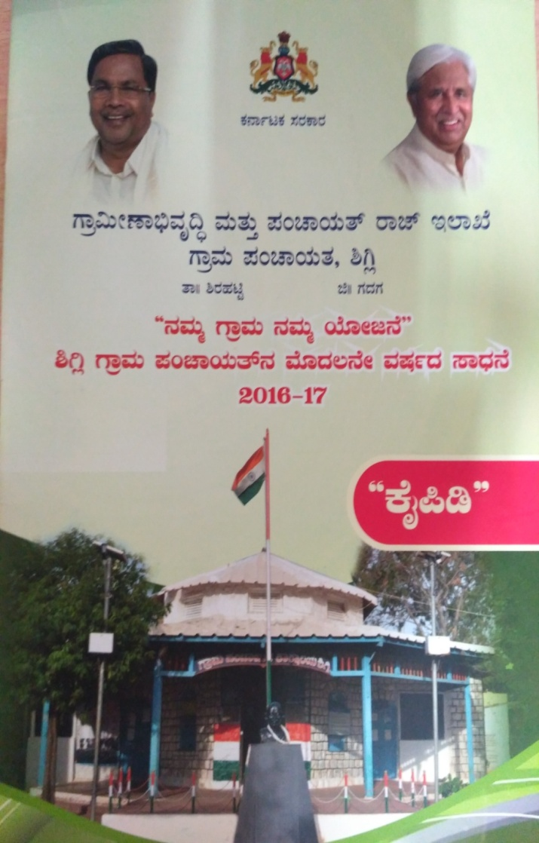
NGNY Progress Report Prepared by Suranagi Gram Panchayat containing schemes of all 28 Departments and list of nearly 15000 Beneficiaries that was placed before Gram Sabha

Slide 17
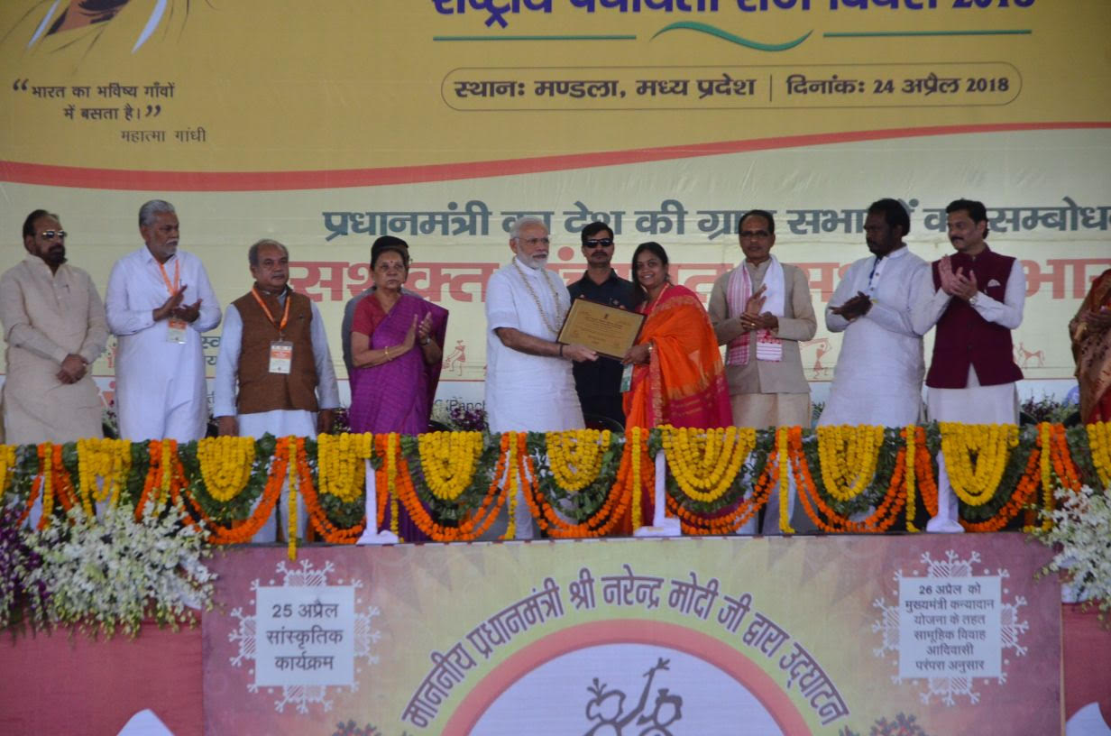
Panchayat Development Officer, Malangi GP receiving the Best GPDP award from Honourable Prime Minister, on National Panchayat Diwas

Slide 18
Looking Ahead
State has earmarked Rs.10 Crores for awarding the Best NGNY prepared by GPs in the state – Rs.10 Lakhs each for 100 GPs in the state
Mysuru and Gadag districts provided with Rs.2.5 crores each for strengthening and Institutionalizing the Decentralised Planning Process in the district
Reaching the Unreached in Capacity Building – Establishing SATCOM Receiving terminals at GP level – State has provided Rs.7 crores this year.
Preparation of GP Link Document
State circular for including all development schemes of other departments in NGNY (GPDP)

Slide 19
THANK YOU

