Slide 1
Panchayati Raj Dept, Bihar
“Sabki Yojana, Sabka Vikas”
-- Status of Preparations
Kuldip Narayan,
Director Panchayati Raj, Bihar.

Slide 2
Activities to be ensured
Gram Sabha on 2nd October and two more Gram Sabha between 2nd October – 31st December.
Mandatory Participation of Key Departmental Functionaries
  All 29 subjects
  Special focus on Agriculture, Infrastructure, Social development
Community Mobilization and Smooth Conduct of Gram Sabha
Basic Social and Economic Assessment – Mission Antyodaya Rankings
Use of Mission Antyodaya App (MA App) and MoPR portal for reporting

Slide 3
Participatory GPDP
Training of State Level Master Trainers at NIRD on 6-7 Sep
Training of District Master Trainers at State HQ on 13- Sep
Block Level Task Force of BDO, BPRO, BAO and PO-MNREGA
Appointment of Facilitators from Jeevika, MNREGA – PRS, Agriculture.
Finalization of Gram Sabha Calendar and Activities
Training of Facilitators between Sep 17 – 30 at District/Block Level
Three Gram Sabha in each Panchayat – 2nd October, Baseline and Discussion, Finalization of Plan.

Slide 4
Activities Done
Training of State Level Master Trainers at NIRD on 6-7 Sep
Block Level Task Force of BDO, BPRO, BAO and PO-MNREGA formed.
State Level Co-ordination among Panchayati Raj Dept (PRD), Rural Development Dept (RDD) and Jeevika.
Identification of Facilitators to be finished by 13th September
Consolidated Instructions Draft ready. It will be released on 14th Sep State level workshop

Slide 5
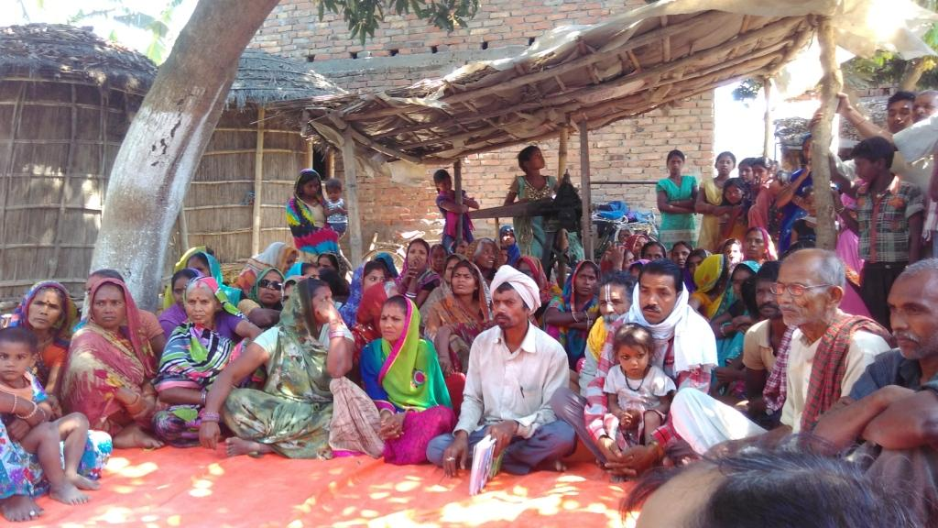
People Participation and ownership
Crux of the Activity
Thing we should always remember : People Participation and ownership

Slide 6
Thank You !!

