Slide 1


Mission Antyodaya
An Android App for Village Infrastructure Baseline Data Collection Under Mission Antyodaya

Slide 2
Objectives
To Survey and Collect The Village Infrastructure Data for all the Villages in the GP.
The Data is Aggregate Level data
The Data Collected Will be used for creating a Baseline for Mission Antyodaya Programme
In Phase -II, All remaining GPs (approx. 2 lakh) have been selected by the states.

Slide 3
Tools To Be Used
Smart phone or Tablet
Mobile App ‘Mission Antyodaya’
Mission Antyodaya Portal - http://missionantyodaya.nic.in
Census 2011 Village Level Data will be Used as Reference/Guidance to the Data Collection Officials. ( To the extent Feasible).

Slide 4
Types Of Users
Gram Panchayat Officer (CRP etc.)
  Main functionary involved in the field survey
Block/District/State Level Officer
  Ensure that all the GP offered by the state have been enabled for survey.
  Ensure That All the Villages under the GP are available and correctly mapped to GP/Block.
  Authorization of Field Officers for enabling their Login.
  Monitoring Of Work Progress.
  MIS

Slide 5
Master Management System
A separate Master Management module is available to update the Block/GP/Village mapping
Three type of users can access this portal i.e. District/Development Block/Gram Panchayat User
Following features are available;
Marking of Gram Panchayat for data collection by District User
To ensure that Gram Panchayat is mapped to the correct Development Block.
To verify by Block User that all GPs and Villages are mapped to right jurisdiction
All the Villages of Gram Panchayat are available in the village dropdown list and there is no additional village mapped.
Mission Antyodaya User credentials will work on this portal
If any changes are done in the LGD Master Directory, then the Mission Antyodaya user has to update the location master from this portal also

Slide 6
Log in Process
Download the Mobile App and Install
Self Registration
Authorization by Controlling Authority
  State Nodal Officer authorizes the District Level Officer
  District Level Officer will authorize the block level officer and GP Level Officer
First Time Login using OTP
Ready for Data Collection and Uploading

Slide 7
Mobile App Requirements
Android Smart phones/Tablets with minimum 1 GB free storage
First Time login and Any Subsequent password Change are OTP based and requires
  Mobile Data/Wi-Fi Connection for Communicating to the Server
  Mobile Network Connectivity to Receive SMS of OTP.
Subsequent Data Entry Operations can work even when data connectivity is not available.
The App Stops Working if GPS is Disabled.
Intermediate Data Can be saved to local storage.
Data can be synched with the central server directly from the mobile or copied to a broadband connected laptop/desktop and uploaded.
The Mobile App Installed on a Phone is locked to a Single User, and can be used by Other User only after completion of assigned GP.

Slide 8
Data Updating Process 1/7
The Mobile App will be available on the Mission Antyodaya Portal and Google Playstore
The Name of the App is ‘Mission Antyodaya’
Download the App directly into the Mobile OR Copy the signed APK file from other device using any file transfer.
Download
Mobile App
The GP Officer Registers using Mobile for login creation.
The corresponding District officer approves/ activates the login.
After activation the GP officer can login and Access the the main dashboard of the App.
Creation Of Login

Slide 9
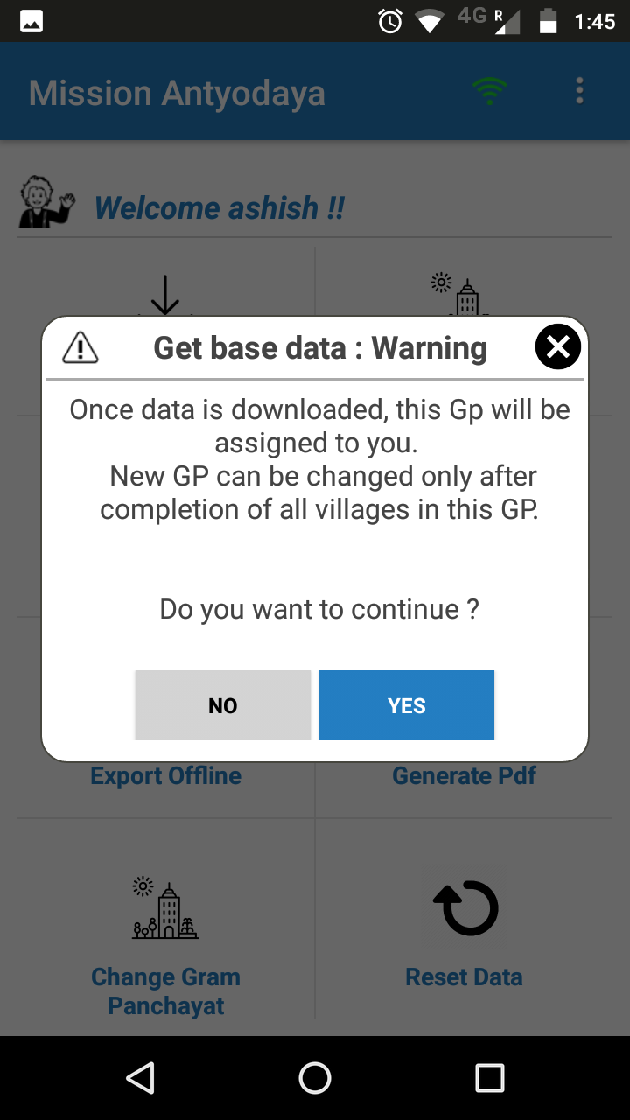
Data Updating Process 2/7
Download Base Data
The ‘Get Base Data’ Feature of the Mobile App is used to Fetch the Village Wise Census 2011 data of the GP from the central Server,
The Data for all the Villages in the GP is downloaded as a single packet.
Now, all Villages under the GP are accessible to user.

Slide 10
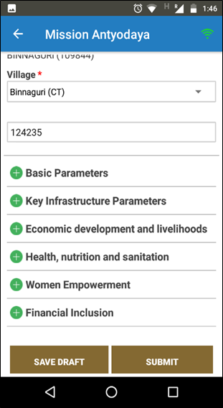
Data Updating Process 3/7
Survey Data Entry/Submit Data
Village-wise data will be updated and user to select village from the dropdown
No internet or data connectivity is needed during the data entry.
The data is saved in local storage of the mobile.
The questionnaire form can be filled in multiple sessions.
The intermediate data can be saved as draft and editing resumed later.
SUBMIT is used to finalize and lock the data for uploading.
Once the data is finalized for a village the data can not be edited further.
The data can be saved as draft and submit later
It is advised that the data should be pre-viewed before finalization.

Slide 11
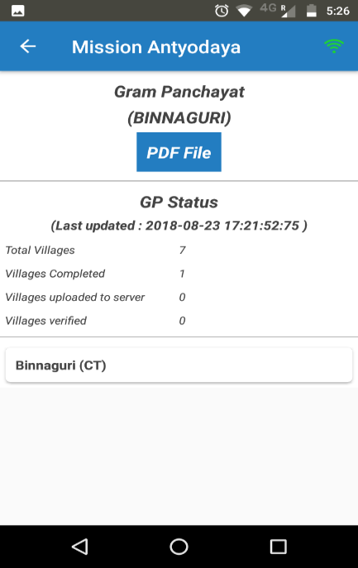
Data Updating Process 4/7
Show GP Data
Preview can be seen using ‘Show GP Data’ feature.
It Provides Summary Status of completion and data uploading for the Villages in The GP .
For the villages where the work is started, the detailed data collected so far can be pre-viewed

Slide 12
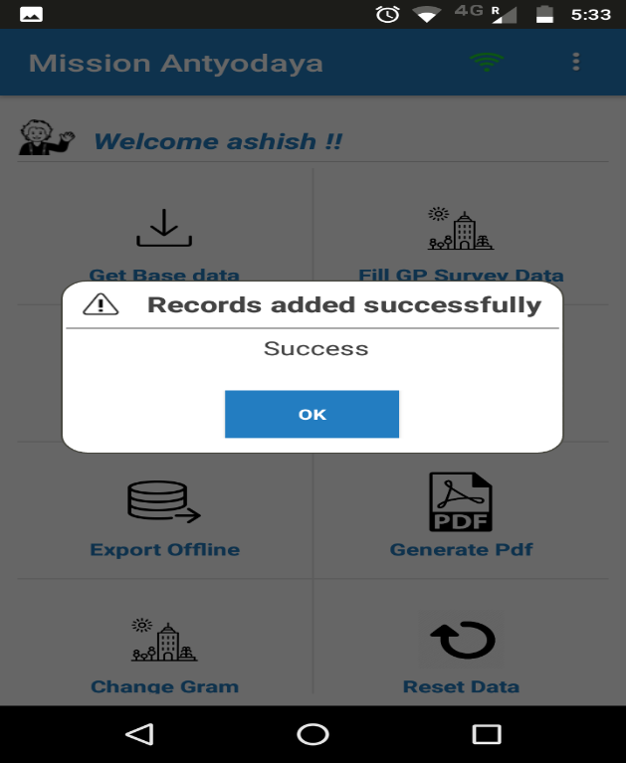
Data Updating Process 5/7
Upload Online
The data can be uploaded directly from the mobile if data connectivity is available.
Data can be uploaded only when at least one village under the GP is finalized.
Data of only finalized/completed villages can be uploaded

Slide 13
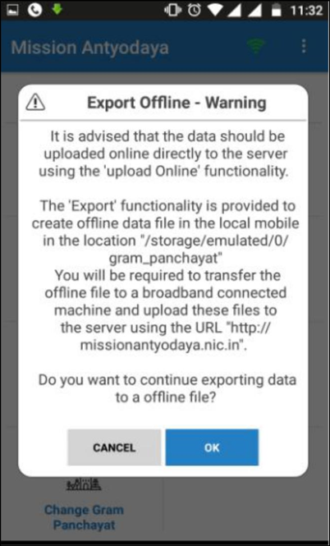
Data Updating Process 6/7
Export Data (Optional)
The feature to be used only when data connectivity is not available for uploading,
The complete GP data after completion of work can be exported to a single data file.
The data file can then be uploaded on the portal using the same login credentials.

Slide 14
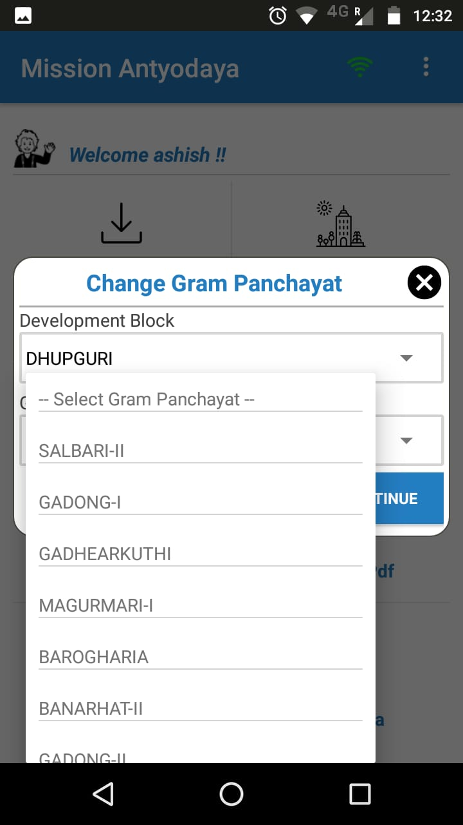
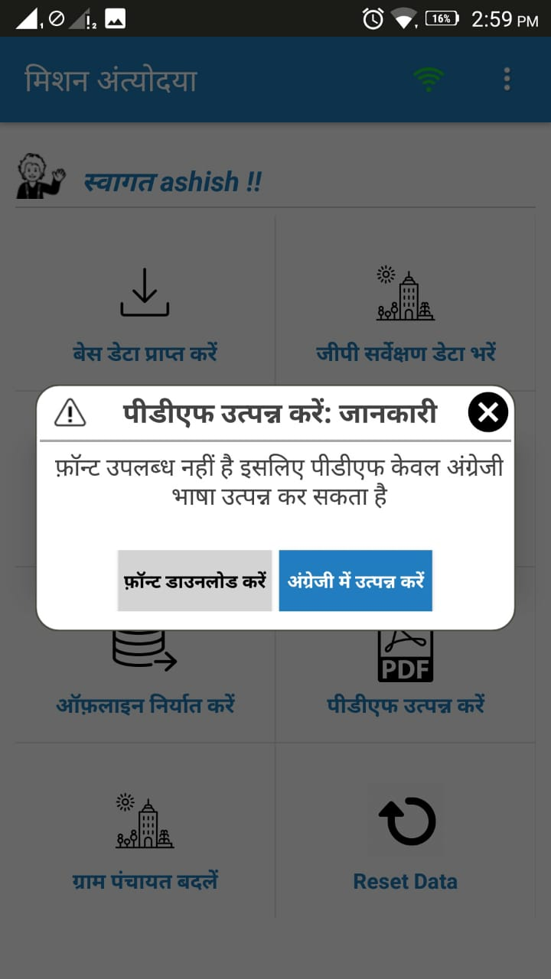
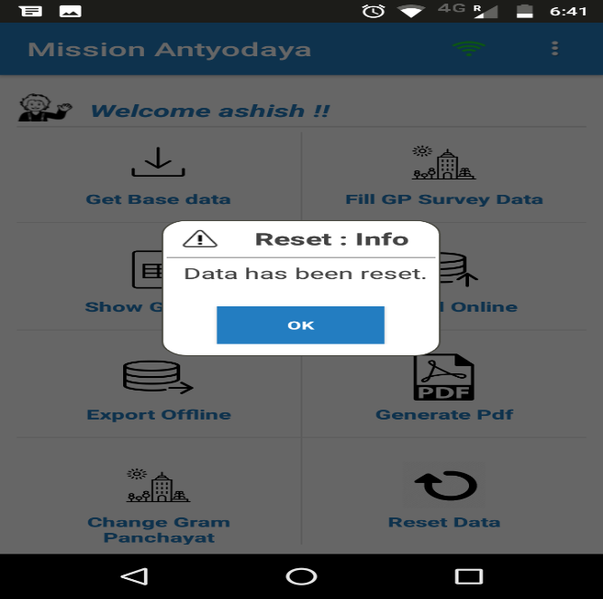
Data Updating Process 7/7
Reset Data (Optional)
Change GP (Optional)
Generate PDF (Optional)
This feature is available to reset the previous data.
All previous will be lost if user perform this operation
Gram Panchayat can only be changed if all the villages are updated by the user
This option will be available only after completion of all the villages.

Slide 15
Web Portal

Slide 16
Web Portal – Salient Features
https://missionantyodaya.nic.in
User Registration; Role based authorization.
User Approval/Rejection/Deactivation
Download Survey Form
Download PDF
View Updated Data
Upload Exported Data
Data Verification
MIS
Progress Monitoring
Same credential for both Web Portal and Mobile App.

Slide 17
Preparatory Activities
All state/district nodal officers should create login on the portal.
Once login is activated, state/district nodal officers
Should verify that all the GPs under their jurisdiction are listed on the portal
For the GPs with blank/invalid LGD codes, the correct LGD codes should be provided.
For the GPs where block is not provided, the correct block (with LGD codes) should be provided
The GPs should also be verified for any omission/wrong mapping of the villages.

Slide 18
Role-wise Functions
Registration/Sign-up can be done using the App or Portal.
Role | Functionality on Mobile App | Functionality On Portal
GP Level Officer | Fetch census data, Survey Data entry, Data Uploading, Export Data, Generate PDF | Upload the Export File, View GP Data
District Level Officer | For GP and Block Officer within District – Approve/Reject New Registrations Deactivate Existing Logins | For GP and Block Officer within District – Approve/Reject New Registrations Deactivate Existing Logins Monitor Progress of Work in District View Uploaded data of All GPs in District Data Verification by Block user
State Level Officer | For GP, Block and district Officer within State – Approve/Reject New Registrations Deactivate Existing Logins | For GP, Block and District Officer within State – Approve/Reject New Registrations Deactivate Existing Logins Monitor Progress of Work in State View Uploaded data of Any District or GP in the State

Slide 19
Mission Antyodaya Mobile & Web Application – Validation List
Parameter Name | Validation
Pincode | Length should be 6
Total Population | Total Population should be equal or greater than to addition of male and female; cannot be 0
Total Household | House hold can not be greater than total population & cannot be 0
Total No of Self Help Group (SHG) | Self help group can not be greater than total female
Total area of village (in ha) | cannot be 0
Net sown Area (in ha) | cannot be > than total area
Total Unirrigated Land Area (in ha) | Total Unirrigated area can not be greater than total area
Area irrigated (in ha) | Area irrigated can not be greater than total area; (unirrigated + irrigated area cannot be greater than total area)
% of households engaged exclusively in farm/non-farm activities | Total Farm and non Farm Activities should be less than or equal to 100 & <= 100
Total no of household using clean energy (LPG/Bio gas) | <= total households
No of household with kuccha wall and kuccha roof | <= total households
No of total children in the age group of 0-3 years | <= total population
No of children aged 0-3 years registered under Aanganwadi | <= total no of children
No of children aged 0-3 years immunized | <= total no of children
Number of children categorized as Non-Stunted as per ICDS record | <= total no of children
No. of households mobilized into SHGs | <= total households
No. of households mobilized into Producer Groups | <= total households
No. of households supported by village based Agricultural Extension Workers | <= total households
No. of households supported by village based Livestock Extension Workers | <= total households
No. of SHGs accessed bank loans | Bank loans can not be greater than house hold

Slide 20
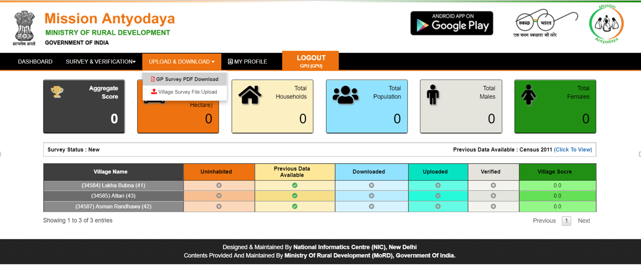
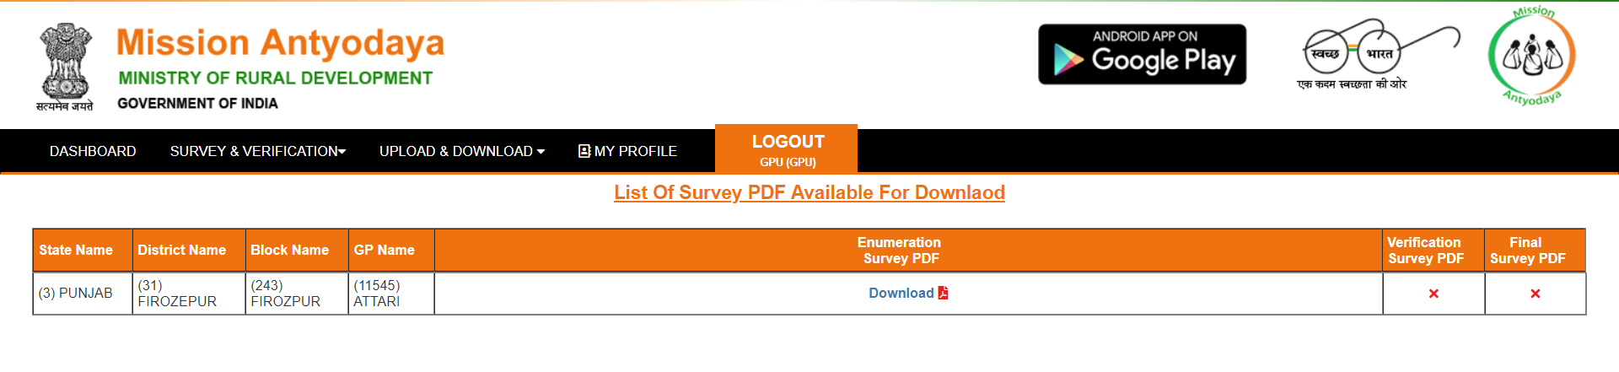
Web Portal – Data Collection 1/4
Download PDF Screen

Slide 21
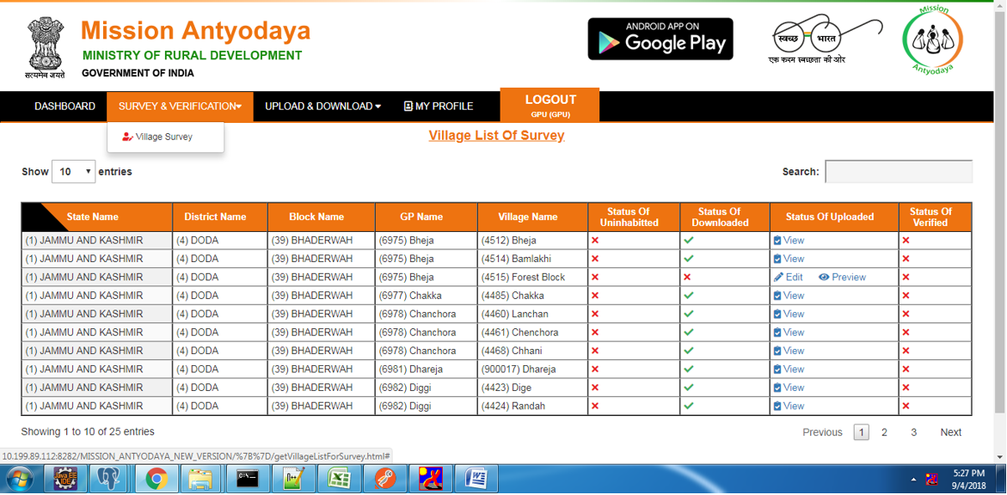
Web Portal – Data Collection 2/4
Village View/Edit/Preview Screen

Slide 22
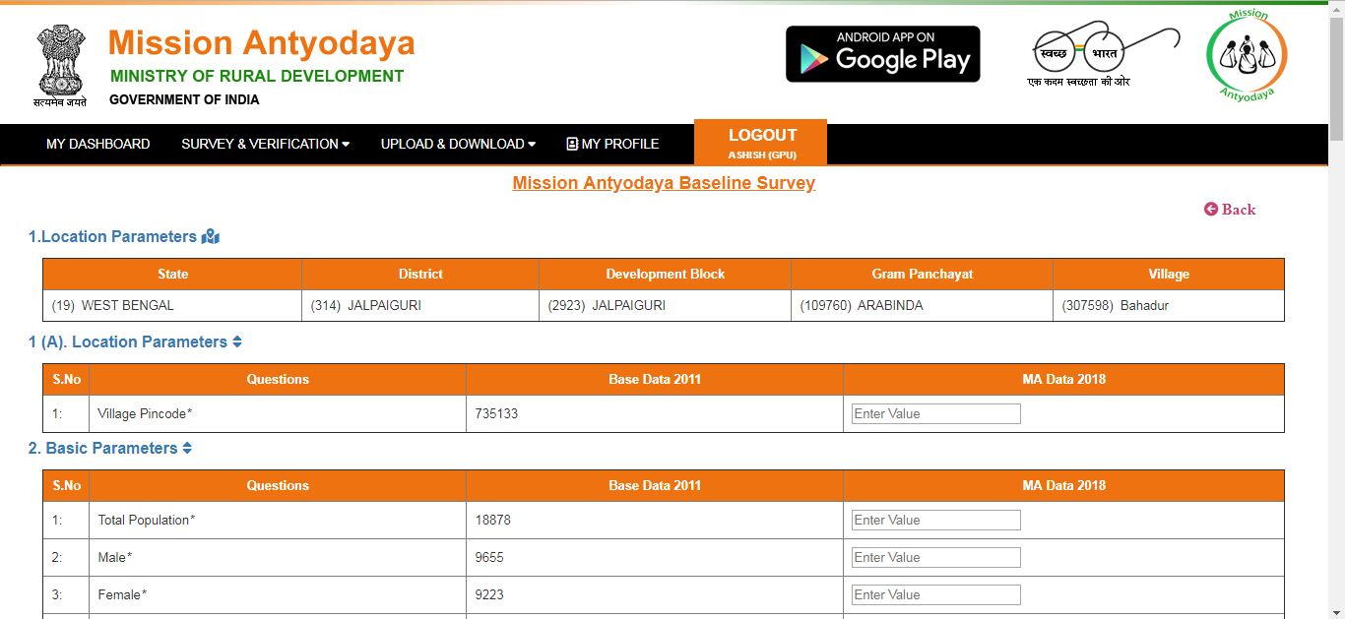
Web Portal – Data Collection 3/4
Entering value in Text Box

Slide 23
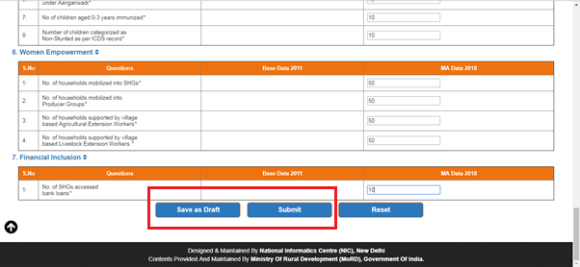
Web Portal – Data Collection 4/4
Saving as Draft or Submit

Slide 24
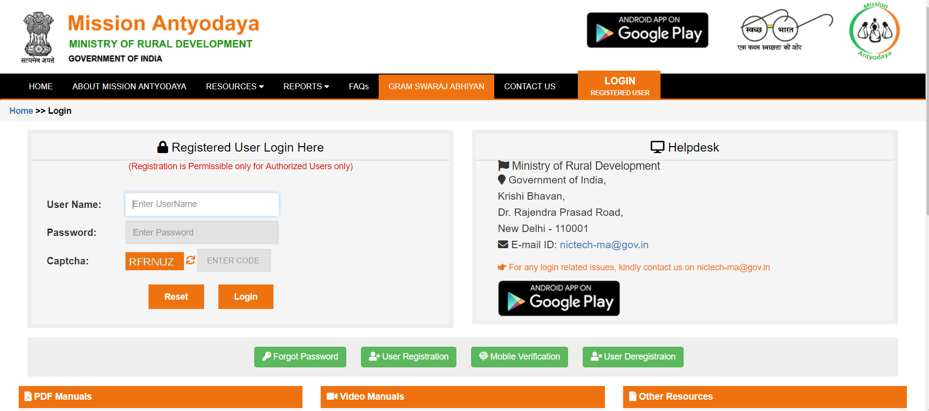
Web Portal - Home

Slide 25
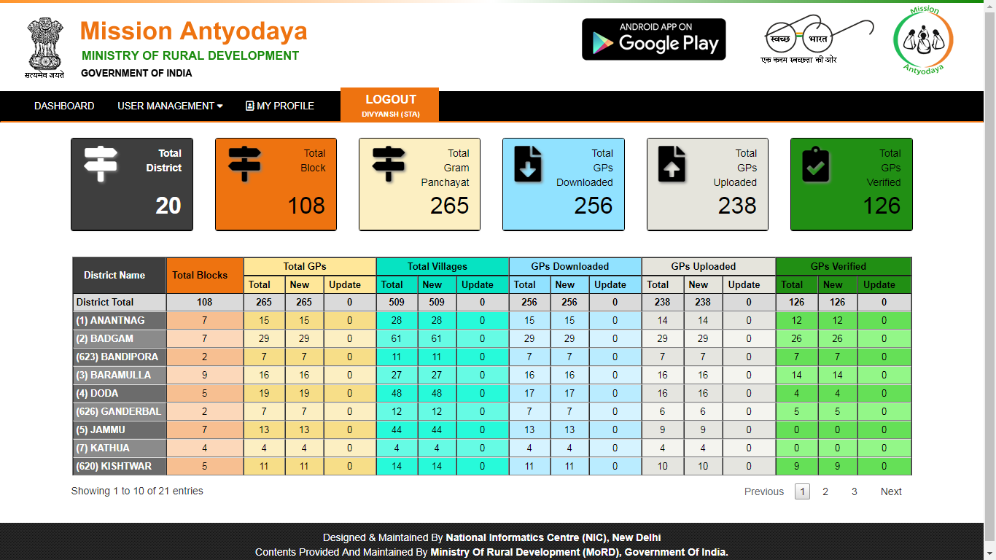
Web Portal - Dashboard

Slide 26
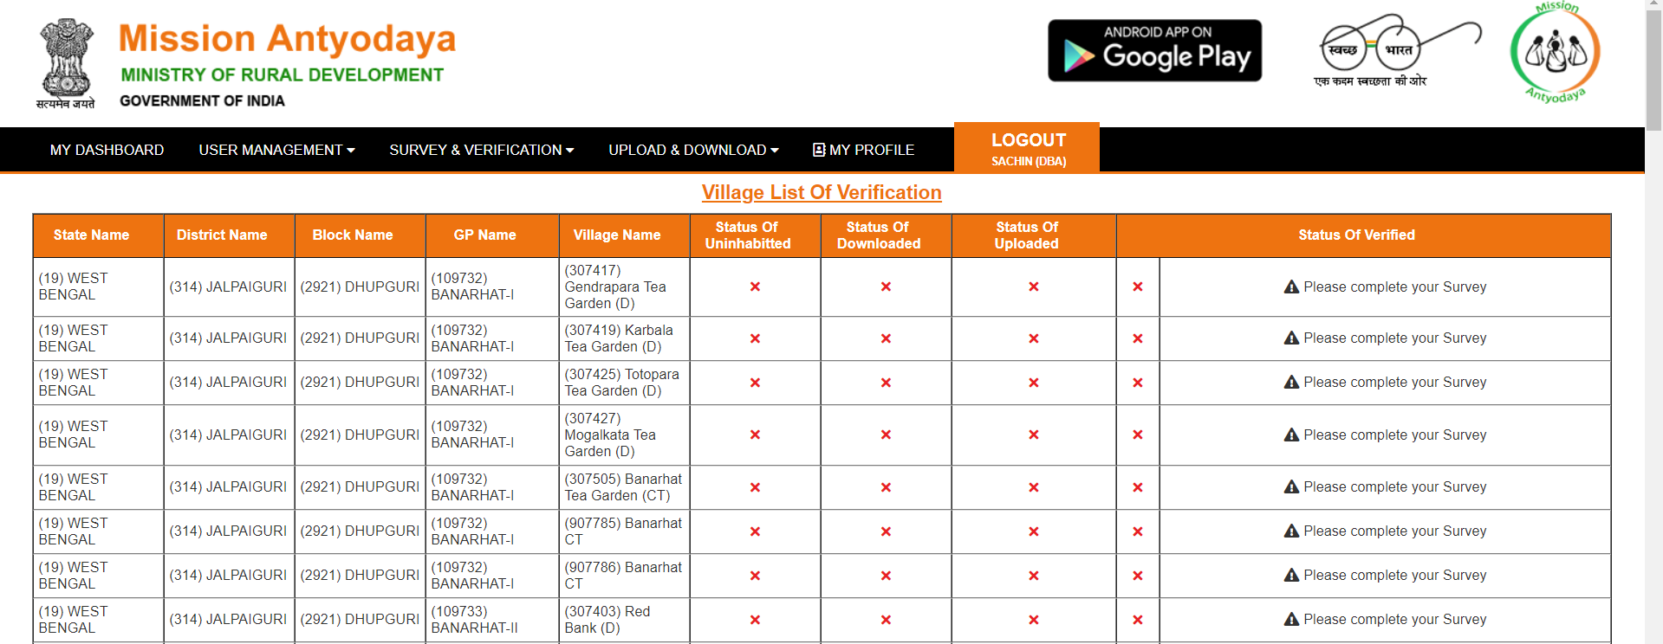
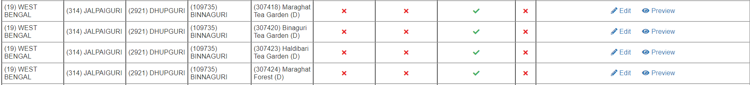
Web Portal – Data Verification 1/2

Slide 27
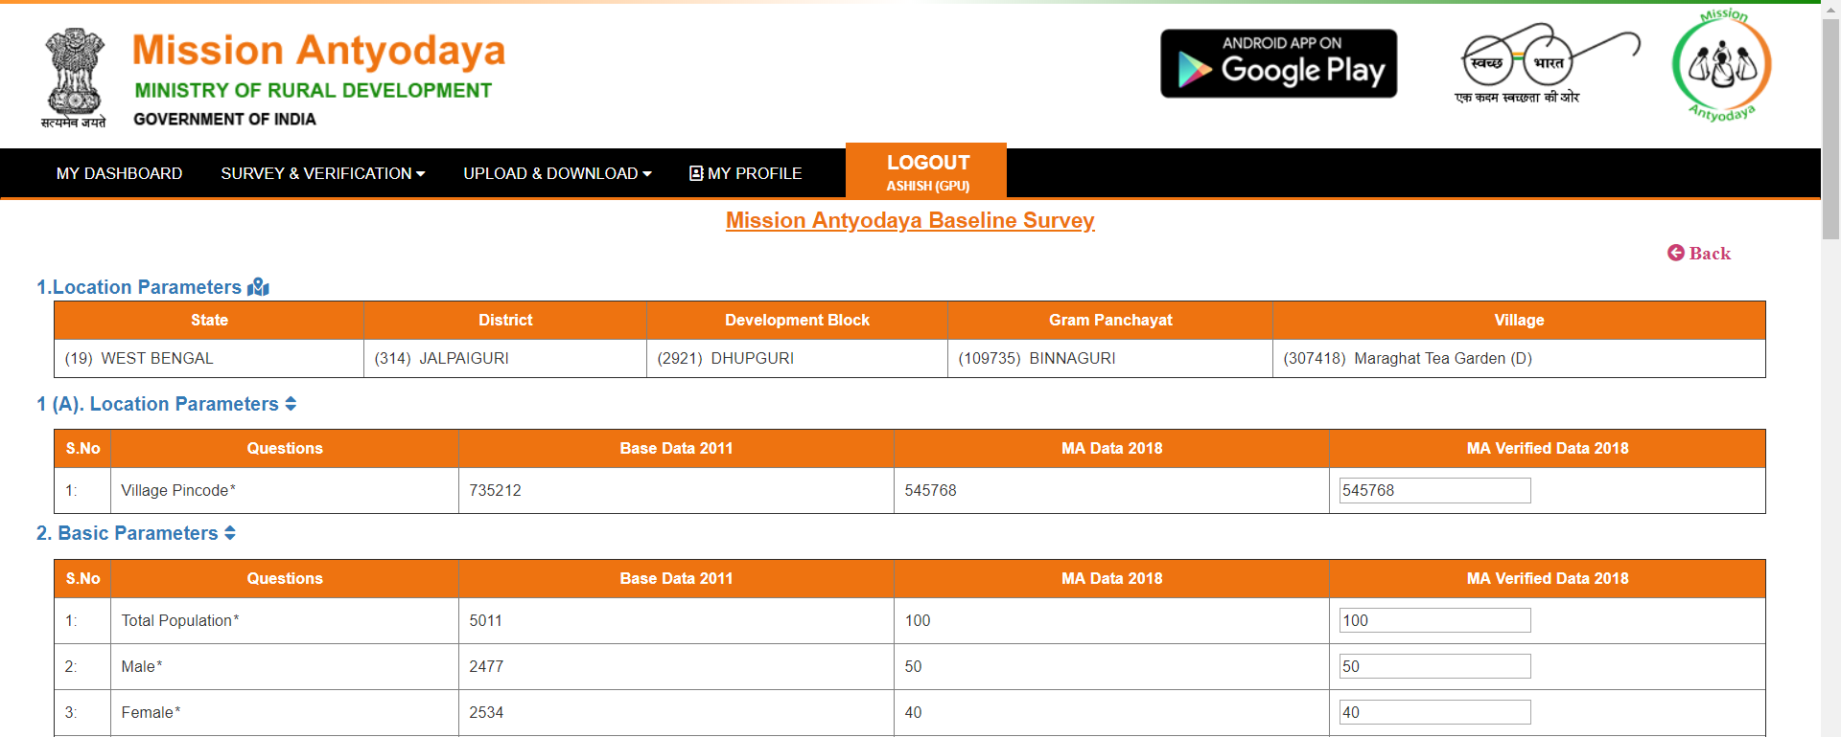
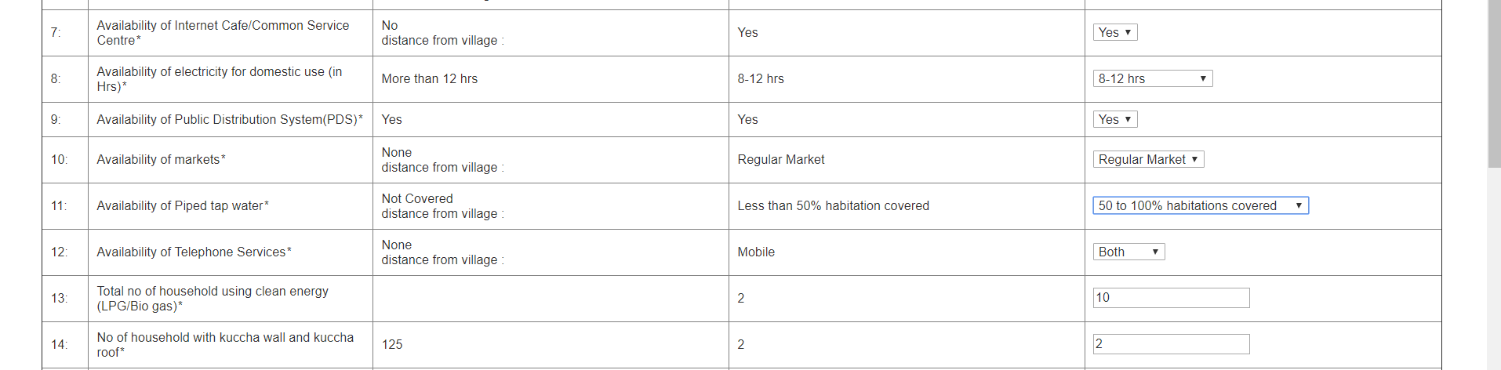
Web Portal – Data Verification 2/2

Slide 28
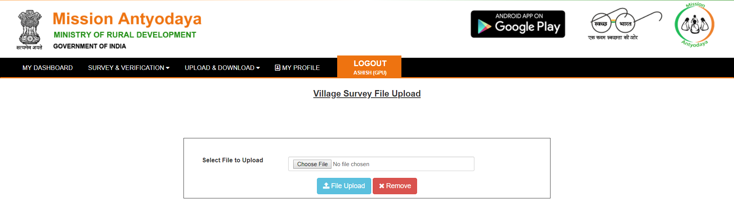
Web Portal – File Upload (Offline data of Mobile)

Slide 29
Thank You

