Slide 1





VILLAGE DEVELOPMENT PLAN:GPDP
People’s Plan Campaign
MY VILLAGE MY PLAN
VDP-GPDP
KA SHNONG JONG NGA:: KA PLAN JONG NGI
2nd October 2018 – 31st December 2018
Sabki Yojana Sabka Vikas

Slide 2
An ideal Indian village will be so constructed as to lend itself to perfect sanitation. It will have cottages with sufficient light and ventilation built of a material obtainable within a radius of five miles of it. The cottages will have courtyards enabling householders to plant vegetables for domestic use and to house their cattle. The village lanes and streets will be free of all avoidable dust. It will have wells according to its needs and accessible to all. It will have houses of worship for all, also a common meeting place, a village common for grazing its cattle, a co-operative dairy, primary and secondary schools in which industrial education will be the central fact, and it will have mechanism for settling disputes. It will produce its own grains, vegetables and fruit, and its own Khadi. This is roughly my idea of a model village...
I am convinced that the villagers can, under intelligent guidance, double the village income as distinguished from individual income. There are in our villages' inexhaustible resources not for commercial purposes in every case but certainly for local purposes in almost every case. The greatest tragedy is the hopeless unwillingness of the villagers to better their lot.
My ideal village will contain intelligent human beings. They will not live in dirt and darkness as animals. Men and women will be free and able to hold their own against anyone in the world.
As Gandhiji himself said, “I know that the work (of shaping the ideal village) is as difficult as to make of India an ideal country... But if one can produce one ideal village, he will have provided a pattern not only for the whole country but perhaps for the whole world. More than this a seeker may not aspire after.”

Slide 3
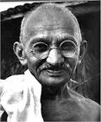
The Greater the power of the Village Governance……….. the better for the people
-Mahatma Gandhi
Haba pynkhraw ia ka bor ka jingsynshar shnong, jingduk la lah ban rat dyngkhong
- Mahatma Gandhi

Slide 4
Kaei ka VDP-GPDP
VDP-GPDP kam dei ka skim sorkar
Ka VDP-GPDP ka dei ka Plan ba sani ba la pynwandur da ka shnong na ka bynta ka shnong bad ki briew ba shong ba sah ha ka.
Ka VDP-GPDP ka thmu ban pynkhlain ia ka synshar shnong na ka bynta ka roi ka par ka shnong (empower it as a development institution)

Slide 5



KA VDP-GPDP ka dei ka plan shnong ba thmu ban
Pynioh ia ki nongshong shnong ka Um bam umdih ba pura, ka jingkhuid (sanitation), ki surok shnong , ki nala,etc
Ban pynkiew ia ka ioh ka kot,ka kamai ka kajih jong kiba duk ha shnong .
Rat dyngkhong ia ka Jingduk da kaba shna ki plan ba sani
Ban pynioh ia baroh ki nongshong shnong ka hok ba dei jong ki:
-ka bylla 100 sngi
-ka pension tymmen
-ka ing shong PMAY-G

Slide 6
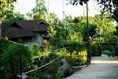
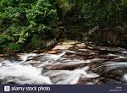


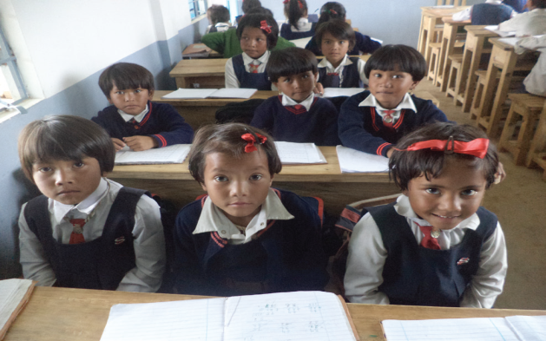
Contd…………KA VDP-GPDP ka dei ka plan shnong ba thmu ban
Ban rat dyngkhong ia ki jait jingpang ha shnong rynkat bad ka jingaiatrei lang ka health department
Ban wanrah ka jingsumar ia ka mariang, ka khyndew, ki lum ki wah, ka khlaw ka btap bad kiwei kiwei da kaba shna ka plan
Ban wanrah ia ka 100 per cent enrolment ha ki skul lyngba ki plan pynbha ia ki skul ha shnong

Slide 7

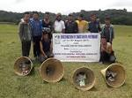

Ban ai lad ia baroh, ki kynthei, ki samla, ki tymmen ki khynnah ban ia shim bynta ha ka ban wanrah ka roi ka par ha shnong
Ensuring (gender equality and equity in all aspects of development)
Ban pynproh ia ka jingmut, jingnang jingstad ki nongshong shnong ha ka rukom synshar bad ban shna ia ka plan shnong ba sani bad janai

Slide 8
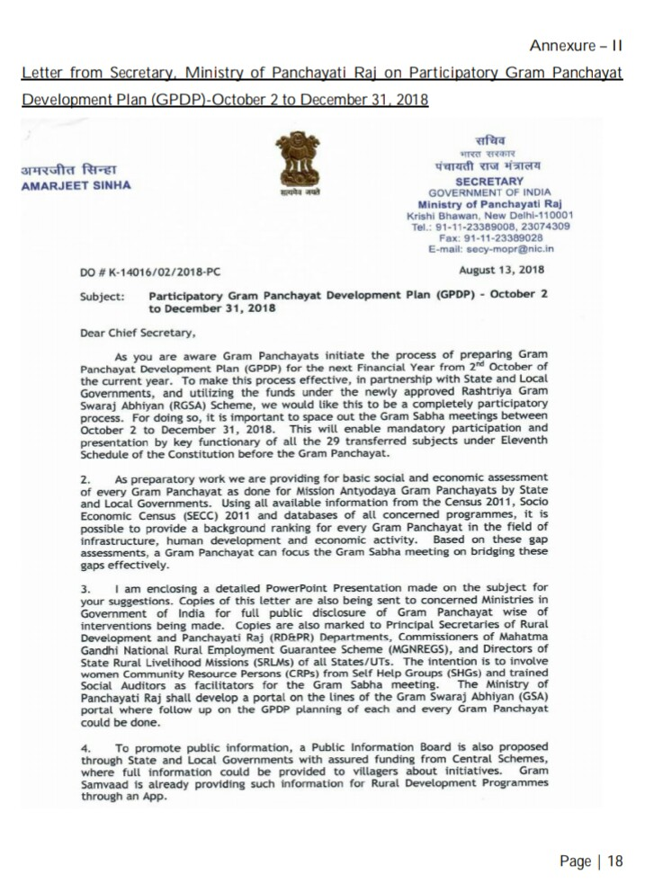
Letter Do No.K.-14016/02/2018 Tarik: 3.Nailar.2018
Na,
U Secretary Ministry of Rural Development
/MoPR
New Delhi, Government of India sha ka Sorkar Meghalaya

Slide 9
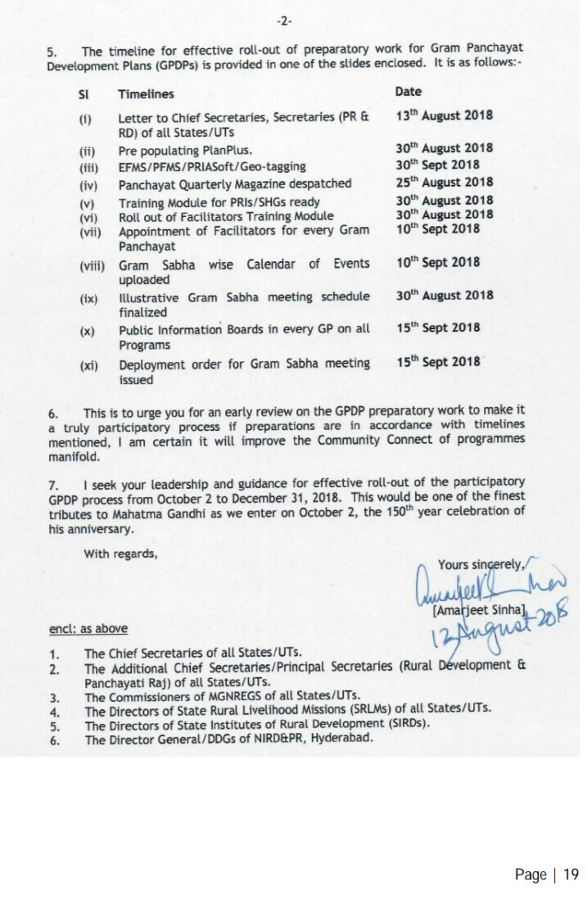
Letter Do No.K.-14016/02/2018
3 tarik u Nailar.2018
Na,
U Secretary
Ministry of Rural Development
/ MoPR
New Delhi, Government of India
sha ka Sorkar
Meghalaya

Slide 10
KI JINGBTHAH KATKUM KATEI KA SHITHI HANENG:
Ki nongshong shnong kidei ban pynkhreh ia ka plan san (5) snem jong ka shnong na ka bynta ki snem
                2018-19,
                2019-20,
                2020-21
                2021-22
                2022-23
Dei ban iadon ka jingshim bynta jong baroh ki Rangbah, Longkmie, ki kynthei, ki samla shnong, ki SHGs bad ki khynnah haba shna ia ka VDP-GPDP)
Ka jingbei tyngka na ka bynta ka VDP-GPDP ka dei lyngba ka Direct Funding sha ki shnong na ka 14th Finance Commission,Govt. Of India bad kiwei kiwei ki skim sorkar.

Slide 11
Ki tnat Sorkar kiban ia shim bynta ha ka VDP-GPDP
Participating Ministries/ Departments
D/o Agriculture Cooperation & Famers Welfare
D/o Animal Husbandry, Dairying & Fisheries
M/o Environment, Forest & Climate Change
M/o Panchayati Raj & M/o Rural Development
D/o School Education & Literacy
M/o Drinking Water & Sanitation
M/o Culture
M/o Health & Family Welfare
D/o Food & Public Distribution
M/o Micro Small and Medium Enterprises
M/o Petroleum and Natural Gas
M/o Power
D/o Financial Services
M/o Women & Child Development
M/o Skill Development & Entrepreneurship
M/o Tribal Affairs
& M/o Social Justice & Empowerment
M/o New & Renewable Energy
D/o Land Resources

Slide 12
Mano Ban Shna Ia Ka VDP-GPDP Plan?
1 | VDP-GPDP Working Committee (No 1) Agriculture and allied sectors | Committee ban peit ia ka rep ka riang
2 | VDP-GPDP Working Committee (No 2) Poverty Reduction & Employment Generation | Committee ban peit ia kaban pynduna ka jingduk,seng kam seng jam ha shnong
3 | VDP-GPDP Working Committee (No 3) Health, Education, WASH and Nutrition, Women and Children | Committee ban peit ia Ka koit ka khiah, pule puthi, jingbam jingdih,jingkhuid ha shnonglongkmie & khynnah)
4 | VDP-GPDP Working Committee (No 4 ) Infrastructure and Basic Amenities | Committee ban peit ia ki surok, iing shnong, street light, ki pung um, jaka saitjain, ing skul etc
Ka shnong rynkat bad ka jingiatrei lang jong ki saw (4) tylli ki COMMITTEE ban thung da ka shnong kin shna ia ka VDP-GPDP. Ki committee kin long kumne harum:-

Slide 13
 | 8 Tylli ki Kyndon ban bud ha ka VDP-GPDP
Kyndon- 1 | Jied/thung ia ki 4 tylli ki Kommittee Pynbna ha shnong ia ka VDP-GPDP
Kyndon -2 | 1st Gram Sabha (Jingialang paidbah shnong ba nyngkong) ryngkat bad ki Agenda ba la pynbiang da ka Sorkar
Kyndon- 3 | Pynkhreh ia ka report Shnong (Draft Status report-DSR) lyngba ka jinglum ka Khanasamari(Household Census/ PRA/ SECC/ Census 2011/ Mission Antyodaya) bad kiwei kiwei ki jingtip ba donkam kum ka ICDS/PHC/CHC/Skul
Kyndon- 4 | 2nd Gram Sabha (Jingialang paidbah ba-ar) Ryngkat bad ki Agenda ba la pynbiang da ka Sorkar ban ai Approval ia ka Draft Status report(DSR) jong ka shnong
Kyndon -5 | Hadien ba la ioh ka Approval jong ka DSR, yn pynkhreh ia ka VDP-GPDP halor ka Draft Status report jong ka shnong da ki 4 tylli ki working Committee da ka jingiarap ki tnat Sorkar ban pynkhreh ia ki plan bad estimate
Kyndon- 6 | 3rd Gram Sabha (Jingialang paidbah ba-lai) Ryngkat bad ki Agenda ba la pynbiang da ka Sorkar ban ai Approval ia ka VDP-GPDP jong ka shnong khnang ban iohrah ia ka sha ka District Planning Committee(DPC) ka sorkar na ka bynta ka Technical/Adminsitartive Sanction
Kyndon- 7 | Implementation/Jingsdang ban trei kam ia ka plan ha shnong da ki Kommitte shnong ryngkat bad ka Technical support jong ki nongtrei sorkar kat kum ki tnatba iadei kam
Kyndon -8 | Monitoring(Jing peitngor) ia ka VDP-GPDP Implementation da Village/ Block/District & State level Kommittees ba la pynkhreh

Slide 14
Ka Pla Tyngka(Resource Envelope) na ka bynta ka VILLAGE DEVELOPMENT PLAN::VDP/GPDP
14th Finance Commission - FFC
State Finance Commission-SFC
Own Source of Revenue – OSR (Synniang ka shnong in Cash/Kind/Labour)
CSR – Corporate Social Responsibility) kaba long 2% na ki kompany/Bank etc
5.MGNREGS | NRHM | 18.PMGSY-PWD | 25.RGGVKY
6.NRLM | 12.NSAP/NFBS/ NOAPS | 19.Swatch Bharat Mission-G | 26.Annapurna-PDS
7.RGSA | 13.SSA/RMSA | 20.Total Sanitation Programme (TSP)/SCS | 27.MHIS/RSBY/JSY/NSSK
8.PMAY- G | 14.ICDS | 21. MNERDA-Solar/Wind energy | 28.NRWDP/IWMP/PMKSY
9.NMSA/RKVY | 15.Fisheries | 22. Border Area Development | 29.Social forestry etc
10.Rural Housing | 16. Horticulture schemes | 23.Employment & Craftsmen Training | 30. Arts & Culture Schemes
11. Industries | 17.Sports &Youth development | 24. DDU-GKY | 31.MDC/MLA/MPLADS

Slide 15
Agenda jong ka 1st Gram Sabha
Shithi na ka Sorkar India halor VDP-GPDP
Approval ia ki Dkhot ki Working Committees(4 nos)
Publicity campaign na ka bynta ka VDP-GPDP ha shnong
Kalendar ban pynkhreh ia ka VDP-GPDP
Jingkren halor ka Phon(Funds) jong ka shnong
Jingiaphylliew halor ka roi ka par ka shnong ha ki 5 snem (2012-2017) bad ka jing pynwandur ia roi ka par ka shnong ha ki 5 snem ban wan (2018-2023) Ki Mat ban ia phylliew:Poverty/Education/Sanitation& water supply/Public health/Local economic development/Natural Resource Management/Issues of special groups/ persons with disabilities/issues of SCs and STs/ aged persons/ children etc./Gender issues/Migration
Visioning Exercise.
Validate/Pynshisha ia ka report/Kaiphod jong the Mission Antyodaya
Kdew ia ki jinduna(gaps) ba mih ha ka kaiphod Mission Antyodaya.
Buh tarik ban pynlong ia ka 2nd Gram Sabha
(U Chairman/RS u dei ban pynpoi ki shithi/notice ka jingialang sha ki paid nongshong shnong, BDO/ ki nongtrei sorkar(Line department/Facilitator/bad ki dkhot ki Working Kommittee ban wan sha ka jingialang Gram sabha)

Slide 16
Jingpynkhreh :DRAFT STATUS REPORT(DSR) ka Shnong
(Ka Kaiphod jong ka jingdon bad jingduna ha shnong)
Hadien ba la dep ka 1st gram sabha
yn don ka jinglum ia ka khana samari (Household census) katkum ka form ba la pynkhreh
Lum jingtip na ki skul, ICDS bad ka PHC/CHC ha shnong(format)
Pynlong ia ka Participatory Rural Appriasal Exercise(PRA)
Pynlong ia ka FGD(Focussed Group Discussion) na ka bynta kiba duk tam ha shnong(PoP),ki longkmie, ki khynnah bad ki tymmen, kiba anna ne don jingduna ha ki dkhotmet.
Pynkhreh ia ka Kaiphod (Draft Status Report-DSR) jong ka shnong
(Yn iarap ban pynkhreh ia kane ka Draft Status Report da ki 4 tylli ki Working Kommittee ba la thung da ka shnong, ba kynthup ruh ia ki nongtrei Sorkar ba dei peit ia ki tnat jingdonkam ka Kommittee)

Slide 17
Agenda jong ka 2nd Gram Sabha
Jingpule ia ka Draft Status Report (DSR) ka Shnong
Jingiaphylliew Jingmut halor ka DSR ka Shnong
Pule ia ka “Resource Envelop Kaiphod” halor ka phon(funds) jong ka shnong 2018-19 kaba wan lyngba ki skim bapher/ne ka OSR jong ka shnong
KaVRP(Village Reduction Plan) ba la pynkhreh da ki SHG/Seng Kynthei/Longkmie /PoP
Approval jong ka Draft Status report(DSR) ka Shnong
Buh tarik na ka bynta ka 3rd Gram sabha
Chairman/RS u dei ban pynpoi ki shithi/notice ka jingialang sha ki paid nongshong shnong, BDO/ ki nongtrei sorkar(Line department/Facilitator/bad ki dkhot ki Working Kommittee ban wan sha ka jingialang Gram sabha)
Ki mat jing iakren halor ka Draft Status report(DSR) ka shnong dei ban thoh sani khnang ban ioh bsut ia ki pat ha ka Final VDP-GPDP PROJECT REPORT

Slide 18
Agenda jong ka 3rd Gram Sabha
Jingpule ia ka VDP-GPDP PROJECT REPORT ka Shnong
Approval (technical& administrative) jong ka VDP-GPDP PROJECT REPORT ka Shnong
Buh tarik na ka bynta ban thoh ia ka FINAL VDP-GPDP PROJECT REPORT ba la biang nadong shadong naduh ki project/sub plan project/ ki NOC/kiwei kiwei ki kot ki sla ba dei ban bsut(annexures/ki PRA report/dur)etc
Buh tarik ban pyndepia ka printing jong ka VDP-GPDP PROJECT REPORT ban ai sha u BDO /District Planning Council (DPC) na ka bynta ban ioh forward pat na ka bynta ka final sanction.
hadien kane ka 3rd Gram Sabha
Dei ban pynthikna(finalise)noh ia ki kyndon ba iadei bad ka implementation ka VDP-GPDP
Ia ki Rai ba la shim ha ka 3rd Garm Sabha dei ban wah ha ka Notice Board jong ka shnong

Slide 19
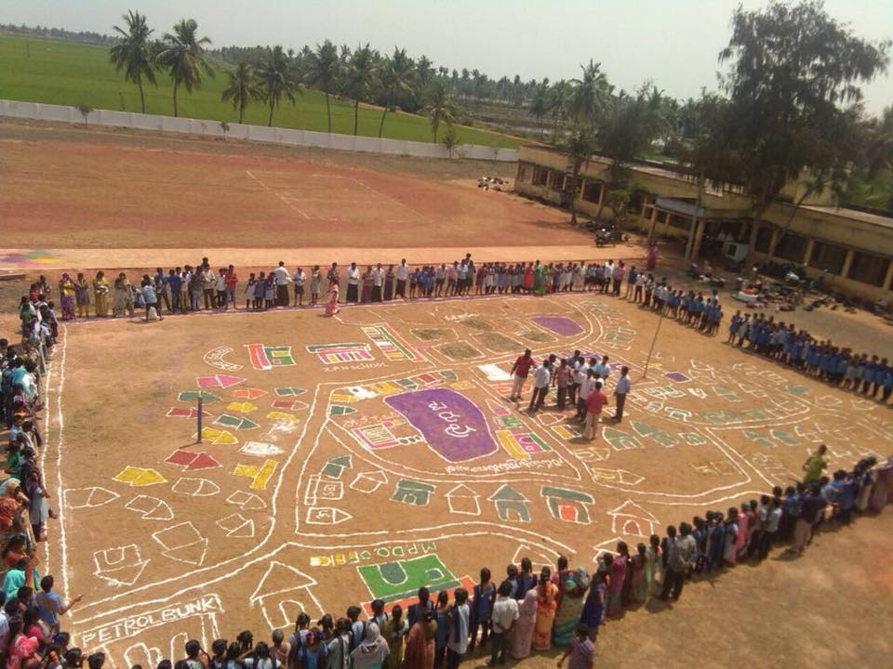
Primary Data collection through PRA in a village

Slide 20


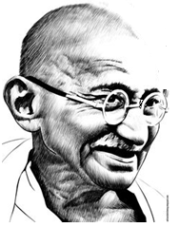
Public Information Board
150th BIRTH ANNIVERSARY OF MAHATMA GANDHI
Village : ........................... | LGD Code: …………………
Name of Chairman : …………………………
10 ft.
Block/Taluka: ............... | District: ..................... | State: .................
Sr. No. | Scheme | Activity | Funds
20 ft.

Slide 21
Conclusion
In due appreciation of potential of comprehensive GPDP, Ministry of Rural Development & Ministry of Panchayati Raj , Government of India has launched People’s Plan Campaign – Sabki Yojana Sabka Vikas during the period from 2nd October to 31st December 2018 for preparation of comprehensive VDP-GPDP. During the said period, comprehensive VDP-GPDP will be prepared by every Village . The VDP-GPDP Campaign will not only see 31 lakhs Village representatives taking the lead in Gram Sabhas, they would also be supported by the network of 5.25 crore SHG Women in the true spirit of participatory democracy to envision, plan and implement the development plan, with your support leading to transform rural India.

Slide 22
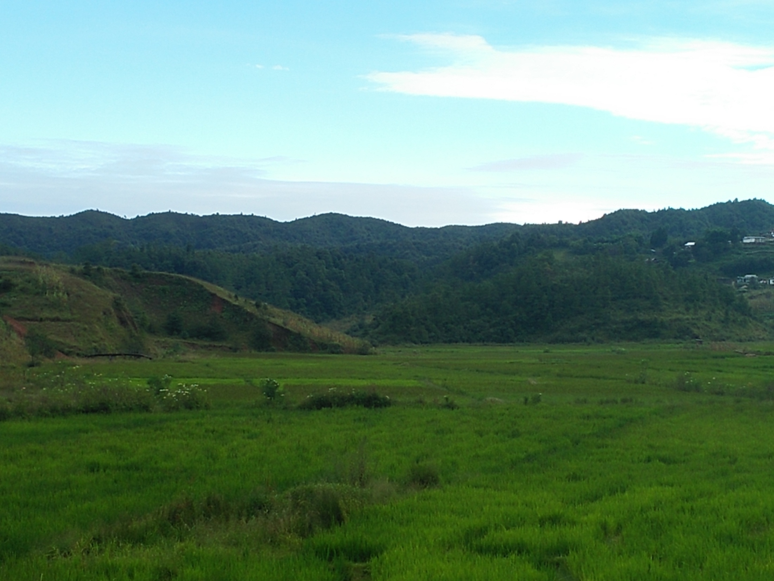
KHUBLEI SHIBUN

