Slide 1

Effort and experiences of localization of SDGs in kerala
Sukanya .k. u, KILA

Slide 2
Decentralized planning Process
The 73rd and 74th constitutional amendments and the ensuing Kerala Panchayat Raj Act, 1994 provided an institutional background for the democratic decentralization and participative decentralized planning in the State.
Decentralized planning Process in Kerala
Decentralization becomes meaningful only when there is democratic decentralization, which is characterized by flow of power through the elected bodies and its members to the people.

Slide 3
Localizing SDGs in Kerala
Localization is described as ‘the process of defining, implementing and monitoring strategies at the local level for achieving global, national, and sub-national sustainable development goals and targets.’ Specifically, it includes the ‘process of taking into account sub-national contexts in the achievement of the 2030 Agenda, from the setting of goals and targets, to determining the means of implementation and using indicators to measure and monitor progress.’

Slide 4
KILA- Roles and Responsibilities
KILA by associating major training institutes to arrange training programmes to officials as part of localising SDGs.
Assist Planning & Economic Affairs (CPMU) Department in conducting stakeholder consultations / workshops / seminars etc.
Develop modules for SDGs related trainings in the State.
Coordinate all training institutes under various Government Departments in Kerala for imparting training programmes sensitising SDGs.
Develop an action plan for localizing SDGs
Sensitisation of all stakeholders including Civil Society Organisations, Voluntary Organisations and Media.

Slide 5
Localizing SDGs
KILA worked with MoPR and UNDP in 2016 itself
Developed an Operational Strategy for Local Governments (LGs) on SDGs
Most SDGs are to be achieved at the local level
Most SDGs are related to the subjects devolved to the Panchayats
Funds transferred to the Panchayats–untied funds
Panchayats prepare and implement development plans
Working group themes and SDGs - similar
SDGs can be achieved through Panchayat Plans - GPDP

Slide 6
Panchayats and SDGs
  Most of SDG targets are within the purview of the Eleventh
  Various flagship programmes at the core of the SDGs
  Panchayats play a pivotal role in many of these – But not alone!

Slide 7
1. Centre for SDGs and Local Governments
Specialized centre - “Centre for SDGs and Local Governments” is for mainstreaming SDGs in to the Local Planning (People’s Plan Campaign).
Trainings, Awareness generation, IEC (Print and Visual Media); designing and handholding Planning Tools such as Toolkits, Helper, Work Book.
Study on Kerala Performance Across SDGs in NITI AAYOG Report

Slide 8
Centre for SDGs and Local Governments- Objectives
Awareness and Training programmes
Information-Education-Communication
Facilitation for local planning with SDGs framework
Advisory services – at national and sub-national levels
Networking with institutions on SDGs

Slide 9
2. Tool Kit and Training Modules
  SDG Training tool kit for setting targets and monitoring SDGs that enable the functionaries at all levels [sub-national, district, sub-district] to track and monitor the progress on SDGs.
  Three separate Modules for major stakeholders viz. Officials, Elected Representatives, and Citizens.
  The Module for Officials along with Workbook takes the learners through an analytical process of data based planning for SDGs.

Slide 10
3. SDG Dashboard
SDG Dashboard is a Training tool kit
Web enabled
Can be used at various tiers of local governments
Improves the quality, reliability, availability and comparability of data
Helps all stakeholders to create their own data base in their respective area
Helps the local governments to plan, review, analyze and modify their SDG as and indicator status
Helps to identify gaps in each goal and plan accordingly

Slide 11
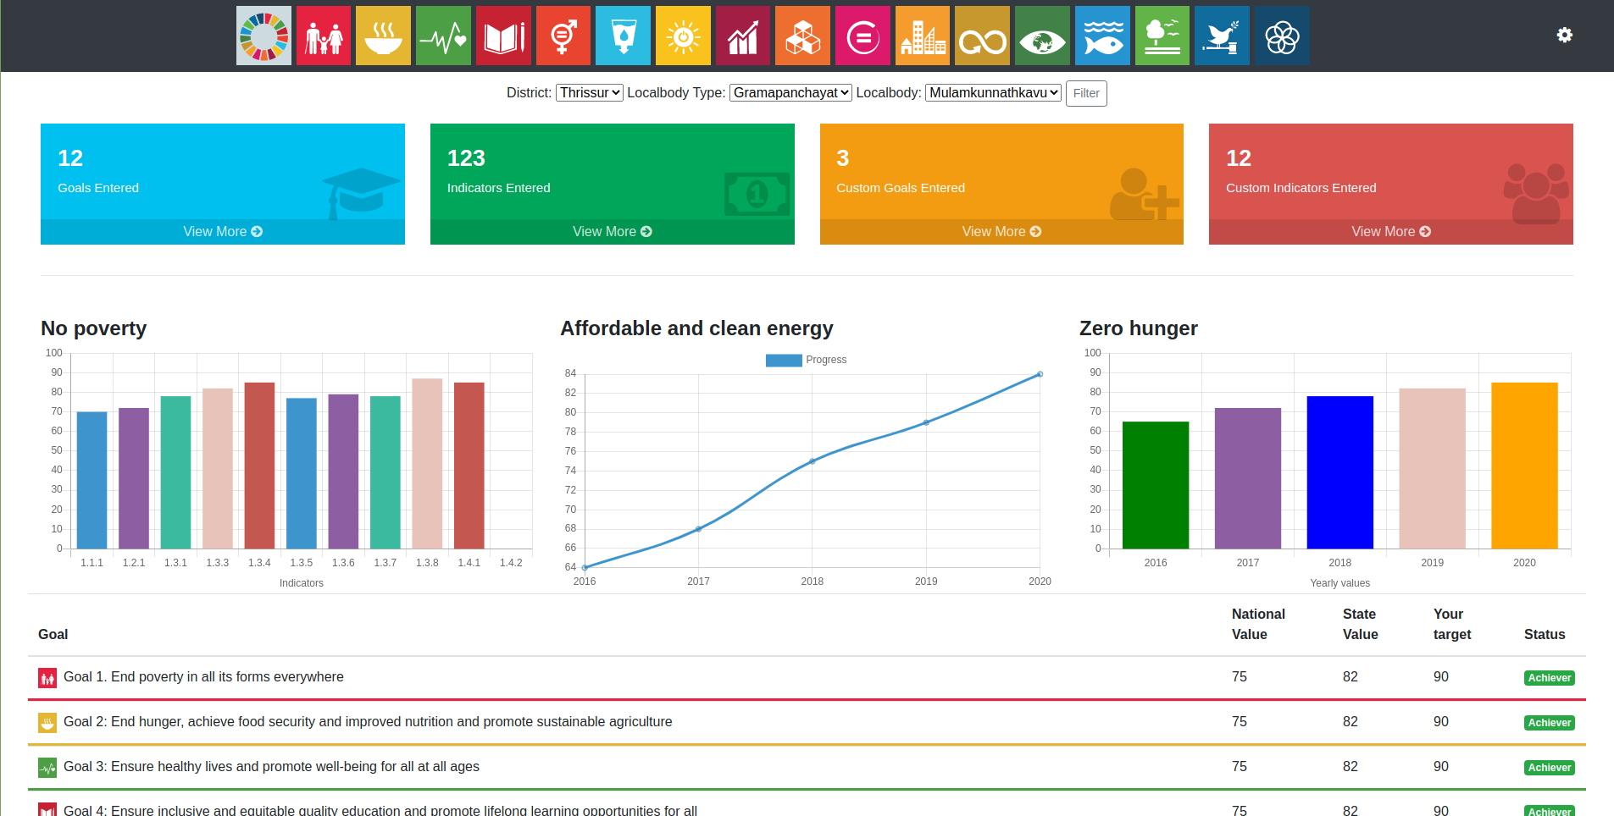
DASHBOARD ON PLANNING AND MONITORING SDGs

Slide 12
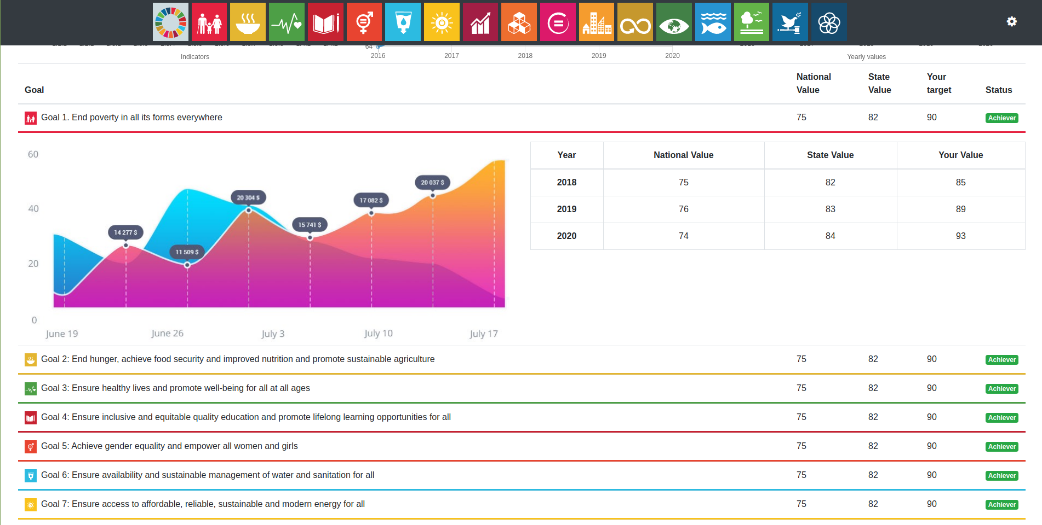
DASHBOARD ON PLANNING AND MONITORING SDGs- Expanded view

Slide 13
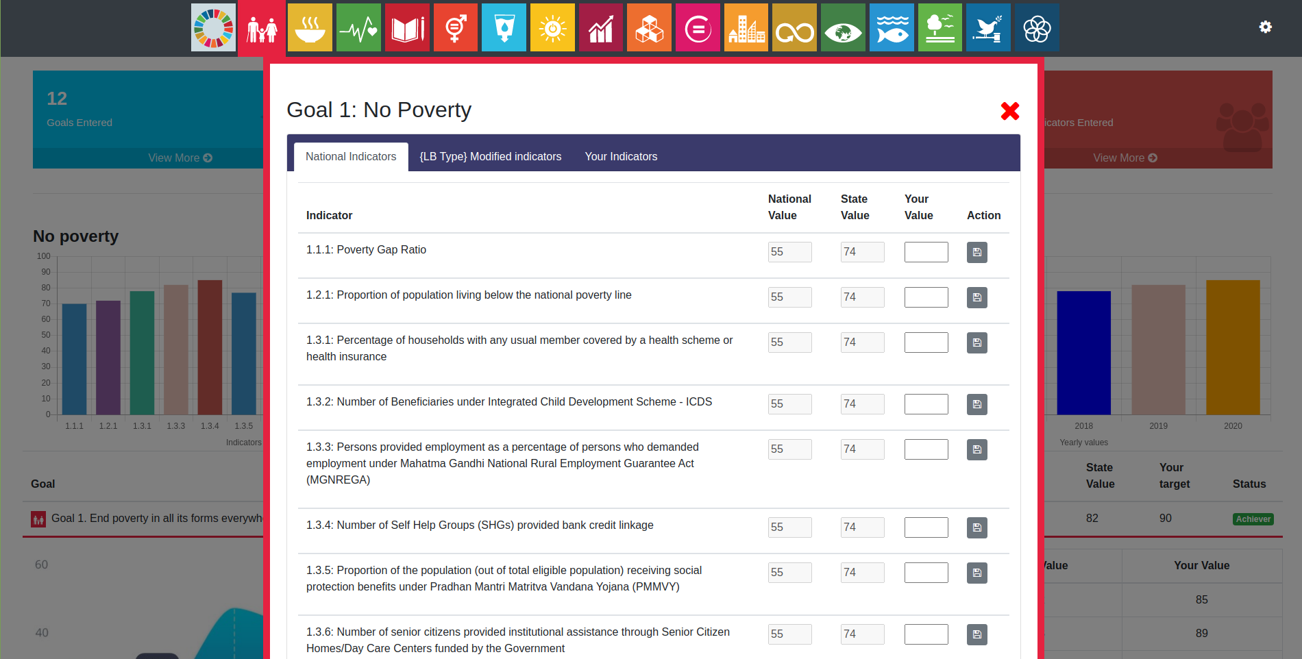
Goal with National Indicators

Slide 14
4. Building Capacities of Local Governments for SDGs
Operational strategy for SDG Capacity Building for local governments
Write shop for Toolkit development
Project on Mainstreaming SDGs in the state and local government
Awareness programme for local government functionaries
Specific trainings on goal and target setting
IEC-print and visual media
Training Modules
Toolkits, Helper and Workbook
Web enabled SDGs Dashboard

Slide 15
Target Groups
Elected representatives and officials of local governments
Citizens who are members of the Village assembly
Other key stakeholders in local planning

Slide 16
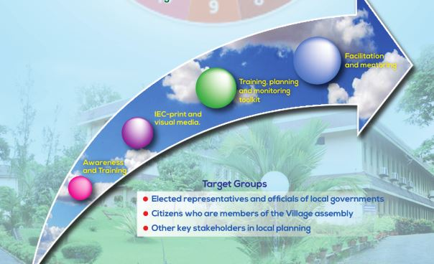
Target Groups

Slide 17
5. Workshops
National level training programme on ‘Building Capacities for SDGs- Strategies & Action’ during March 5-6, 2018.
Module for training the district level officials of line departments
    State vetting workshop on building capacities for sustainable development goals – strategies and action.
    National vetting workshop on building capacities for sustainable development goals – strategies and action

Slide 18
Workshops
    Thematic workshop on Sustainable Development Goals (SDGs) conducted on February 16, 2018
    A State level workshop conducted on Mapping of Plan Schemes with goals/targets of SDGs on June 19, 2018
A workshop on “Preparation of Guidelines for Institutional Framework for the Implementation and Monitoring of SDGs in the State

Slide 19
6. Trainings
Social Education programme on SDGs for
  Elected Representatives and Officials of Local Governments
  VOs/NGOs (Kudumbashree, Youth Welfare Board, Kerala State Literacy Mission, Kerala State Library Council, Mahila Samakhya, Senior Citizens Friends Welfare Society, SEVA, Kerala Senior Citizen Forum, Focal Group Members, Community Counselling Facilitator etc.) in the State.

Slide 20
Trainings

Slide 21
7. IEC Initiatives
Video Documentary on ‘Building the Villages for Tomorrow’ provides tips on post-disaster health and sanitation measures that deals with SDGs. [SDG 3, SDG 6]
Video Documentary on ‘CANALPY’, explains sewage canal rejuvenation initiative of youth. [SDG 3, SDG 6, SDG 11]
Pocket Diary on SDGs in Malayalam [local language] provides a quick glance at the Targets, against the goals. [All SDGs]
Flower Vase [made of clay], embedded with SDGs, is a low cost tool for disseminating SDGs. [All SDGs]
Wall Paper on SDGs is also a low cost tool for disseminating SDGs. [All SDGs]

Slide 22

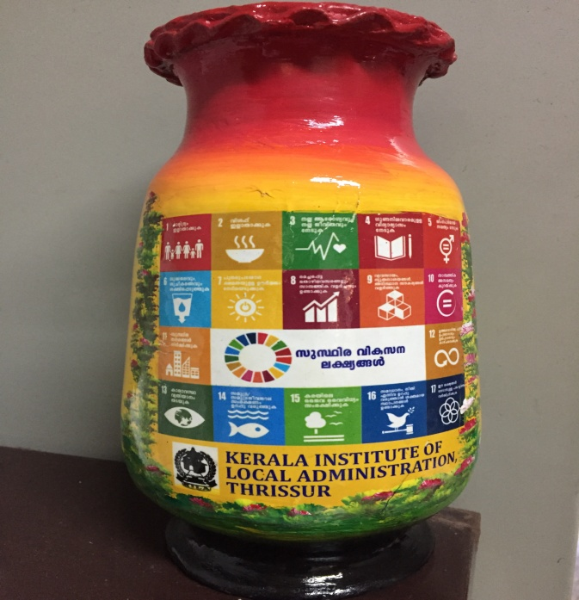
IEC Materials

Slide 23




8. Integration Framework
NAVAKERALAM KARMAPADHATHI (NKKP)
Harithakeralam Mission– Umbrella Mission integrating waste management, organic farming, water resources management
Total Housing – LIFE (Livelihood Inclusion and Financial Improvement) Mission – Comprehensive scheme for all the landless and homeless in the state
Public Education Rejuvenation Mission – Comprehensive educational reforms transforming Government schools to international standard.
Aardram Mission – Create people friendly Health Delivery System in the State.
LEAVE NO ONE BEHIND

Slide 24
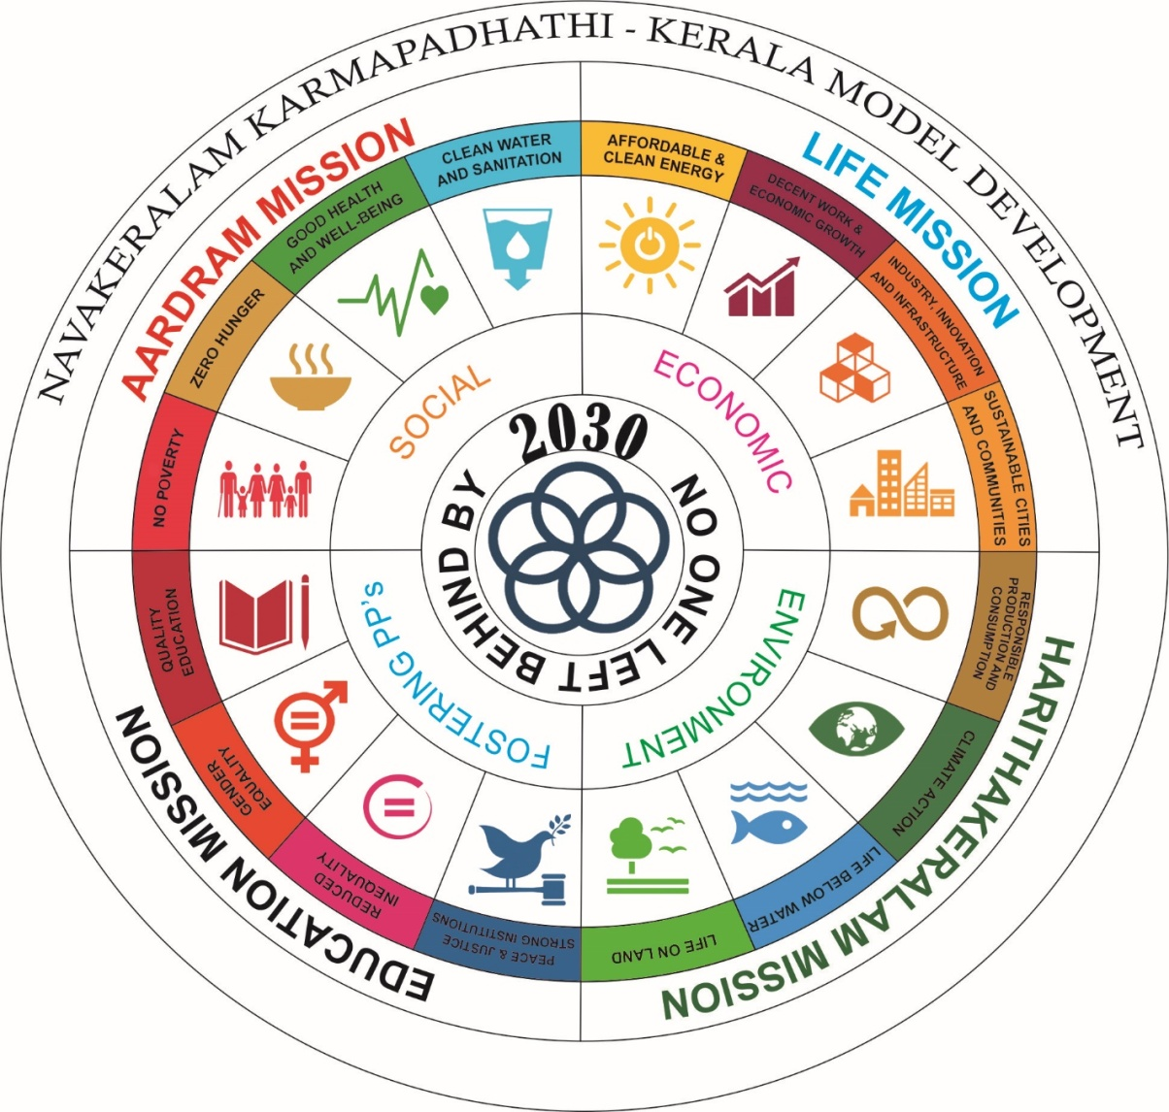

Convergence of SDGs with NavaKeralam Karmapadhathi

Slide 25
SDGs vs. Development Programmes
Most SDGs are to be achieved at the local level
Most SDGs are related to the mandates of Panchayats
Funds transferred to the Panchayats –untied and tied funds
Own funds
Focus areas of these actions lead to many SDGs
SDGs can be achieved through these actions

Slide 26
The Panchayat Dilemma
And ours too!
SDGs or development activities?
Or What?
Where to Start?
How to do?

Slide 27
Limitations and Challenges
Life in a Panchayat is not SDG based
So, discussions for GPDP also is not SDG based, mostly issue based
So far, the Panchayat planning is only output based
Many indicators and targets not locally relevant
Panchayat disaggregated data not available in many cases
Separate guidelines on SDG do not work
Trainings on SDGs as a separate theme do not help

Slide 28
Moving Forward
Challenge is to integrate SDG into GPDP
Provision for locally relevant indicators and targets required
Trainings on SDGs as a separate theme do not help
Panchayat planning has to be made Outcome based / Results based
These outcomes and the indicators could be SDG related
Working groups could be aligned to SDGs or a set of SDGs (thematic)
In depth training on GPDP planning needed which addresses the issue of outcome based planning leading to achievement of SDGs

Slide 29
Thematic Area Based
Instead of goal and targets, the concerned thematic area/s taken
For example, Goal 3, instead of moving into the targets, we take Health as the issue.
Move ahead with the determinants of health
How can these issues be addressed
What role should/can the Panchayat play
What could be the indicators and targets with time frame in their own area (state/district/ LGs)

Slide 30
Thematic Area Based
What could be the activities
Which are the programmes/schemes contributing to these activities
Available human and financial resources
How can convergence (of programmes, schemes, HR and finances) be brought in
How can they set milestones
How can they monitor
And this basically what the GPDP Guidelines should focus
Our thematic working groups have similarity with SDGs

Slide 31
How can Panchayats Act?
Promote
Initiate
Develop
Facilitate
Environment building
Mobilise
Plan
Implement
Manage data
Monitor

