Slide 1

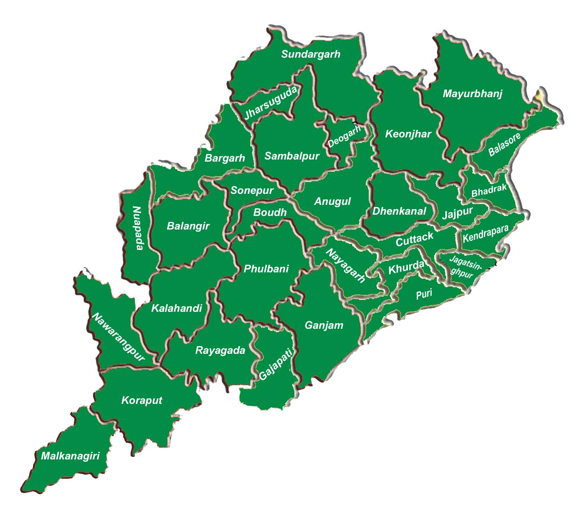

Peoples Plan Campaign
2021
Odisha Experience
2nd October – 31st January, 2021
PR & DW Department, Govt. of Odisha

Slide 2
PPC ODISHA : 2021 at a Glance
Activities | Nos | % of Achievements (Till 10th Nov 2021)
No of Nodal Officers Appointed | 343 | 100% in all blocks and districts
No of Facilitator's appointed | 6453(GPs), 116(BPs), 18(ZPs) | 95% in GPs, 37% in BPs, 60% in ZPs
No of Frontline Worker's | 6365(GPs), 111(BPs), 30(ZPs) | 94 % in GPs, 35 % in BPs, 100 % in ZPs
Meeting scheduled | 5820(GPs), 38(BPs), 5(ZPs) | 86% in GPs , 12% in BPs, 17% in ZPs
Meeting Held | 5722(GPs), 36(BPs), 5(ZPs) | 84% in GPs , 12% in BPs, 17% in ZPs
Facilitator Feedback | 1463(GPs), 3(BPs), 0(ZPs) | 22% in GPs , 1% in BPs, 0% in ZPs
Public Information Board Images | 1988(GPs), 10(BPs), 9(ZPs) | 29% in GPs , 3% in BPs, 30% in ZPs
Gram Sabha Images | 4326(GPs), 10(BPs), 4(ZPs) | 64% in GPs , 3% in BPs, 13% in ZPs

Slide 3
PPC -21 CB Activities
Training imparted by SIRD&PR for district level resource persons (Addl.PD, DPM (OLM), MC (MGNREGS), DPM(RGSA) and DPO)
Massive training programmes organised for GRSs, Executive Officers and APOs/ other line deptt officials at District level.
Training of DLTT members, screening committee members and BLTT members was completed during the month of Sep - Oct 21 in virtual mode.
Special webinar was conducted for all Directors, Sectoral departments, PD, DRDAs by the Principal Secretary, PR&DW and Addl. Secy, MoPR on 8th Oct 21 for coverage of more sectoral activities in Panchayat Planning.

Slide 4
PPC : 2021-22 in Action
Detail Guideline issued for Rolling out PPC-21 in the State on 23rd Sep 2021
State Sankalpa : for PPC-2021 -“Maintenance of GP Assets and its proper utilization”.
Focus on achieving SDGs and inclusion of one Sankalpa in tune with SDGs towards attainment of GPDP.
GPDP, BPDP, DPDP may not be viewed as an event rather a process.
Integration of VPRP prepared at SHG level with GPDP is mandatory.
Ensuring Quality GPDP/BPDP / DPDP through effective convergence with sectoral departments such as S&M, W&CD, Animal Resources & Health Department.

Slide 5
PPC : 2021-22 in Action.... Contd.
Focusing more on localization of SDGs compliance activities in terms of 7 Goals (Poverty free, Hunger free, Education for all, Quality Health, Gender Equality, Clean Water & Inclusion)
An advisory in odia issued to PRIs / Functionaries. comprising all indicative activities such as Mass Cleaning in Public Institutions, SLWM, Drinking Water, Livelihoods, Health and Nutrition, Community Cattle shed, Women and Child issues
More thrust given to the sectoral departments to incorporate their activities into GPDP, BPDP and DPDP.

Slide 6
PPC : 2021-22 in Action.... Contd.
Constitution of screening committee at Block and District level for providing support to PS and ZP for preparation of comprehensive and inclusive BPDP and DPDP.
Prepared Public Information Board at GP Level indicating the projects and fund available.
Webinar on preparation of quality GPDP held with Senior Officials of various Departments focusing on need for convergence and visibility of the sectoral departments in the preparation of GPDP under the leadership Dr. C.S. Kumar, I.A.S, Addl. Secy, MoPR.
Active engagement with SRLM through a Senior level official committee for VPRP and its linkage with GPDP.

Slide 7
PPC : 2021-22 in Action.... Contd.
Identification of 2 facilitators (GRS/Executive Officer/CRP) per Gram Panchayat to facilitate PPC-21 and VPRP.
Identification of Nodal Officers of Line Departments for attending GP / PS / ZP meeting and to present their plan proposal
Nomination of frontline workers from Line Departments at GP / PS / ZP Level for effective co-ordination of the campaign.
The Gap Analysis reports of Mission Antyodaya Survey has been utilized for preparation of Plan.
As per the prescribed time frame the State is in the right track for completion of all activities under PPC-21

Slide 8
A Robust Monitoring System
Functioning of Project Management Unit at State level
Functioning of State level Monitoring Team under the leadership of Special Secretary, PR&DW Department
Functioning District level Monitoring Team under the leadership of PD, DRDA
Weekly review meeting of District Functionaries through Video Conferencing on PPC related activities by Principal Secretary.
Functioning of Control Room at State, District, Block level for smooth conduct of PPC-21.

Slide 9
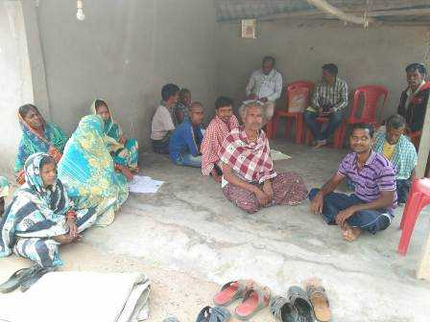
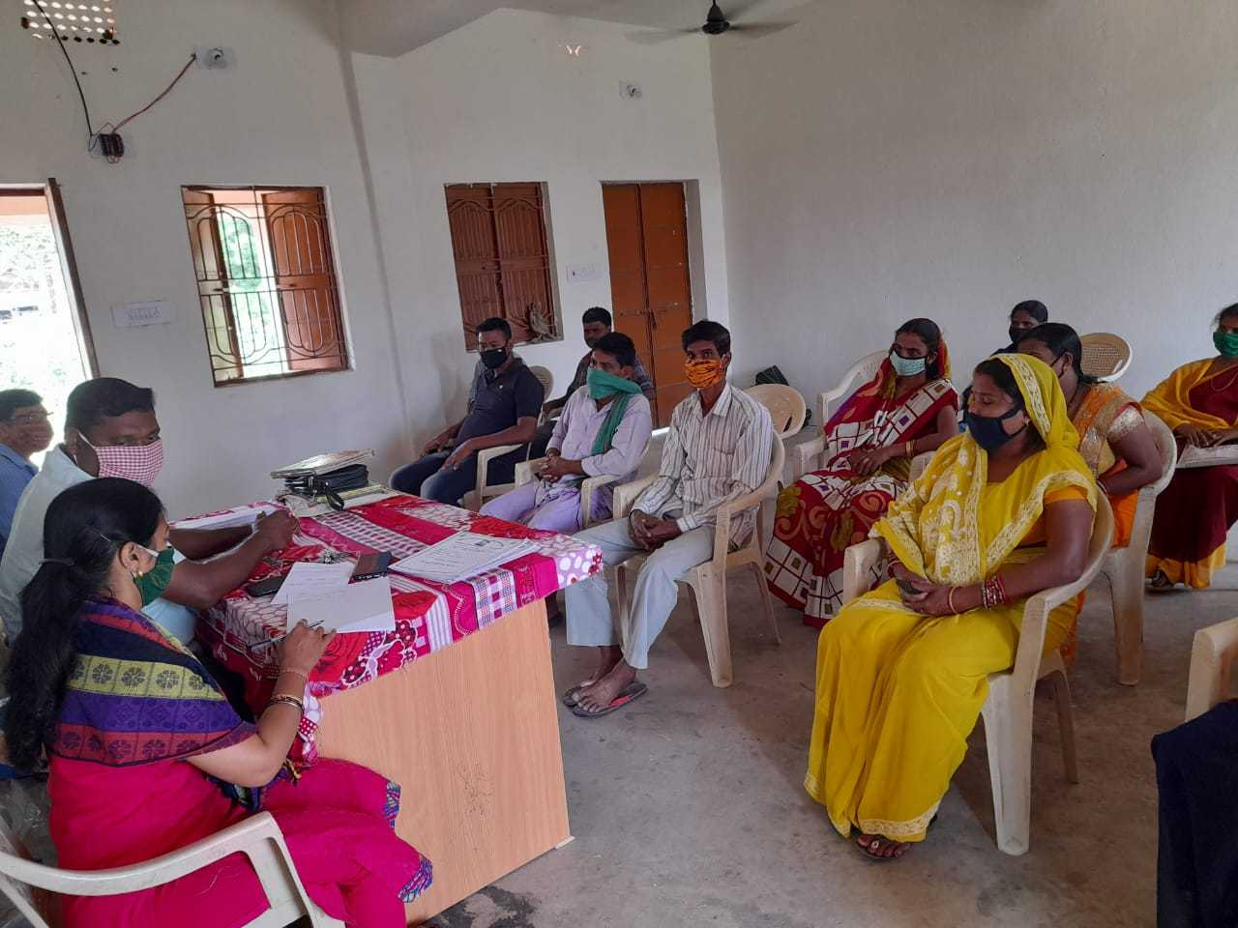
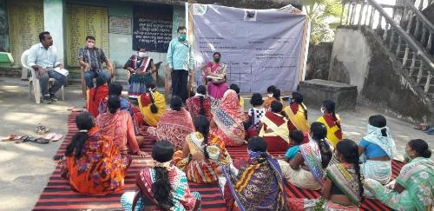
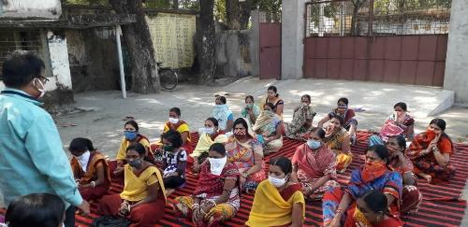
GP Meeting
Angul – Angarbandh GP
Bargarh – Bheden GP

Slide 10
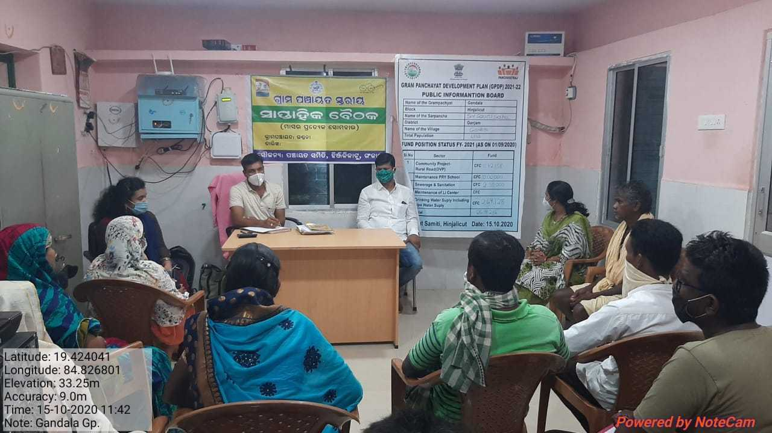
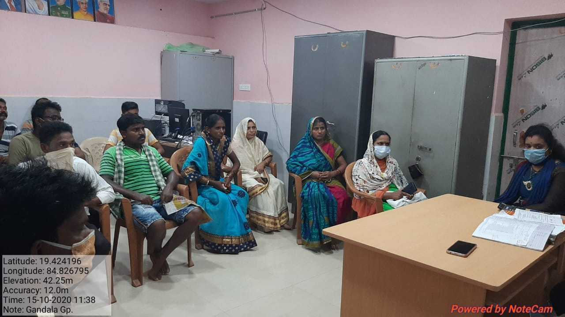
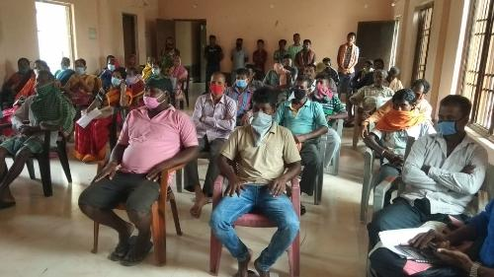
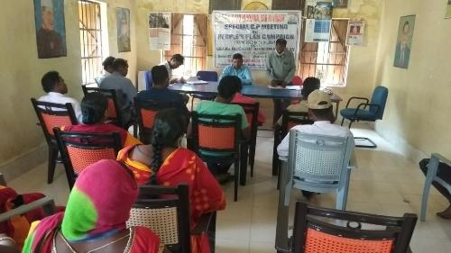
GP Meeting
Ganjam – Gandola GP
Malkangiri – Serpalli GP

Slide 11
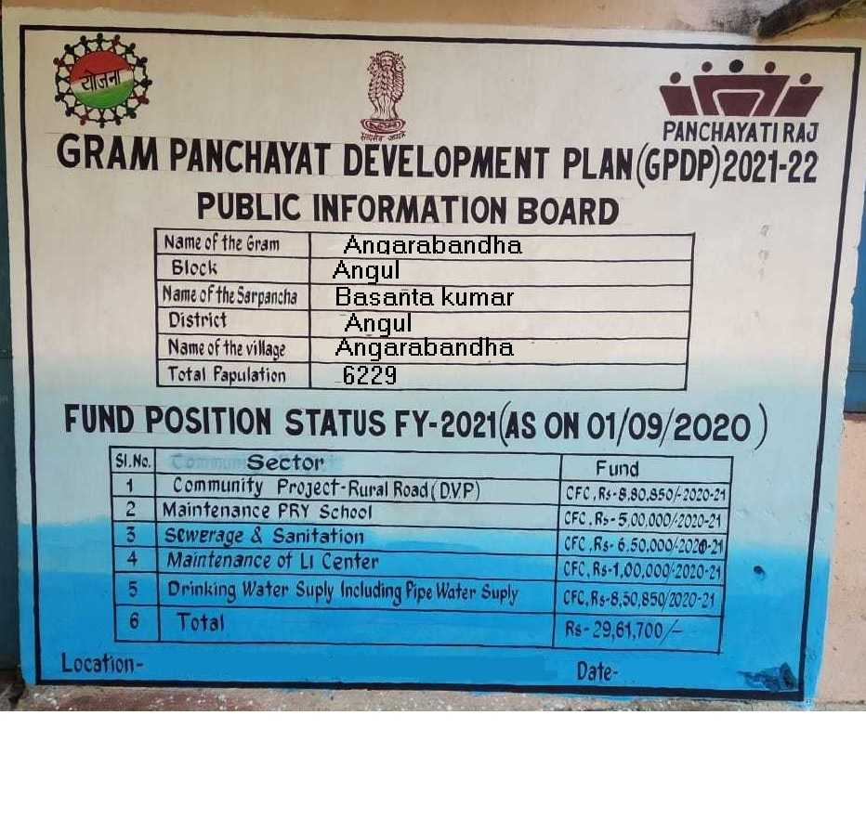
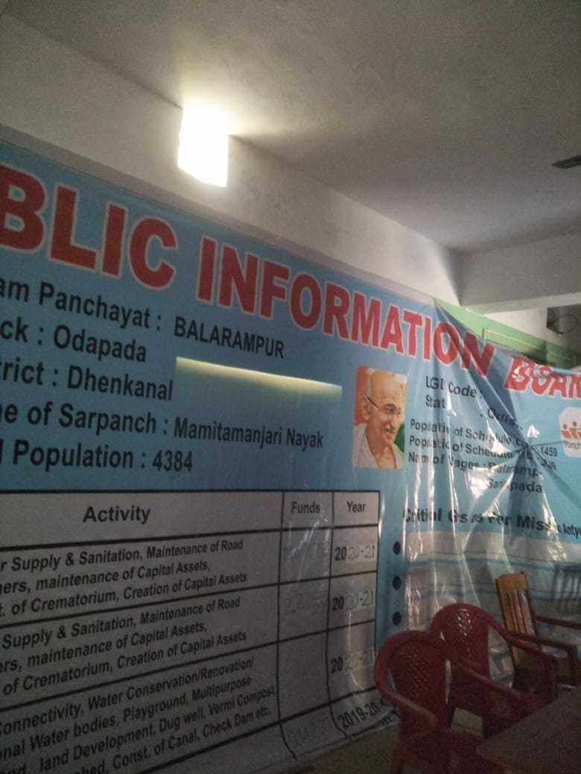
PIB Images
Angarbandha GP – Anugul
Odapada GP – Dhenkanal Dist

Slide 12
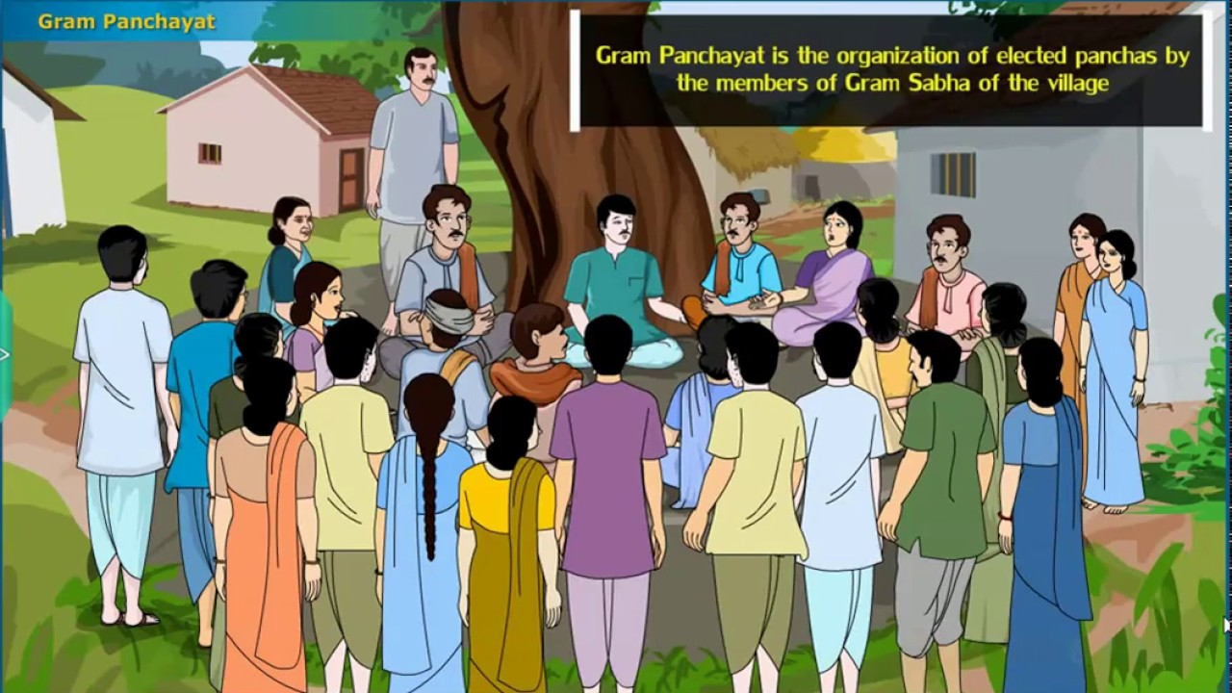
Thank You

