Slide 1
Brief Profile of Rashtravikas Agro Education Sanstha
Particulars | Information
Name of Organization | Rashtravikas Agro Education Sanstha
Vision | Evolving participatory approach to improve the quality of life of the people through economical, social, and cultural development of the rural area.
Mission | RAES envisages bringing out economic self sufficiency amongst poor Segments through development of human and natural resources With focus on components of capacity building, increased Organizational ability and adherence to the social and ethical values that ensure just and eco friendly appropriate interventions.
Registration Details | Registration under Bombay Public Trust act 1950 and Society Regd. Act 1860
Date of Registration with Registration Number
i) Trust Registration Number. | F/3507/Jalgaon, dt. 04-03-1997
ii) Society Registration Number | Maharashtra/3837/Jalgaon. Dt. 23-12-1996
iii) PAN | AAATR4594G
iv) TAN | NSKR04932E
v) 12 A Regd. No. | 12AA / 22 / 3 / 2009-10
vi)GST No. | 27AAATR4594G1Z7
Address of Head office (for corresponds) | Amalner : 10, “Ramkunj”, Shivparvati Colony, Near Surabhi Colony, Amalner, Dist. Jalgaon, Maharashtra, Pin- 425 401.
Address of Branch offices | 1. Jalgaon: C/O Shri Kishor Ramkrihna Mahajan, Gat No.156/2/2B., Sadoba Nagar, Behind ST Workshop, Near Hira Pipe Factory, Vittal Peth, Jalgaon
 | 2. Pimpalner (Dist. Dhule): “Shivlai”, Anuradha Colony, In front of Bhoye Petrol Pump, Pimpalner, Tal. Sakri, Dist. Dhule
 | . 3Rajasthan (Dist. –Jaipur): A-25, Manayawas, Mansarover, Jaipur
Other Details:
Number of years of existence | The Rashtravikas Agro Education Sanstha (RAES) is currently working in Maharashtra State. Since last 24 years of its establishment in 1996-97, till to date 77numbers of projects in Maharashtra State are completed or on going

Slide 2
Experience in Tribal Development/ Projects implemented for the development of tribals
1. Project Name – Indo German Watershed Development Program (2006-2013) in Nanarkhi, Kadupada and Hanumantnagar Clusters
Name of District – Dhule, Sakri Block (Tribal area)
Number of Targeted Villages – 21
Number of Population Benefited –7800
Problem and Need of Community were identified under the project
Before there was a major problem of migration of community during December to March, but after the implementation of project- constructed various Watershed Structures in 5000 H and other income generation activities i.e. Mango Plantation, Dairy Farming, Small Enterprise Development, Goatry, poultry etc. migration was decreased.
Impact of Project – Migration decreased and income of tribal farmers increased from 4000 to 7000-10000

Slide 3
Conti…
2. Project Name – Implementation of Sustainable Development Plan (SDP) (2017-2019)
Name of District – Dhule , Sakri Block (Tribal area)
Number of Targeted Villages – 21
Number of Population Benefited –7800
Problem and Need of Community – Transportation of Supply Agriculture Produce, Supply of inputs Fertilizers, Seeds etc. were the problems in the community, local farmers were depended on to near city for sale of agriculture production, purchase of seeds & fertilizers etc.
Impact of Project – We have formed the 03 Framers Producers Organization (FPOs) in 21 villages and now the FPO works as Krushi kendra and purchase the agriculture produce of farmers in their nearby villages and also sales the seeds, fertilizers. They are also going to start Agriculture Equipment bank in the future. Due to this, the access expenditure of farmers on transportation is reduced and the travelling expenditure made on purchasing seeds and fertilizers is reduced, thus their income is increased about 2000-3000 per month.

Slide 4
Conti…
3. Project Name – Swarnajayanti Gram Swarojgar Yojana (SGSY), Nandurbar (2003-2012)
Name of District – Nandurbar district (Tribal area)
Number of Targeted Villages – 74 villages in Taloda Block and 91 villages in Nandurbar Block
Number of Population Benefited –More than 25000
Problem and Need of Community – the tribal area was depended on traditional income generation activity viz. agriculture only, limited income sources
Impact of Project – We have formed 400 SHG in more than 150 villages and provided them different kind of income generation activities i.e. Goat Rearing , Dairy and milch Animal, Backyard Poultry, Fruit Processing, Chili Powder Processing, Spice (Masala) Powder, Chemical Fertilizer, Tractor for Rental basis to farmers, Contract Farming, Pickle, SHG Federation for collective marketing, Strawberry cultivation, Nursery , Honey collection (NTFP etc. Thus, the income of people were increased to 2000 – 4000 / per family

Slide 5
Conti…
4. Project Name – LRA for Livelihood and non livelihood Development and preparation of Micro Livelihood Plans for SHG women in Maharashtra under Tejaswini Program
Number of Targeted Districts– 1.Nasik, 2.Nadurbar, 3.Parbhani 4.Osmanabad 5. Latur, 6.Jalgaon, 7.Beed, 8.Ahemednagar 9.Dhule, 10. Hingoli, 11.Aurangabad, 12.Jalana, 13. Nanded
Number of Population Benefited –15000
Problem and Need of Community – Limited sources of income generation activity
Impact of Project – We have given more than 400 Entrepreneurship Development Programme (EDPs) covering more than 15000 no. of SHG members on subjects viz. 1. Goat Rearing 2. Dairy and milch Animal 3. Backyard Poultry 4. Fruit Processing 5. Chili Powder Possessing 6. Spice (Masala) Powder 7. Chemical Fertilizer 8.Tractor for Rental basis to farmers 9.Contract Farming 10.Pickle 11.SHG Federation for collective marketing 12. Strawberry cultivation 13.Nursery 14.Honey collection (NTFP) etc. were conducted in the above given districts. Due to this programmes, some SHG women started their own businesses in the relevant fields and thus their level of income was increased to 3000-4000.

Slide 6
Conti..
5. Project Name – Promotion of 03 FPOs in Dhule district under PODF-ID fund of NABARD
Number of Targeted area– 03 FPOs in Dhule district of Maharashtra State
Number of Targeted Villages – 78
Number of Population Benefited –20000
Problem and Need of Community – Transportation of Supply Agriculture Produce, Supply of inputs Fertilizers, Seeds etc. were the problems in the community, local farmers were depended on to near city for sale of agriculture production, purchase of seeds & fertilizers etc.
Impact of Project – We have formed and promoting the 03 Framers Producers Organization (FPOs) in 21 villages and now the FPO works as Krushi kendra and purchase the agriculture produce of farmers in their nearby villages and also sales the seeds, fertilizers. They are also going to start Agriculture Equipment bank in the future. Due to this, the access expenditure of farmers on transportation is reduced and the travelling expenditure made on purchasing seeds and fertilizers is reduced, thus their income is increased about 2000-3000 per month.

Slide 7
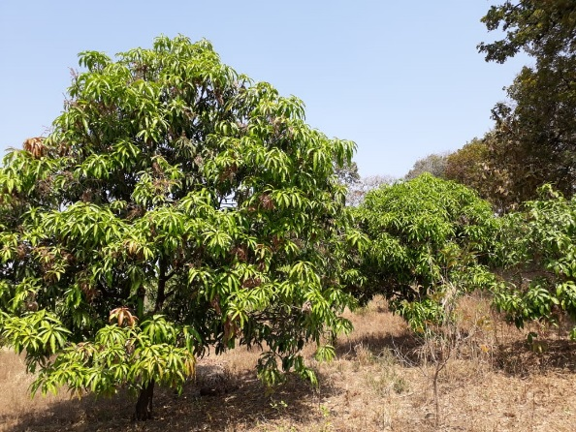
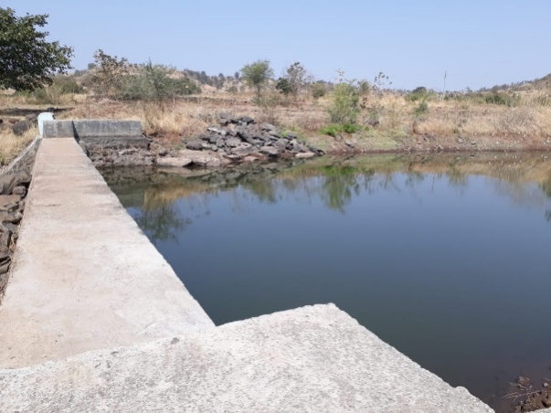
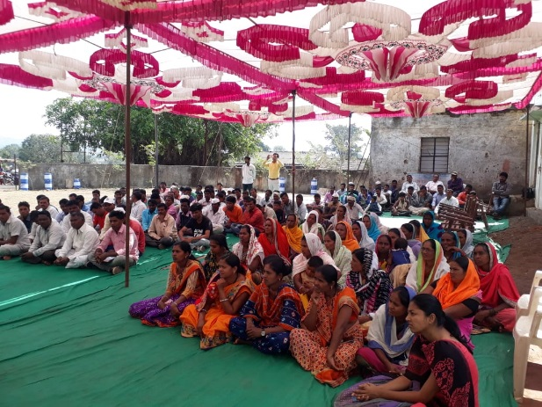
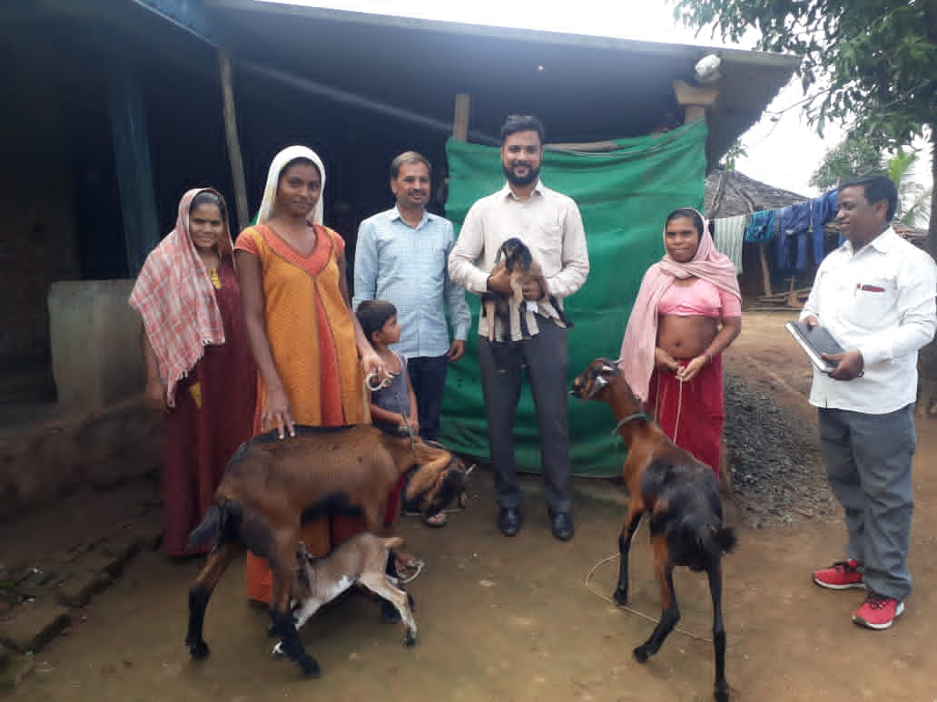
Some clicks from the field…

Slide 8
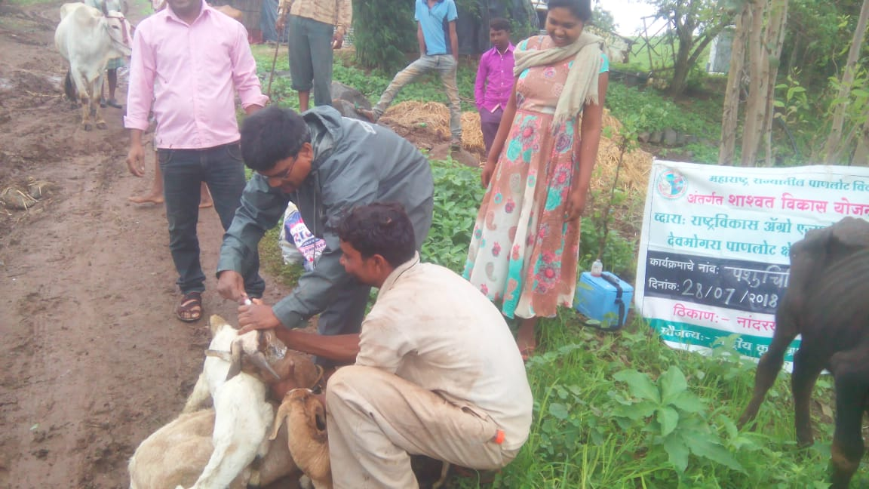
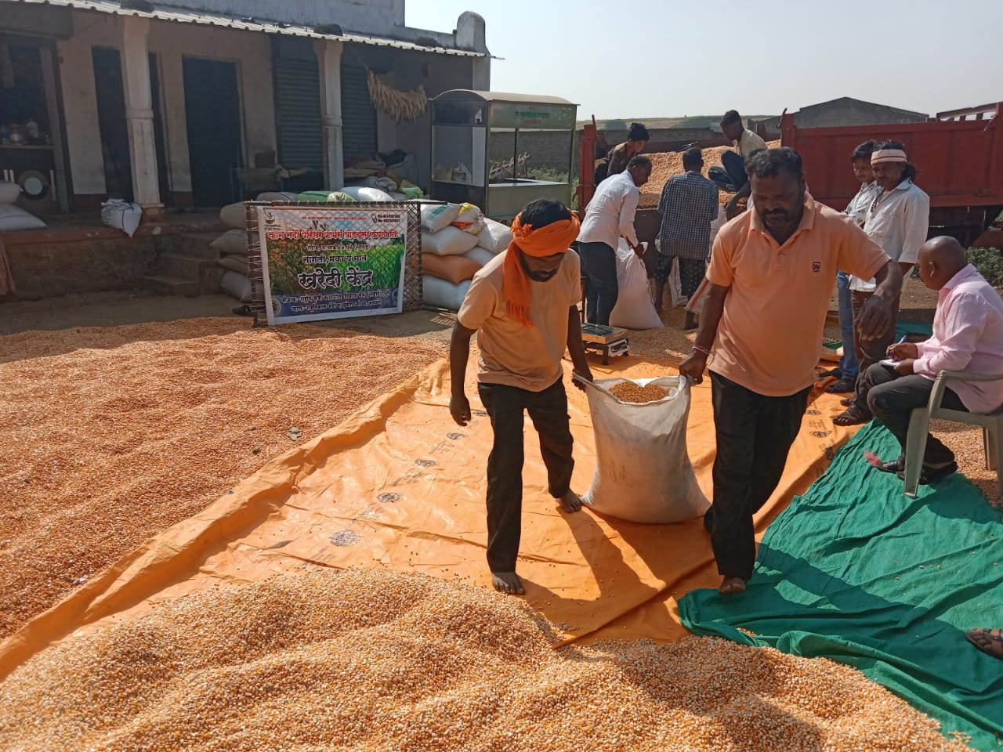
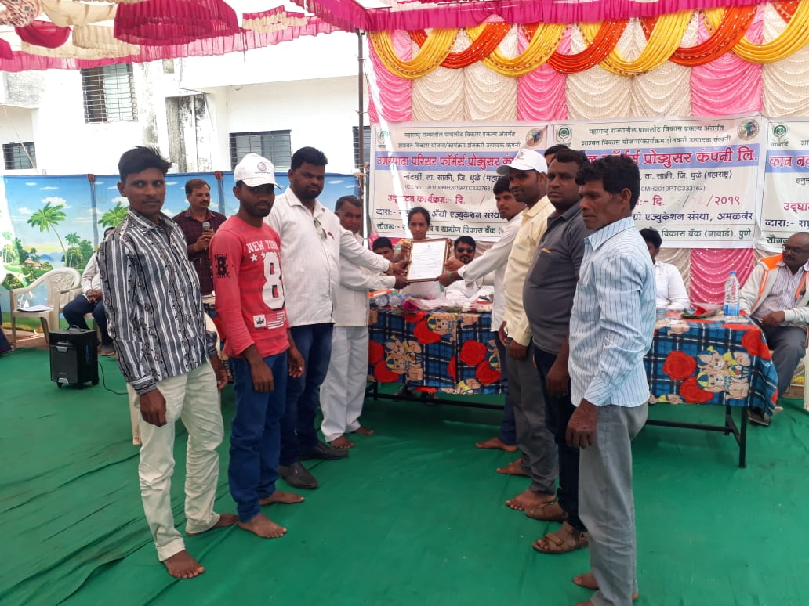
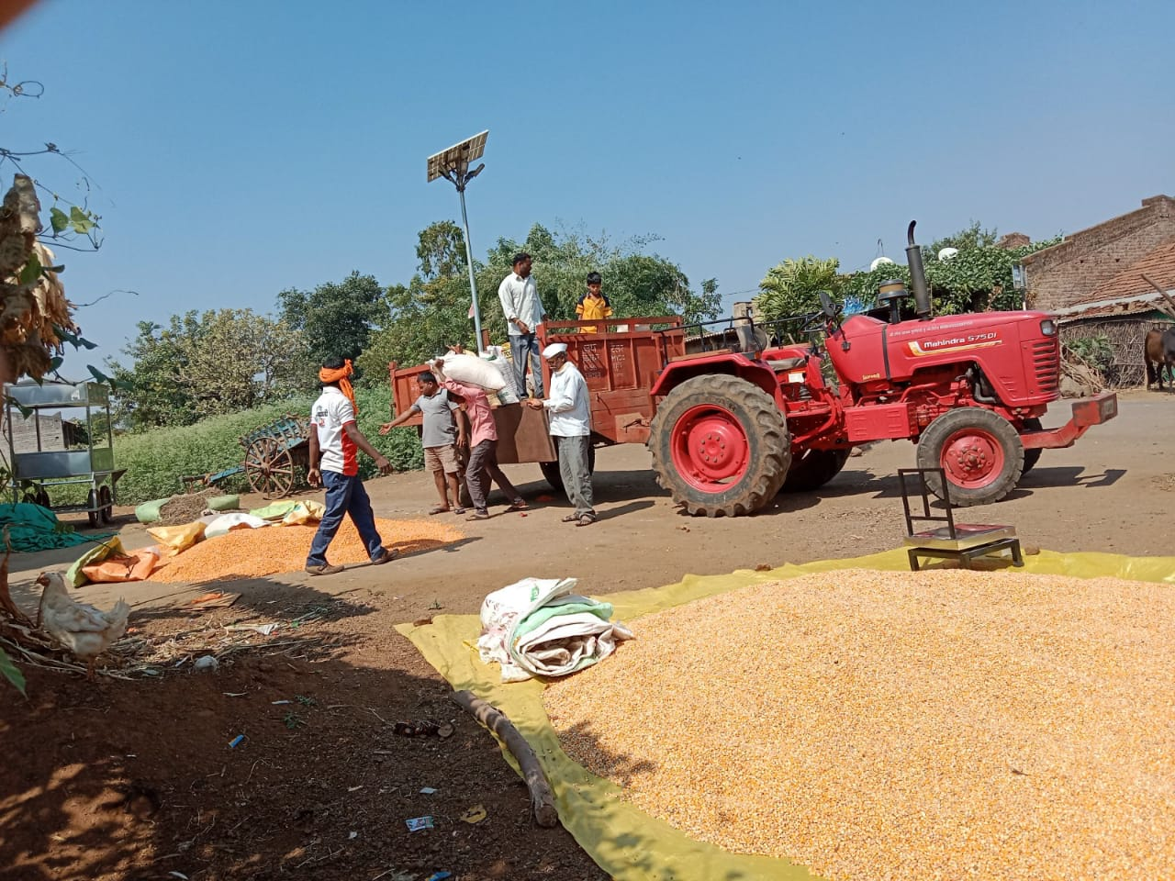

Slide 9
Thank you !!!

