Slide 1

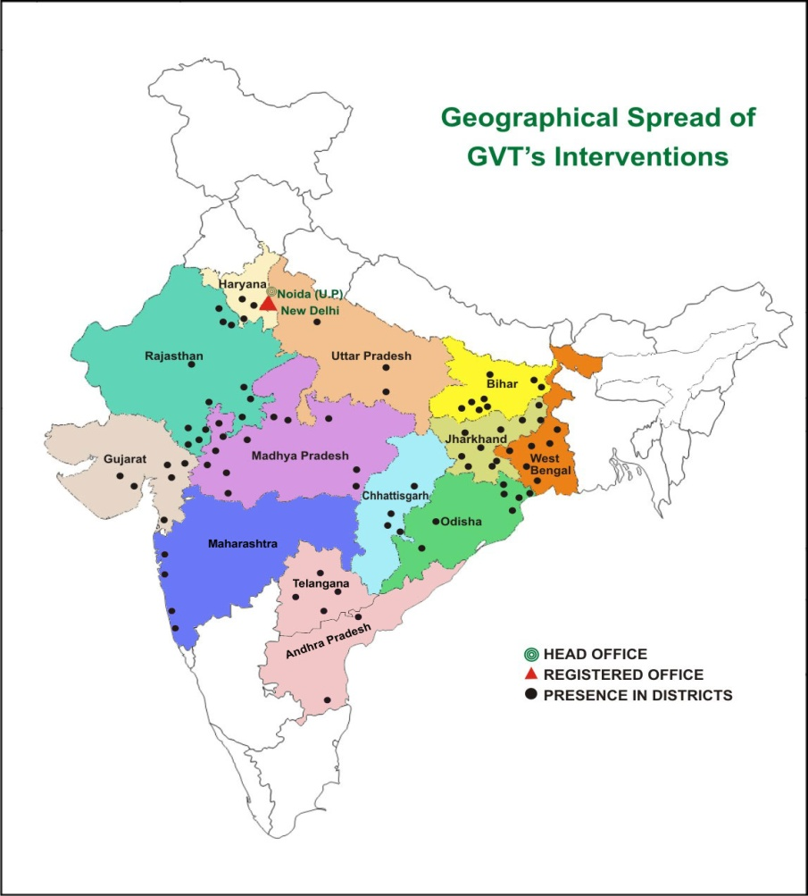
GRAMIN VIKAS TRUST
Since 1992
Established by KRIBHCO and DFID (UK)
26-Years, 370-Professionals
52-Offices, 98-Districts, 14-States
Residential National Livelihood Resource Institute at Ratlam (M.P.) and an AICTE approved School of Rural Management.
Krishi Vigyan Kendra at Godda
55 FPOs (Farmer Producer Companies)

Slide 2
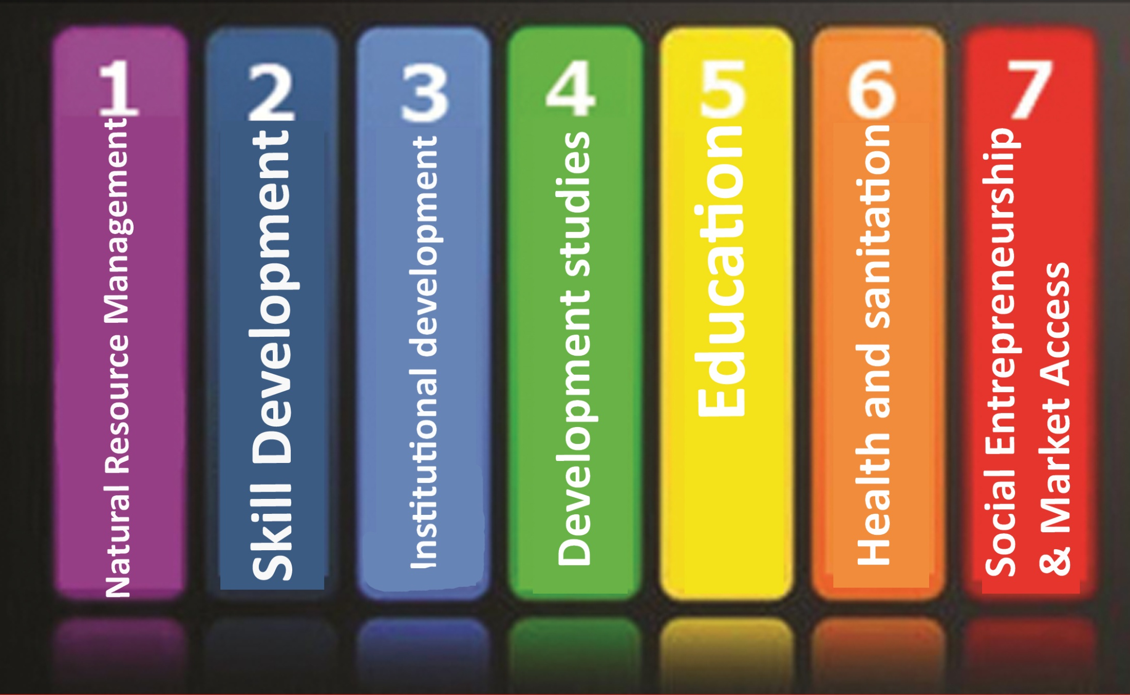
7 Thematic Areas

Slide 3

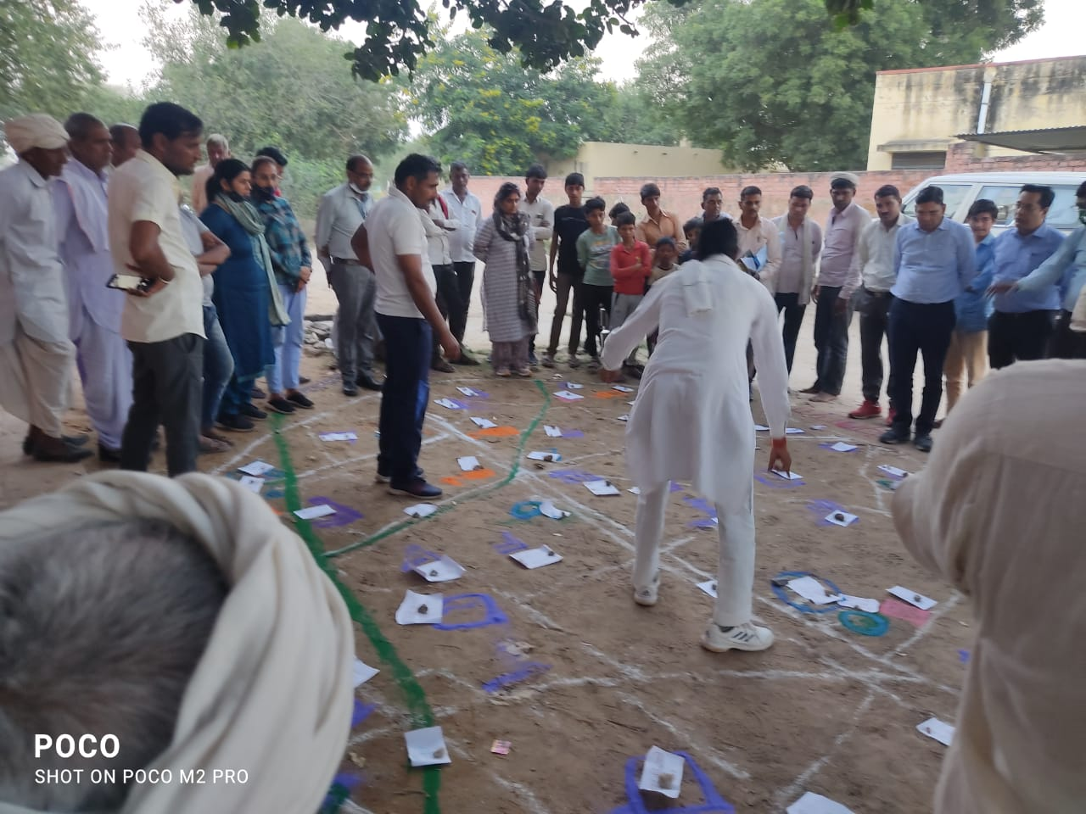
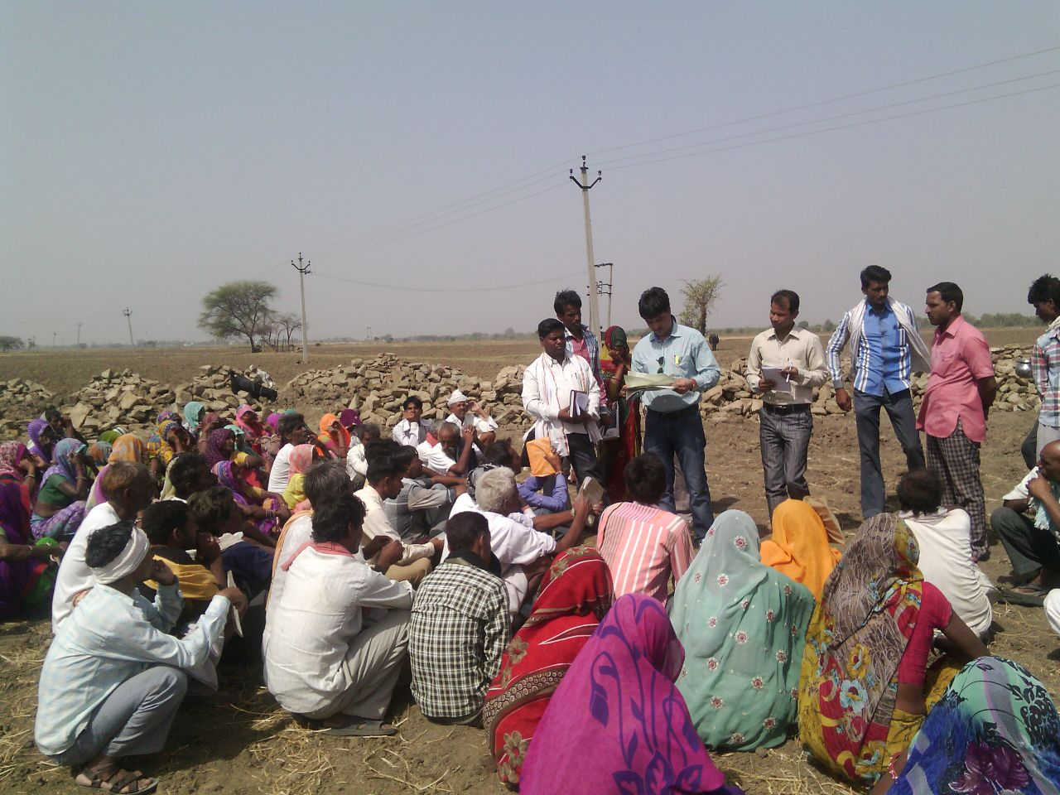
Involvement of PRIs
Preparation of VAP through PRA
Selection of beneficiaries for AKAK

