Slide 1



Pension Fund Regulatory and Development Authority
Atal Pension Yojana (APY)
a massive pension program of the country to
benefit 88 % of Unorganized Sector workforce to lead
a dignified life after 60 years
Regional Workshop on Economic and Social Transformation organized by Ministry of Panchayati Raj -Jaipur
22.11.2021

Slide 2
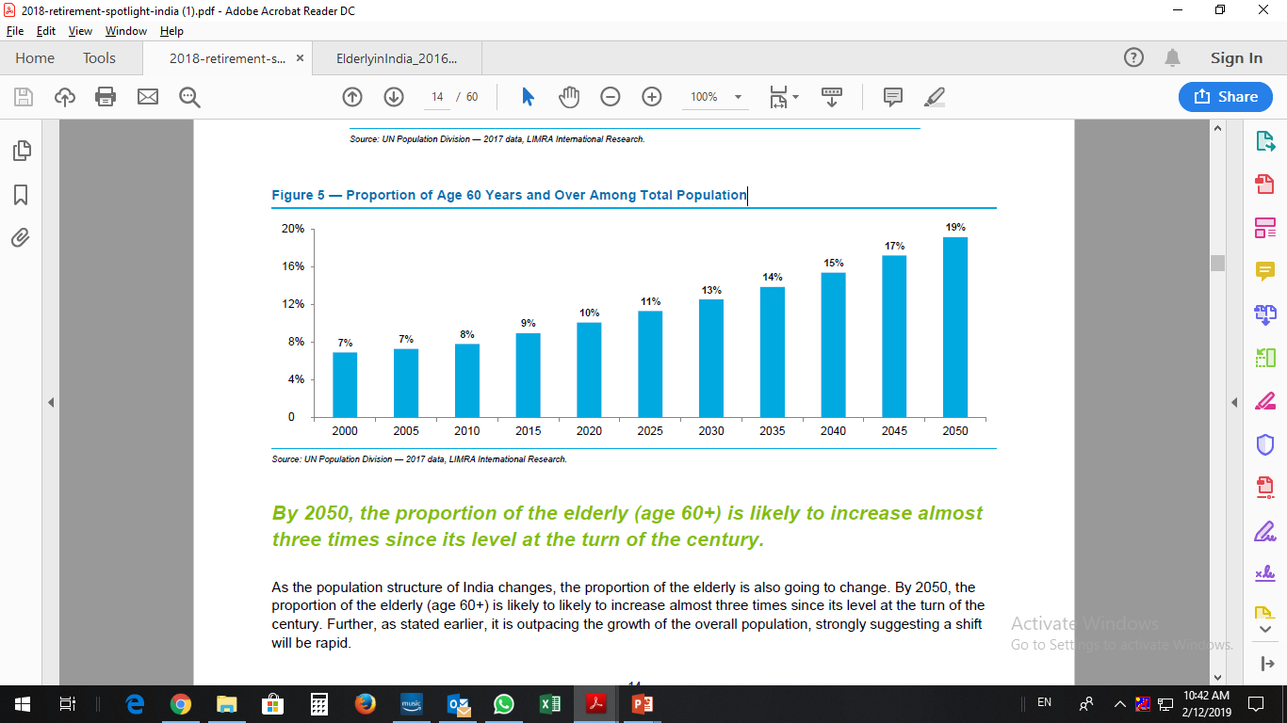
Proportion of people Aged above 60 Years to the Total Population/ कुल जनसंख्या के अनुपात में 60 वर्ष से अधिक आयु के व्यक्ति
Source: UN Population Division — 2017, LIMRA International Research.
As the population structure of India changes, the proportion of the elderly is also going to change/ भारत की जनसंख्या संरचना बदल रही है, वृद्ध जनसंख्या का अनुपात भी बदल रहा है I
By Year 2050, the proportion of the elderly (age 60+) is likely to increase almost three times since its level at the turn of the century./ वर्ष 2050 तक, वृद्धों (आयु 60+) का अनुपात सदी की शुरुआत के अपने स्तर से लगभग तीन गुना बढ़ने की संभावना है।
As on year 2020, we have 10% population above 60 years while in the year 2050, we would be having around 19% population above 60 years. It indicates that old to young ratio would be doubled in next 30 years, indicating more older population dependent on younger ones/ वर्ष 2020 तक के अनुसार, हमारी 10% जनसंख्या 60 वर्ष से ऊपर है, जबकि वर्ष 2050 तक हमारी 19% जनसंख्या 60 वर्ष से अधिक आयु की होगी I यह दर्शाता है कि अगले 30 वर्षों में, युवावर्ग की तुलना में वृद्धों का अनुपात दोगुना हो जाएगा, जो कि युवा वर्ग पर अधिक वृद्ध जनसंख्या की निर्भरता को दर्शाता है I

Slide 3
Life Expectancy at 60 years/ 60 वर्ष की आयु पर जीवन-प्रत्याशा

Slide 4
Percentage of working elderly/ वृद्ध कामकाजी व्यक्तियों का प्रतिशत
Source: Census 2011

Slide 5
Background/ पृष्ठभूमि
The announcement in the budget for F.Y 2015-16 on creating a universal social security system for all Indians, especially the poor, the under-privileged and the workers in the unorganised sector was made/ वित्तीय वर्ष 2015-16 के बजट में सभी भारतीयों, विशेष रूप से गरीबों, वंचित वर्गों और असंगठित क्षेत्र के श्रमिकों के लिए सार्वभौमिक सामजिक सुरक्षा प्रणाली के निर्माण के लिए घोषणा की गई I
Subsequent to this the Government of India introduced a pension scheme called the Atal Pension Yojana (APY), with effect from 1st June, 2015/ इसके बाद भारत सरकार ने 1 जून, 2015 से अटल पेंशन योजना (एपीवाई) की शुरुआत की I
APY is administered by the Pension Fund Regulatory and Development Authority (PFRDA) under the overall administrative and institutional architecture of the National Pension System (NPS)/ एपीवाई को पेंशन निधि विनियामक और विकास प्राधिकरण द्वारा राष्ट्रीय पेंशन प्रणाली (एनपीएस) के सम्पूर्ण प्रशासनिक और संस्थानिक ढाँचे के तहत प्रशासित किया जाता है I

Slide 6
Atal Pension Yojana/ अटल पेंशन योजना
Entry/ शामिल होना
All Citizens of 18-40 years join through any Bank where savings account is maintained/ 18-40 वर्ष की आयु के सभी नागरिक किसी भी बैंक, जहां उनका बचत खाता प्रबंधित हो, के माध्यम से योजना में शामिल हो सकते हैं I
Potential Subscribers may fill up a simple one-page form along with SB account details/ संभावित अभिदाता बचत बैंक खाता विवरण को देते हुए एक पृष्ठ का सरल प्रपत्र भरें I
These potential subscribers may choose Pension options Rs. 1000-Rs. 5000/ संभावित अभिदाता रूपये 1000- रू. 5000 की पेंशन राशि का विकल्प चुन सकते हैं I

Slide 7
Atal Pension Yojana/ अटल पेंशन योजना
Subscribers may deposit Monthly /Quarterly/Half yearly contributions in the savings account to ensure the auto debit transactions/ ऑटो-डेबिट सुनिश्चित करने के लिए बचत खाते में मासिक/त्रैमासिक/अर्धवार्षिक अंशदान जमा करा सकते हैं I
Pension amount opted and frequency may be changed to higher/lower amount once in a year by all APY Subscribers./ सभी एपीवाई अभिदाता चयनित पेंशन राशि और आवृत्ति को वर्ष में एक बार अधिक/कम राशि के रूप में परिवर्तित कर सकते हैं I
Accumulation/ संचयन

Slide 8

Atal Pension Yojana- A BRIEF
On attaining 60 Years/ 60 वर्ष की आयु प्राप्त करने पर
Exit/ निकास
Return of indicative pension wealth to nominees after death of spouse/ पति/पत्नी की मृत्यु के बाद नामिति को अनुमानित पेंशन संपत्ति की वापसी I
Triple Benefit/ तिगुना लाभ
The same pension is payable to Spouse after death of Subscriber/ अभिदाता की मृत्यु के बाद पति/पत्नी को भी समान पेंशन प्रदान की जाएगी I
If the actual returns on the pension contributions are higher, then higher the pension.
Minimum guaranteed Pension of ₹1000 to
₹5000/ ₹1000 से
₹5000 की न्यूनतम गारंटीड पेंशन
Returns arrived at 8% and pay outs at 7%

Slide 9
Atal Pension Yojana- A BRIEF
Before 60 Years/ 60 वर्ष से पूर्व
In the event of the death of the subscriber, the amount of accumulated wealth in the APY account will be paid to spouse who is the default nominee or the nominee prescribed by the subscriber/ अभिदाता की मृत्यु की स्थिति में, एपीवाई खाते में संचित पेंशन राशि को पति/पत्नी, जो कि डिफॉल्ट नामिति है या अभिदाता द्वारा दिए गए नामिति को दिया जाएगा I
Further, in case of death of subscriber, Spouse has an option to continue contribution under Scheme/ इसके अलावा, अभिदाता की मृत्यु की स्थिति में अभिदाता के जीवित पति/पत्नी के पास अंशदान जारी रखने का विकल्प होगा I
In case of voluntary Exit, the accumulated wealth (subscriber contribution + returns) is paid to the subscriber with applicable deduction of charges, forfeiture of GOI co-contributions/ स्वैच्छिक निकास के मामले में, संचित राशि (अभिदाता अंशदान + रिटर्न्स) अभिदाता को वापस की जाएगी, जो कि लागू कटौती शुल्कों, और भारत सरकार के सह-अंशदान की कटौती के बाद होगी I
Exit/ निकास

Slide 11
Few scenarios of contributions/ अंशदान के विभिन्न परिदृश्य
For illustration purpose only
Subscriber/ अभिदाता (A) | Age/ आयु (वर्ष) (B) | Pension Slab/ पेंशन स्लेब (C) | Monthly Contribution/ अंशदान राशि प्रति माह (D) | Vesting period/ निहित अवधि (E) | Total contribution/ कुल अंशदान (F) | Pension amount, if live till 80 years/ पेंशन राशि, 80 वर्ष तक जीवित (G) | Spuse alive, after subscriber’s death/ पति/पत्नी जीवित, अन्य 5 वर्षों के लिए (H) | Amount payable to nominee/ नामिति को संचित सम्पत्ति (न्यूनतम) (I) | Total payout/ कुल लाभ (J)
Mr. Amit | 18 | 5,000/- | 210/- | 42 years | 1,05,840/- | 12,00,000/- | 3,00,000/- | 8,50,000/- | 23,50,000/-
Mr. Amit | 40 | 5,000/- | 1,454/- | 20 years | 3,48,960/- | 12,00,000/- | 3,00,000/- | 8,50,000/- | 23,50,000/-
Family Pension
Subscriber/ अभिदाता (A) | Age/ आयु (वर्ष) (B) | Pension Slab/ पेंशन स्लेब (C) | Monthly Contribution/ अंशदान राशि प्रति माह (D) | Vesting period/ निहित अवधि (E) | Total contribution/ कुल अंशदान (F) | Pension amount, if live till 80 years/ पेंशन राशि, 80 वर्ष तक जीवित (Husband) (G) | Pension amount, if live till 85 years/ पेंशन राशि, 85 वर्ष तक जीवित (Wife) | Amount payable to nominee/ नामिति को संचित सम्पत्ति (न्यूनतम) (I) | Total payout if spouse survives till 85 years/ कुल लाभ (J)
Husband | 21 | 5,000/- | 269/- | 39 years | 1,25,892/- | 12,00,000/- | - | 8,50,000/- | -
Wife (pension for own account) | 18 | 5,000/- | 210/- | 42 years | 1,05,840- | - | 15,00,000/- |  | -
Wife (pension for husband’s account) | - | - | - | - | - | - | 4,80,000/- | 8,50,000/- | -
Total payout |  |  |  |  | 2,31,732 | 12,00,000/- | 19,80,000/- | 17,00,000/- | 46,80,000/-

Slide 12
APY – Progress Chart
APY gross enrolment has reach to 347 lakhs on 25th Oct. 2021 from 24.84 lakhs at 31st March 2016 with CAGR of 60.16%

Slide 13
Bank Category Wise Performance under APY/ एपीवाई के तहत बैंक श्रेणी अनुसार प्रदर्शन
Bank Category | 31, Mar 2016 | 31, Mar 2017 | 31, Mar 2018 | 31, Mar 2019 | 31, Mar 2020 | 31, Mar 2021 | 15, Nov 2021
Public Sector Banks | 1,693,190 | 3,047,273 | 6,553,397 | 10,719,758 | 1,56,75,442 | 2,12,52,435 | 2,49,16,076
Private Banks | 218,086 | 497,323 | 873,901 | 1,145,289 | 15,62,997 | 19,86,467 | 21,56,042
Small Finance Bank | - | - | - | 9,190 | 15,760 | 35,114 | 60,450
Payment Bank | - | - | - | 48,182 | 3,44,001 | 8,18,800 | 11,36,933
Regional Rural Banks | 476,373 | 1,115,257 | 1,987,176 | 3,171,152 | 43,30,190 | 57,10,770 | 65,62,209
Co-op Banks | 21,903 | 33,978 | 45,621 | 54,385 | 70,556 | 80,073 | 87,101
Dept. of Posts | 75,343 | 189,998 | 245,366 | 270,329 | 3,02,712 | 3,32,141 | 3,46,861
Total | 24,84,895 | 48,83,829 | 97,05,461 | 1,54,18,285 | 2,23,01,658 | 3,02,15,800 | 3,52,65,672

Slide 14
Analysis on APY Subscribers – Gender Wise/एपीवाई अभिदाताओं का विश्लेषण – लिंग अनुसार

Slide 15
Analysis on APY Subscribers – Subscriber Age Wise/ एपीवाई अभिदाताओं पर विश्लेषण- आयु अनुसार अभिदाता

Slide 16
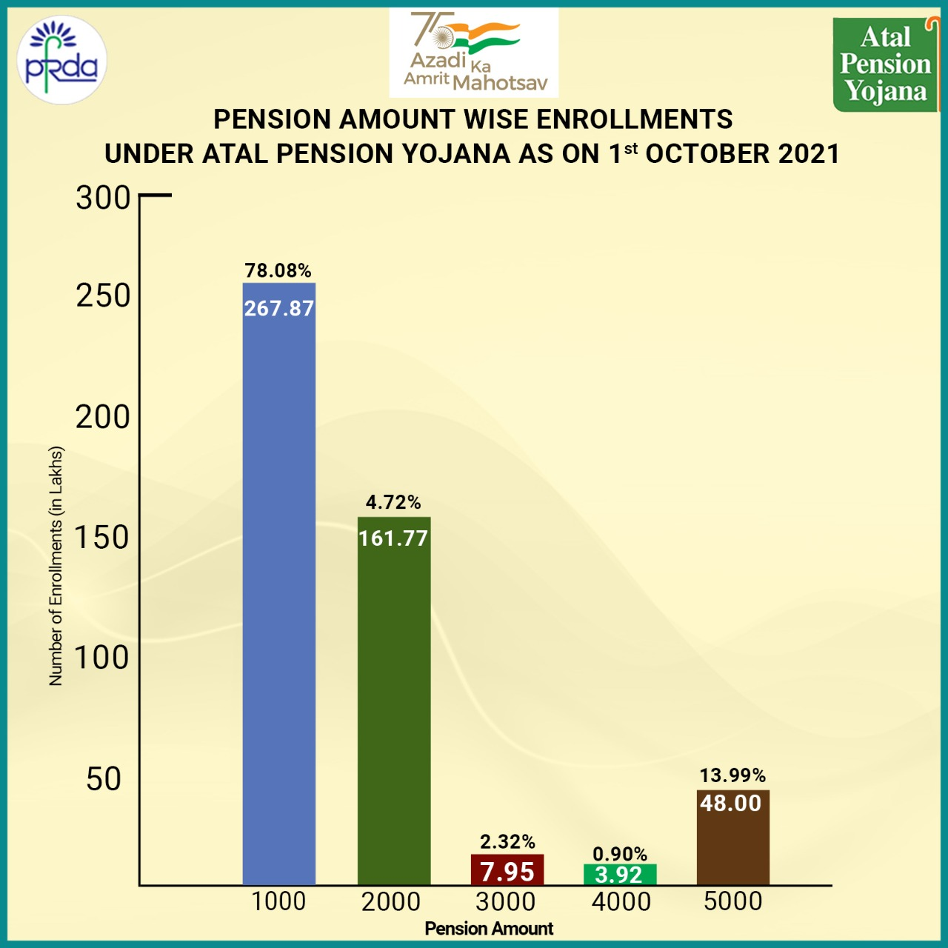
Analysis on APY Subscribers – Pension Slab wise

Slide 17
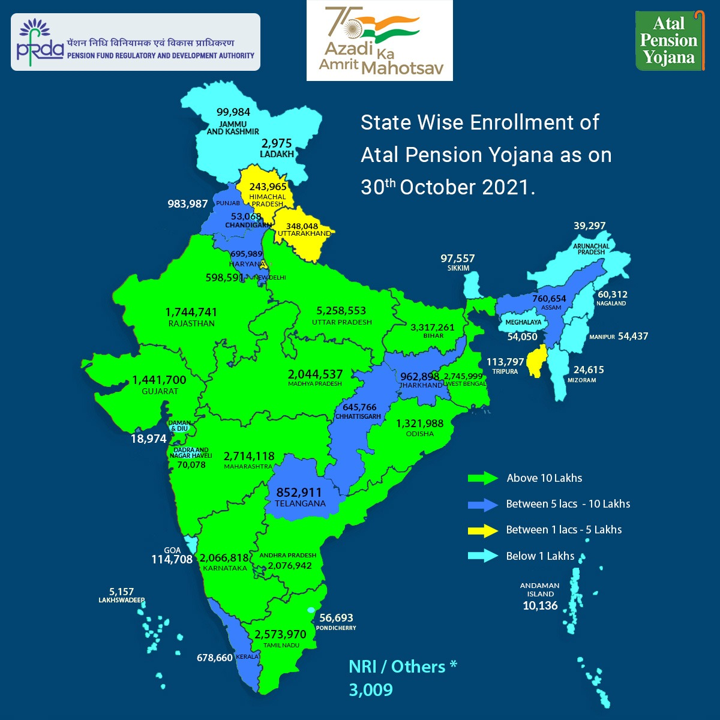

Slide 18
Top 10 STATE WISE APY COVERAGE
S.NO | STATE | POPULATION BETWEEN AGE GROUP 18 TO 40 | Number of APY Subscribers as on 30.10.2021 | % Coverage
1 | UTTAR PRADESH | 7,12,89,176 | 52,25,435 | 7%
2 | BIHAR | 3,54,84,731 | 32,94,290 | 9%
3 | WEST BENGAL | 3,66,88,732 | 27,34,580 | 7%
4 | MAHARASHTRA | 4,52,74,703 | 26,97,369 | 6%
5 | TAMIL NADU | 2,90,69,600 | 25,60,766 | 6%
6 | ANDHRA PRADESH | 3,48,32,527 | 20,65,939 | 6%
7 | KARNATAKA | 2,53,59,036 | 20,55,920 | 6%
8 | MADHYA PRADESH | 2,72,34,721 | 20,33,712 | 7%
9 | RAJASTHAN | 2,52,77,598 | 17,33,577 | 7%
10 | GUJARAT | 2,38,27,045 | 14,35,907 | 6%

Slide 19
APY coverage in PESA States
S.NO | STATE | POPULATION BETWEEN AGE GROUP 18 TO 40 | Number of APY Subscribers as on 15.11.2021 | % Coverage
1 | ANDHRA PRADESH | 3,48,32,527 | 20,91,075 | 6%
2 | CHHATTISGARH | 96,75,449 | 6,52,746 | 7%
3 | HIMACHAL PRADESH | 26,85,526 | 2,45,939 | 9%
4 | GUJARAT | 2,38,27,045 | 14,49,141 | 6%
5 | JHARKHAND | 1,19,67,910 | 9,69,738 | 8%
6 | MADHYA PRADESH | 2,72,34,721 | 20,58,880 | 8%
7 | MAHARASHTRA | 4,52,74,703 | 27,30,684 | 6%
8 | ODISHA | 1,61,18,865 | 13,34,590 | 8%
9 | RAJASTHAN | 2,52,77,598 | 17,60,547 | 7%
10 | TELANGANA |  | 8,64,107

Slide 20
Saturation of Pension for Unorganised sector
The Govt. has envisioned for saturation of 3 PM’s Jan Suraksha Schemes (PMJSS) viz. Pradhan Mantri Jeevan Jyoti Bima Yojana, Pradhan Mantri Suraksha Bima Yojana and Atal Pension Yojana.
PFRDA is planning to cover nearly 7 crore new enrolments under APY, in the next 3 to 5 years.
Efforts being made:
  Periodic review, capacity building program, webinars, awareness program
  40 locations have been identified for conducting outreach programmes, before March 2022.
  Conducted meetings with both ministries of Rural Development and Panchayati Raj for enrolling target population with them, under APY
  Mass media campaigns in regional languages are being planned

Slide 21
Initiatives
PFRDA has taken many initiatives in the recent past for popularizing the scheme, such as:
Launching of eAPY platform for online-onboarding of subscribers
Launch of APY mobile app
APY app on UMANG: APY app is now live on UMANG platform.
xxii. On-boarding using Bank’s own web-portal
Lead Generation by relatives and well-wishers
Social media platforms like Youtube, twitter and facebook being used for mass awareness

Slide 22
Various Methods of Joining APY
The Gram Panchayats can play a vital role in ensuring comprehensive coverage of the APY scheme.
Since APY accounts are being sourced by bank branches (under service area approach), therefore all Gram Panchayats may visit nearest bank branch preferably public sector and RRBs for participation in people’s plan campaign/ GPDP for enrolment of APY subscribers.
Bank officials/BCs shall establish a desk (Camp/canopy) during Gram Sabha to open APY accounts.
Identified unorganised workers (Aanganwadi, SHG members, factory workers, local artisans, etc) may be advised to open APY accounts.
Ministry of Panchayati Raj may also consider sharing the schedule of proposed and upcoming Gram Sabha meetings with PFRDA, which in turn can be shared by PFRDA with SLBCs/LDMs/HO of RRBs, for better coordination at Gram Sabha level.

Slide 23
Important links:
A) Atal Pension Yojana (APY) Notification dated 16th October 2015/ अटल पेंशन योजना अधिसूचना दिनांक 16 अक्टूबर 2015
https://www.pfrda.org.in/myauth/admin/showimg.cshtml?ID=789
B) ATAL PENSION YOJANA (APY) - SUBSCRIBER INFORMATION BROCHURE/ अटल पेंशन योजना- अभिदाता सूचना विवरणिका (ब्रोशर)
https://www.pfrda.org.in/myauth/admin/showimg.cshtml?ID=1739
C) APY Subscriber Registration Form / एपीवाई अभिदाता पंजीकरण प्रपत्र (फॉर्म)
https://www.pfrda.org.in/myauth/admin/showimg.cshtml?ID=1269
D) Social Media Links of the APY Advertisement Video / एपीवाई विज्ञापन वीडियो के सोशल मीडिया लिंक्स
https://twitter.com/PFRDAOfficial/status/1347433610484219904
https://www.facebook.com/OfficialAPY/posts/725638848069967
https://www.youtube.com/watch?v=nP8fOal2S9A
E) FAQs On APY/ एपीवाई पर अधिकतर पूछे जाने वाले प्रश्न
https://www.pfrda.org.in/myauth/admin/showimg.cshtml?ID=1789
F) APY, PFRDA Page available at: Facebook G) APY KI PATHSHALA Page is available at: Youtube
H) APY, Citizen’s charter: www.pfrda.org.in/myauth/admin/showimg.cshtml?ID=1779
I) APY enrollment details and download of Account Statement / ePRAN Card: https://npscra.nsdl.co.in/enrollment-details-of-apy.php

Slide 24
Thank You !/ धन्यवाद!

