Slide 1
Village Disaster Management Plan (VDMP)
&
Integration of DRR in
Gram Panchayat Development Plan (GPDP)
Anuj Tiwari
National Disaster Management Authority (NDMA)

Slide 2
Failing to Plan is Planning to Fail
Disasters take away decades of Developmental Gains
Every Disaster also provides an opportunity to build back better
One Dollar spent on preparedness/risk reduction or mitigation, saves seven dollars needed for response and relief

Slide 3
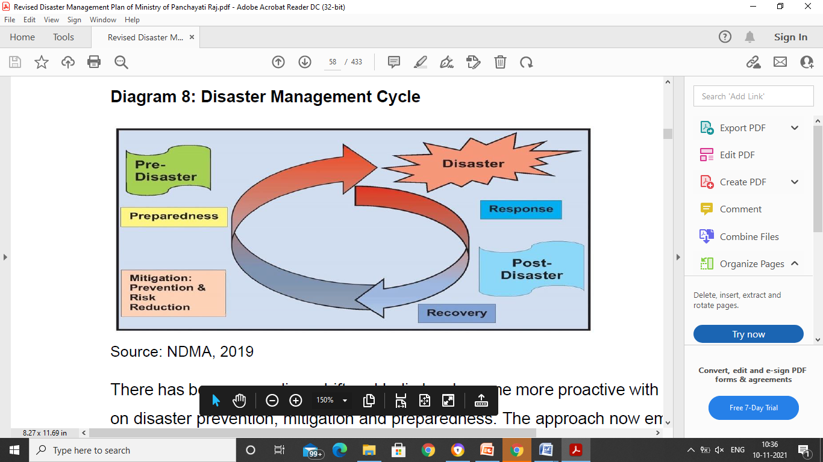
Disaster Management Cycle

Slide 4
Importance of DM at Local Level
Disasters have most impact at local level
Need for Global Actions with Local Impacts
PRIs are grass root level institutions and more aware of the ground level realities.
PRIs have better knowledge and understanding of the area and skill to deal with the disasters and about the locally available resources.
Village community has good repository of knowledge in terms of their hazards, risks and vulnerabilities
They are both the first receivers and responders of disasters in their area.

Slide 5
Importance of DM at Local Level
Need to capacitate them as first available resource in disaster situation.
PRIs need to be capacitated and strengthened to tackle any disaster till specialised external assistance reaches them. This can prevent loss of many precious lives and also reduce the damages.
Panchayats are people’s participation on an institutionalized basis.
The PRIs can act as catalysts for the social mobilization process and tap the traditional wisdom of the local communities to complement the modern practices in disaster mitigation efforts.

Slide 6
Panchayati Raj Institutions (PRI)
India has remarkable achievement of continuing Panchayati Raj System, which is an integral part of its culture and civilization.
Panchayats provide unique local self-governance and developmental institutions for rural areas.
The 73rd Amendment of the Constitution of India introduced uniform structure of three tiers of Panchayat viz. (i) Gram Panchayat at village level, (ii) Intermediate Panchayat (IP) at Block / Sub-Division / Taluk / Mandal level, and (iii) District Panchayat (DP) at district level for rural area.

Slide 7
National Disaster Management Plan - NDMP
Inclusive Approach to DRR
Considering an important stakeholders, the PRIs have been given specific responsibilities in the mitigation matrix for all disasters in the NDMP.
Capacity building and strengthening of PRIs and local institutions is priority area.
Special emphasis on Mainstreaming DRR

Slide 8
Provisions in DM Act , 2005
Section 37 of the Disaster Management Act mandates, every Ministry or Department of the Government of India to have a disaster management plan.
Section 41 of the Disaster Management Act mandates, as per the directions of District Authority, a local authority shall—
  ensure that its officers and employees are trained for disaster management;
  ensure that resources relating to disaster management are so maintained as to be readily available for use in the event of any threatening disaster situation or disaster;
  ensure all construction projects under it or within its jurisdiction conform to the standards and specifications laid down for prevention of disasters and mitigation by the National Authority, State Authority and the District Authority;
  carry out relief, rehabilitation and reconstruction activities in the affected area in accordance with the State Plan and the District Plan.
The local authority may take such other measures as may be necessary for the disaster management.
Notes:
“local authority” includes panchayati raj institutions, municipalities, a district board, cantonment board, town planning authority or Zila Parishad or any other body or authority, by whatever name called, for the time being invested by law, for rendering essential services or, with the control and management of civic services, within a specified local area;

Slide 9
PM’s Ten-Point Agenda for DRR
The Hon’ble Prime Minister enunciated a Ten-Point Agenda in his inaugural speech at the Asian Ministerial Conference on Disaster Risk Reduction (AMCDRR), 2016, held in New Delhi during November 2016, which has also been incorporated in the NDMP. The ten key elements consist of the following:
1. All development sectors must imbibe the principles of disaster risk management
2. Risk coverage must include all, starting from poor households to SMEs to multi-national corporations to nation states
3. Women’s leadership and greater involvement should be central to disaster risk management
4. Invest in risk mapping globally to improve global understanding of Nature and disaster risks

Slide 10
PM’s Ten-Point Agenda for DRR
5. Leverage technology to enhance the efficiency of disaster risk management efforts
6. Develop a network of universities to work on disaster-related issues
7. Utilise the opportunities provided by social media and mobile technologies for disaster risk reduction
8. Build on local capacity and initiative to enhance disaster risk reduction
9. Make use of every opportunity to learn from disasters and, to achieve that, there must be studies on the lessons after every disaster
10. Bring about greater cohesion in international response to disasters

Slide 11
XV FC on PRIs for Disaster Preparedness and Management
Lack of disaster preparedness and mitigation planning at the local level
Gives rise to considerable problems in the management of disasters.
Need to build adequate capacity at the panchayat level - Empowering Panchayats.
Proximity to the local community (including the weaker sections of society) - more significant for quick response to disasters
Minimise dependence on the government for rescue and relief operations.
Improved planning, coordination and monitoring, and thus making the overall relief and rehabilitation interventions better.
PRIs can play a pro-active role in all stages to disaster management.

Slide 12
DM Plan of MoPR
Provides a basic framework to PRIs to contribute substantially in mitigation, preparedness, response, recovery and reconstruction phases.
Guidelines for the preparation of Village Disaster Management Plan (VDMP) for every village
Integration of the VDMPs into the Gram Panchayat Development Plan (GPDP) through a dedicated Working Group
Presents a larger perspective of community based planning starting from village to District Panchayat level.
Aligned with the NDMP, 2019 and also in consonance with the three landmark global agreements reached in 2015 – (i) the SFDRR, (ii) SDGs, and (iii) COP 21 and also with the Prime Minister’s ten- point agenda for disaster risk reduction.

Slide 13
Village Disaster Management Plan - VDMP
Development of VDMPs will be done in a three-step process
VDMP
Strategy
Process
Component (Template)

Slide 14
Resilient Villages through VDMPs
  Community - aware and recognize the risk/hazards and take appropriate action.
  Practice safe behaviours
  Able to meet small-scale disasters
  DRR is mainstreamed in GP level plans
  Risk analysis, risk communication, preparedness and risk reduction actions
  Timely access to early warning information and emergency services
  Continuity of basic services
  Easy access to essential items and life-saving equipment
  Inclusive and participatory manner - differential needs and capacities

Slide 15
VDMP: What & Why?
  VDMP can prove to be beneficial as:
    It outlines the process by which the village should manage the disasters.
    It can be used to tap human and material resources in the aftermath of a disaster.
    It lists down the contact details of important administrative officials ensuring quick communication with the administrative officials.
    It describes the roles and responsibilities of the concerned officials, stakeholders and various teams (community) in the wake of a disaster.
    It can play a vital role in helping to avoid mistakes or recognize hidden opportunities.

Slide 16
VDMP: What & Why?
  Why VDMPs are needed?
    Past hazard profile
    Present vulnerabilities
    Prepare for future
  The VDMP must have the following features:
    Have a clearly stated objective or set of objectives
    Reflect a systematic sequence of activities in a logical and clear manner
    Assign specific tasks and responsibilities
    Offer a benchmark against which actual performance can be measured and reviewed
    Integrate its activities, tasks and responsibilities to enable the overall objective or series of objectives to be achieved

Slide 17
Strategy for Development of VDMPs
  Framework for VDMP:
    By the local participants - participatory approach
    Disaster Management Committees and Teams
    Mock Drills check the response of the community in a mock environment - also test the applicability of the village disaster management plan
    Awareness has to be generated amongst the community through various media

Slide 18
Process for Development of VDMPs
  Past History of Hazards and Disasters
  Transect Walk (Preliminary survey of village) by the Core Team
  First meeting with all villagers
  Sharing of objectives of VDMP and modalities of development
  Village level institutions, functionaries and their roles and responsibilities for DRR
  Social Mapping (involving villagers)
  Hazard, Risk and Vulnerability Mapping

Slide 19
Process for Development of VDMPs
  Identification of village level mitigation needs/projects
  Resource/Equipment and Capacity Mapping
  Planning for Awareness Generation, Training & Capacity Building and Mock Drills
  Preparedness and Response Planning
  Identification of sources of finances / funds
  Drafting of Village Disaster Management Plan
  Other useful information to be annexed
  Plan Management

Slide 20
VDMP Template

Slide 21
Gram Panchayat Development Plan (GPDP)
The Article 243G of the Constitution of India mandates the Gram Panchayat (GP) to prepare and implement the Gram Panchayat Development Plan (GPDP) for economic development and social justice by converging and integrating all such programmes of the Panchayat, State and Centre within its geographical area.
As local government, they are responsible for delivery of basic services to local citizens and address the vulnerabilities of poor and marginalized sections of the population.
Essentials of GPDP
  It should be prepared through a participatory, inclusive and transparent process.
  The plan should be long-term (perspective plan), ideally for five years with annual operational plan, which is based on priorities arrived at Gram Sabha.

Slide 22
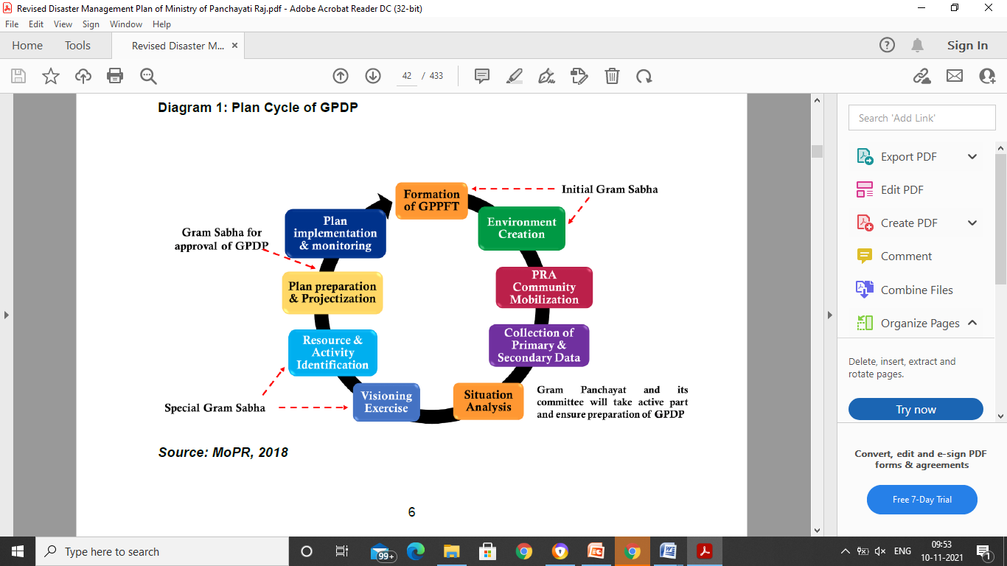
Plan Cycle of GPDP

Slide 23
Role of Panchayats in Disaster Management - Pre-Disaster
Organising awareness campaign and promoting community education on disaster preparedness
Articulation of community needs for developing preparedness plan through community involvement and Panchayat ownership
Identifying the resource gaps (both physical and manpower) and replenish the same through capacity building
Establishing synergy with local agencies including NGOs/ CBOs
Dovetailing risk reduction into various development programs of national and state governments

Slide 24
Role of Panchayats in Disaster Management - Pre-Disaster
Establishing convergence with local institutional structures created for implementing education, health, livelihood, social justice etc.
Activating the DM Plans with the participation of the community
Formation of Task forces and their capacity building
Identifying land/building for relief camp

Slide 25
Role of Panchayats in Disaster Management - During Disaster
Arranging emergency communication through available resources
Evacuation to temporary shelter and running relief camps
Supplementing rescue and relief efforts in coordinating different agencies
Monitoring of Relief distribution
Safe disposal of carcass and arranging safe drinking water and sanitation
Special arrangement for health care for adolescent girls and women
Protection of vulnerable groups

Slide 26
Role of Panchayats in Disaster Management - Post Disaster
Damage assessment particularly assisting in identifying victims for compensation and its distribution
Formulating rehabilitation and reconstruction plan of houses and other local infrastructures
Enforce minimum specification for safe reconstruction
Supervise and monitor long term reconstruction and mitigation projects
Mobilizing special funds to use disaster resistant construction technology in vulnerable areas
Mobilising local resources and manpower in relief and rehabilitation

Slide 27
DRR Issues for Discussion in GPs
GP – An important platform for villagers to share their concerns before their representatives.
DRR ensures the sustainability of all developmental initiatives and schemes.
Good repository of knowledge in villages in terms of hazards, risks and vulnerabilities, locally available resources, ways of tackling disasters at community level
Many low budget interventions can be taken up at village level by community themselves.
Important issues concerning villagers with regard to disaster risk reduction can be discussed in Gram Sabha.
The discussion will lead to formulation of Village level Disaster Management Plan and Risk Informed Gram Panchayat Development Plan (GPDP).

Slide 28
Issues for Discussion
History of past disasters in the village
  Name of the disaster
  Year of occurrence of disaster
  Impact and losses
  Relief and Recovery
  Lessons Learnt
Hazards in the village
  Natural
  Man-Made
Vulnerabilities in the Village
  Vulnerable Population (location, age, disability, social issues, gender etc.)
  Vulnerable Areas (elevation, topography etc.)
  Vulnerable Buildings (built according to Building Codes, quality of construction – disaster resistant norms etc.

Slide 29
Issues for Discussion
Awareness Generation
  Preparedness Measures (preparedness means the state of readiness to deal with a threatening disaster situation or disaster and the effects thereof)
  Undertaking Mock Drills
  Dos & Don’ts
Role of Individuals, Community and Panchayat in disaster risk reduction
Early Warning
Response (Team Formation)
  Evacuation
  Search & Rescue
  Relief
Village Level Plan
  Disaster Management Plan
  Integration of disaster risk reduction with Village Development Plan

Slide 30
Initiatives by MoPR and NDMA
NDMA is committed for inclusive DRR
MoPR has also shown its commitment for a development of a resilient nation and is among the leading few Ministries to have a disaster management plan and also commitment for integrating the DRR in all GPDPs.
NDMA developed a template for Village Disaster Management Plan (VDMP) and shared with the MoPR for sharing with all GPs and also shared issues for discussion at GP level and how to integrate DRR in GPDP.
MoPR and NDMA togehter can move forward to integrate DRR in GPDP and to have VDMPs prepared for every village.

Slide 31
Innovations in the Disaster Management Plan of Ministry of Panchayati Raj (DMP-MoPR)
Disaster Management Plan of each Village and Panchayat
Community Based DM Planning
Modified Bottom up Approach
Participative and Inclusive Planning Process
Disaster Management fully mainstreamed with development planning
Seamless coordination from National Level to Village
Working Group on Disaster Management at GP, Block and Districts Panchayat
Competence based training on Disaster Management( REF XXVII of MOPR)

Slide 32
Expectations from MoPR and PRIs
There are Nodal Ministries for management of different disasters but MoPR can play a key role in ensuring mainstreaming of DRR at village level, cutting across all disasters.
MoPR should share the VDMP templates with all villages in every State and also prepare strategy for integration of DRR in GPDP.
NDMA will provide all technical supports in this process.

Slide 33
Thanks!

