Slide 1

S R Meena Scientist
MNRE
29.12.2021

Slide 2
RE : SDG-7 : Affordable and Clean Energy
The affordability and reliability of energy supply are key concerns for India’s consumers
Over 80% of India’s energy needs are met by three fuels: coal, oil and solid biomass.
India’s electricity demand projected to grow by almost 5% per year to 2040. (nearby double of energy demand)
India is the 3rd-largest global emitter of CO₂, despite low per capita CO₂ emissions
  Energy is the dominant contributor to climate change, accounting for around 60 per cent of total global GHG emissions.
  Since 1990, global emissions of CO2 have increased by > 46 %.
Despite recent success in expanding coverage of LPG in rural areas, 660 million Indians have not fully switched to modern, clean cooking fuels or technologies.
Securing energy demand sustainably with lower emissions could be attained by RE Sources
India’s overall energy consumption is expected to rise to 1921 Mtoe by 2040 with an average growth rate of 4.2% per annum.
789 million people around the world lack access to electricity

Slide 3
(PM-KUSUM) Scheme
PM- Kisan Urja Suraksha evam Utthan Mahabhiyaan
Scheme approved on : 8/03/2019
Target : Cumulative 25.75 GW
Validity : up to 31.12.2022
Outlay : Rs. 34,422 crore
  Component A: 10,000 MW (Grid Connected)- 0.5-2 MW size
  Component B: 17.50 lakh standalone Solar Ag Pumps
  Component C: Solarisation of 10 Lakh(Grid-conn.) Agr. Pumps
  Guideline notified on 22.07.2019

Slide 4
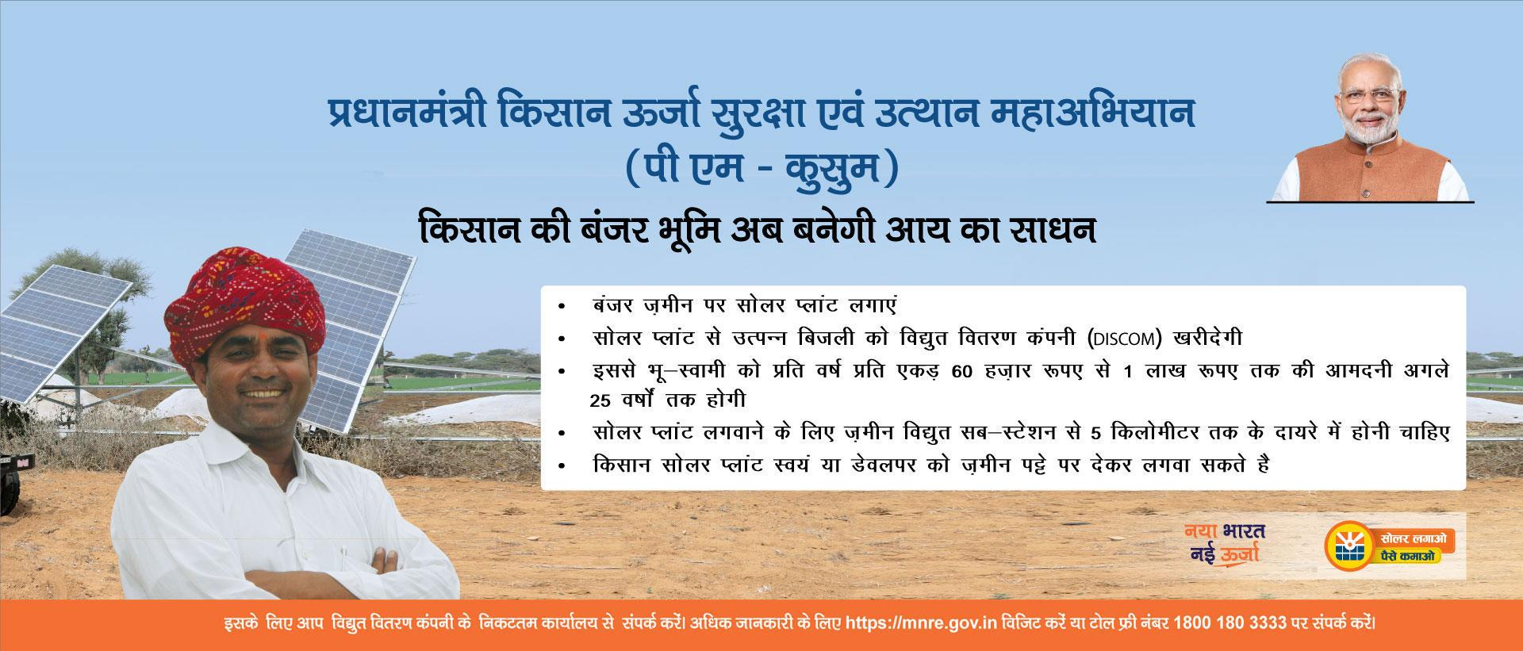
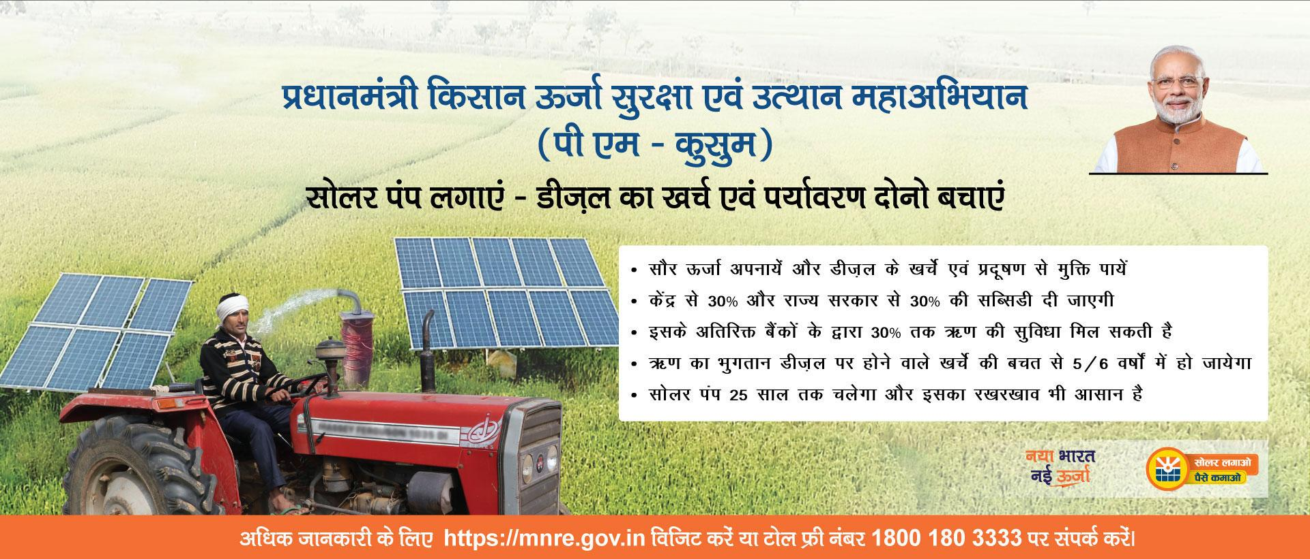

Slide 5
PM-KUSUM - Objectives
Reliable day time solar power to farmers
Enhancing farmers’ income – RE plants on barren land of farmers.
Additional source for income to farmers by selling surplus power
Water conservation
To reduce carbon footprint
Reduction of burden of subsidy to agriculture sector
Reduction of T&D losses by installing decentralized PV system

Slide 6
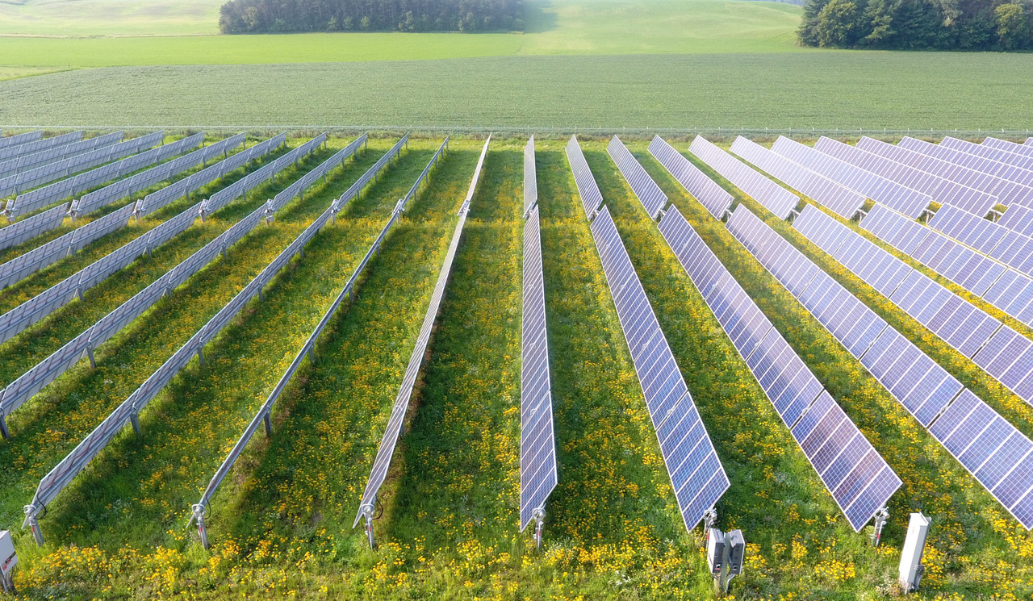
Component A (Solar plant on farmers’ land)

Slide 7
Component A -1/2
Capacity per Plant : 500 kW to 2 MW
Distance from sub-station : up to five km
Substation capacity : 33/11 or 66/11 or 110/11 kV
Setup by farmers / cooperatives/ panchayats/ project developer / Farmer Producer Organisation (FPO) / Water User associations (WUA)
Primarily on barren / uncultivable land
If on agricultural land – SPV installation in stilt fashion
DISCOM eligible for PBI - @ Rs. 0.40 per unit/Rs. 6.6 lakh per MW
DISCOMs to purchase power : At pre-fixed tariff/Tariff based bidding if
applications are more than capacity

Slide 8
Component A- 2/2
Extn. PPA>25 years (mutual agreements b/w RPG & DISCOM
DISCOM to maintain LC and Escrow Arrangement
Commissioning period- within 9 months from LoA
  Two months extension permitted with penalties
  No penalties if delay beyond control of RPG
PBI to Discom for timely payment of monthly lease rent to the land owner & payment made to RPG
SNAs to help farmers/developers - clearances, finance, DPR, EPC tendering/ project execution - Rs. 25,000/MW as Service Charges.

Slide 9
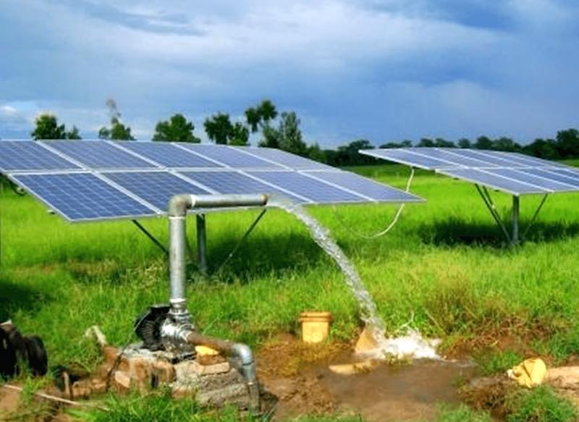
Comp-B (Standalone Solar pumps)

Slide 10
Component B – 1/2
Standalone Solar Agriculture Pumps : 17.50 lakh
Aggregate capacity : 8250 MW (9430 MW for 20 lakh)
Pump capacity : up to 7.5 HP & more
Beneficiary: : Individual farmers, Water User Asso.,
& community based irrigation system
CFA (benchmark cost/Tender cost) : 30% (50% NE/ hilly States/Island UT)
State Governments subsidy : 30%
Farmer’s contribution : 40% (20%-NE/ hilly States/Island UT)
Bank finance : 30% / 10% of the Cost

Slide 11
Component B -2/2
Implementing Agency - DISCOM/ Agriculture Department/ Minor Irrigation Department or any Department designated by State Govt.
  Service charges @ 2% of CFA to Implementing Agency
  MNRE to retain some part of service charge for IEC activities
Option of Universal Solar Pump Controller (USPC) to enable use of solar power for other activities - additional cost of USPC to be borne by the farmer
Provision of Centralized tendering - concluded by EESL.
AMC- 5 years included- blacklisting for poor performance. Remote monitoring and data monitoring through web-portal
Authorized service center of vendor in each operational district and a helpline number in local language
Size of pump - water table, land covered and quantity of water

Slide 12
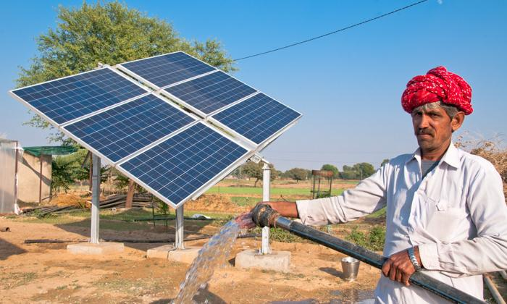
Component C (Grid connected solar pumps)

Slide 13
Component C – 1/2
Standalone Solar Agriculture Pumps : 10 lakh
Aggregate capacity : 7500 MW ( 11250 MW for 15 lakh)
Pump capacity : up to 7.5 HP & more
Beneficiary: : Individual farmers, Water User Asso.,
& community based irrigation system
CFA (benchmark cost/Tender cost) : 30% (50 %-NE/ hilly States/Island UT)
State Governments subsidy : 30%
Farmer’s contribution : 40% (20%-NE/ hilly States/Island UT)
Bank finance : 30% / 10% of the Cost
Solarisation capacity in kWp : Up to twice of pump capacity
Discom will buy Surplus power : Tariff to be fixed by the State/SERC

Slide 14
Component C -2/2
Implementing Agency – DISCOM / Agriculture Department/ Minor Irrigation Department or any Department designated by State Govt.
  Service charges @ 2% of CFA to Implementing Agency
  MNRE to retain some part of service charge for IEC activities
  to select vendors through transparent bidding
DISCOMs to ensure “must-run” status to the solarised feeders during day time
AMC- 5 years included- blacklisting for poor performance. Remote monitoring and data monitoring through web-portal
Authorized service center of vendor in each operational district and a helpline number in local language
Feeder-wise implementation – to solarize all pumps in a feeder if possible
State specific business models as developed by AP, Haryana Gujarat, Karnataka & Maharashtra - Net Metering/Gross metering/ No drawl from grid

Slide 15
Expansion of PM KUSUM Scheme
  Hon’ble Finance Minister has announced in Budget for the year 2020-21 to enhance the scope of PM-KUSUM
  The target for standalone solar pumps has now been increased to 20 lakh from 17.5 lakh.
  The target for solarisation of grid connected pumps has been increased to 15 lakh from 10 lakh pumps.

Slide 16
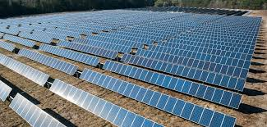
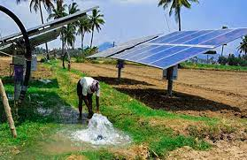
Reforms: Feeder Level Solarization under PM-KUSUM
Advantages
  (i) Day time electricity to farmers at little or no cost
  (ii) The burden of electricity subsidy on the states reduces; becomes Nil in 4 years
  (iii) Discom losses reduction
States have demanded 43 lakh pumps
9.25 lakh pumps allocated as per FY 2020-21 target
Farmers will earn money by saving electricity : incentive for water conservation

Slide 17
Implementation Status
Component A : 4909 MW sanctioned to 22 States/UTs
Component B : 3.59 lakh pumps to 24 States/UTs
Component C : 76,650 pumps to 13 States/Uts
Component C (FLS) : 9.25 lakh pumps (13 States/Uts)
Demand from States : 43 lakh
Installations : 7 MW under Comp-A, 47,146 pumps under
Comp-B and 580 pumps under Comp-C
Third party evaluation of Comp-A and Comp-C underway

Slide 18
Gobardhan
Gobardhan is an integral part of Swachh Bharat Mission Phase II under Solid Waste Management
Gobardhan supports villages to convert bio-waste including cattle waste, kitchen leftovers, crop residue and market waste to biogas and slurry, to improve environmental sanitation and curb vector borne diseases.
Under SBM(G) financial assistance of INR 50 Lakh per District is available for setting up of Gobardhan projects.

Slide 19
Objectives and Benefits
Objectives
Benefits
  Converting bio-waste including animal waste, kitchen leftovers, crop residue and market waste to biogas and bio slurry.
  Support villages safely manage their cattle waste, agricultural waste.
  Support communities, convert their cattle and organic waste to wealth.
  Promote environmental sanitation and curb vector borne diseases.
  Promote rural entrepreneurship employment and income generation opportunities
  Effective biodegradable waste management.
  Improvement in health of the community
  Reduction of GHG emission.
  Reduction in import of crude oil.
  Employment opportunity for the local community.
  Boost to entrepreneurship.
  Additional income for farmers/ local village community from organic waste.
  Promotion of organic farming.

Slide 20
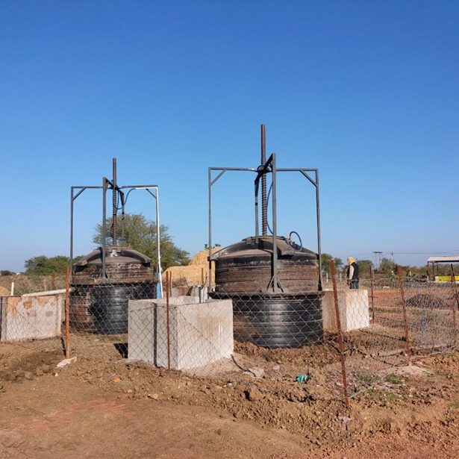
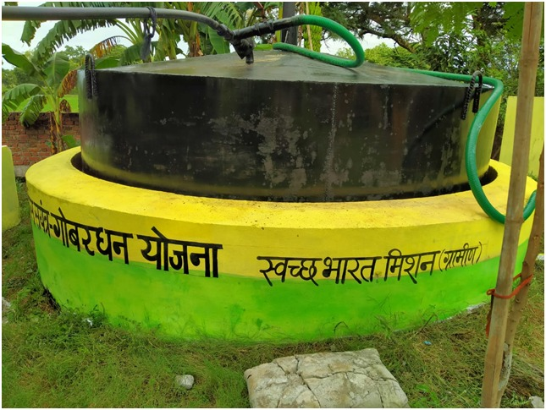
Planning and Implementation
Site selection:
  Site should be selected based on availability of feedstock nearby and gas utilization.
  For model GOBAR-Dhan projects, the districts should preferably take up community-level projects near Gaushalas for uninterrupted supply of organic wastes.
Project Preparation
  The project preparation, supervision and monitoring costs of the projects to be made a part of the project cost itself.
  Maintenance costs for the first five years of operation may be made a part of the project cost.
  Agencies having a minimum of 3 years’ experience in the implementation of Biogas plants may be chosen based on track record and proven sustainable models.
  State can decide on getting support from any technical agency/ BDTCs under MNRE.
Capacity:
  Capacity of plant should be decided based on the available feedstock.
Biogas and Slurry Utilization:
  Biogas and Slurry utilization plan should be incorporated while DPR is being prepared for projects.
  Beneficiaries should be identified during the site selection process.

Slide 21
Funding Norms
Financial assistance up to Rs. 50 lakhs per District will be provided under SBM-G, to be shared between the Centre and States as prescribed in SBM-G Phase-II Operational Guidelines. States have the flexibility to provide additional State share.
The funds will be utilized for the cluster/institutional/community projects as approved by the Districts.
For community projects including gaushala-based plant, funding will be based on actual requirements and will be released through the GP or directly to the implementing agency identified by the GP, as the case may be.
Funds can be dovetailed from other resources such as the 15th Finance Commission funds, CSR funds, State schemes, PPP model, Gap-funding schemes of GoI, etc. to meet additional requirements for a GOBARDHAN project if any.

Slide 22
Roles and Responsibilities
STATE
Create provisions for the implementation of GOBAR- Dhan Scheme Lead implementation of GOBARDHAN in the State Ensure that plans prepared/approved by the Districts are incorporated in the GPDP and AIP of SBM-G Provide technical support to the Districts/GPs and identify professional agencies, wherever required, for smooth implementation of GOBARDHAN Allocate funds to the District, considering the approved plan for implementation Contribute State share funds

Slide 23
Roles and Responsibilities
DISTRICT
The District will ensure that overall funding under SBM-G will not exceed the cap of Rs. 50 lakhs for the entire programme period i.e. up to 2024–25. Lead implementation of GOBARDHAN in the District Develop a plan along with Blocks and Gram Panchayats/SHGs/Farmer Groups (FGs) to implement GOBARDHAN Support implementation of model projects at Block/District Identify GPs for implementation of GOBARDHAN Identification of appropriate sites for construction of GOBARDHAN model projects at Block/District level, with support of GPs, if needed Approval and disbursement of funds for implementation of GOBARDHAN, provide technical support to the GPs and identify professional agencies, wherever required, for smooth implementation of GOBARDHAN Capacity building of GPs/SHGs/FGs Create a suitable environment for entrepreneurs, gaushalas, etc., and provide them technical assistance for setting up commercial units.

Slide 24
Roles and Responsibilities
GRAM PANCHAYAT
Identify SHGs/FGs/cooperatives/milk unions/Farmer Producer Organizations (FPOs)/CBOs developed under DAY-NRLM/Private entrepreneurs/agencies etc. for implementation of GOBARDHAN Identify potential households which could be mobilized for community/ cluster level projects Mobilize households to use biogas and slurry Identify the location for projects Identify agency/agencies for implementation of GOBARDHAN project. Prepare project proposals, including identification of financial resources and estimation of cost for setting up of projects and cost for O&M for 1st five years, and submit them to the District for approval. Implement the cluster, community, institutional projects, approved by the District, through their available human resources or by engaging professional agencies Own responsibility for O&M/ensure O&M of community/cluster/ institutional projects

Slide 25
Monitoring
District Water and Sanitation Committee (DWSC) is the monitoring agency at the district level.
DWSC to conduct quarterly physical verification of biogas plants and upload functionality status on the unified portal of Gobardhan.(https://sbm.gov.in/GBDW20)
Stats have been provided login credentials to states for updation of project ststus.
The projects to be audited annually.
The state shall also set up an independent evaluation mechanism to monitor the functioning of plants installed and the successful operation of the project bi-annually.
The State may also set up a mechanism to receive grievances from villages and ensure redressal of the same promptly

Slide 26
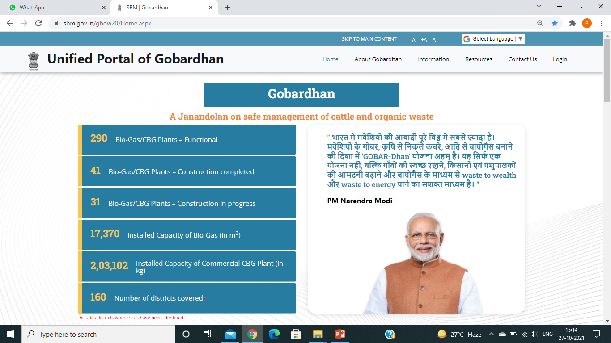
Unified Portal of Gobardhan

Slide 27
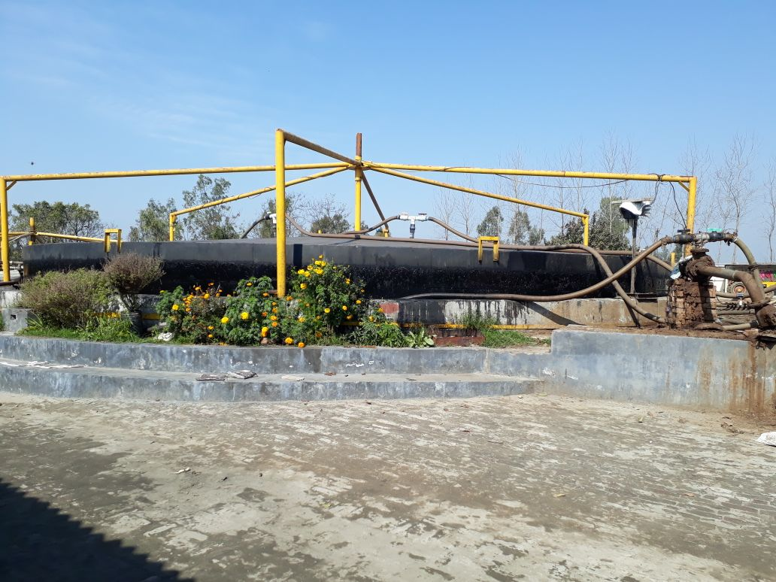
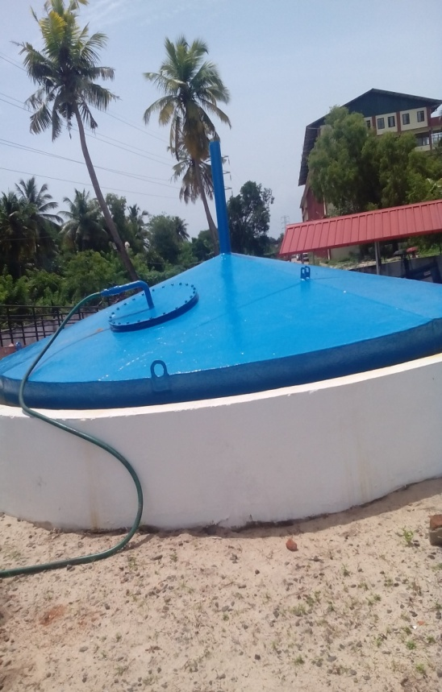
Technological Options
The District / State can decide on the technology to be adopted in the construction of biogas plants based on the quantity of waste generated and ensuring an uninterrupted supply of waste
Different Biogas Plant Design Options like:
  Floating-Drum Type / KVIC Model Biogas Plant
  Deenbandhu Model Biogas Plant
  Fixed Dome PAU Janta model biogas
Other models made from different materials like FRP, PVC reinforced concrete etc., of both the fixed and floating variety may also be used.

Slide 28
बायोगैस का वरदान I
खुशहाल गांव और किसान II
THANK YOU
Feedback are most welcome
Email: meena.sr@nic.in
Web: www.mnre.gov.in
+91 11 24361920 (Tel)
+91 96543 92685 (Mob)

